Slide 1
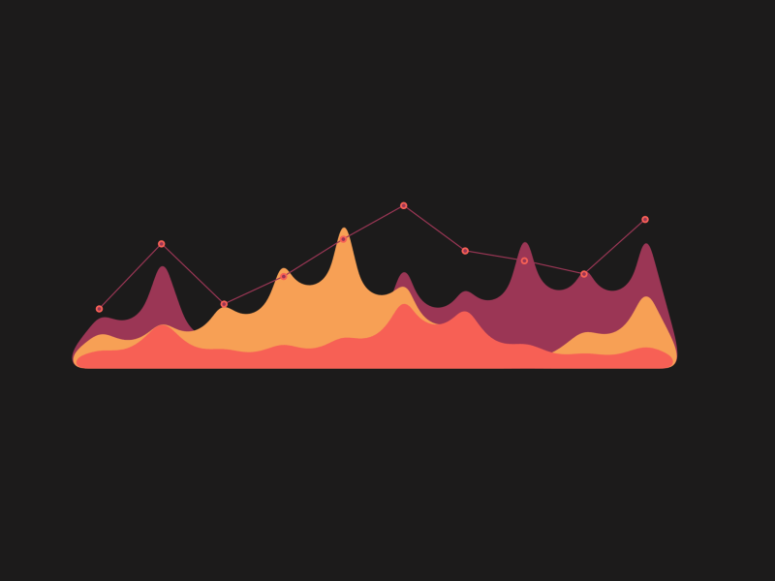

Graph

Slide 2

Hello!
I am Diana….

Slide 3

We’ll discuss the following things today
01
Overview
What is graph
02
Examples
Where we use graphs in our daily life
03
Types & Properties
We’ll discuss some of the common types of graphs
04
Operations
We’ll discuss some of the common operations
Applications
05
We’ll discuss some of the common applications.

Slide 4

Sudden !
I planed Get - Together with Friends at Marvie’s house

Slide 5


Marvie
Jhon
Jimmy
Jacky
Friends
They are connected Via Social Media

Slide 6
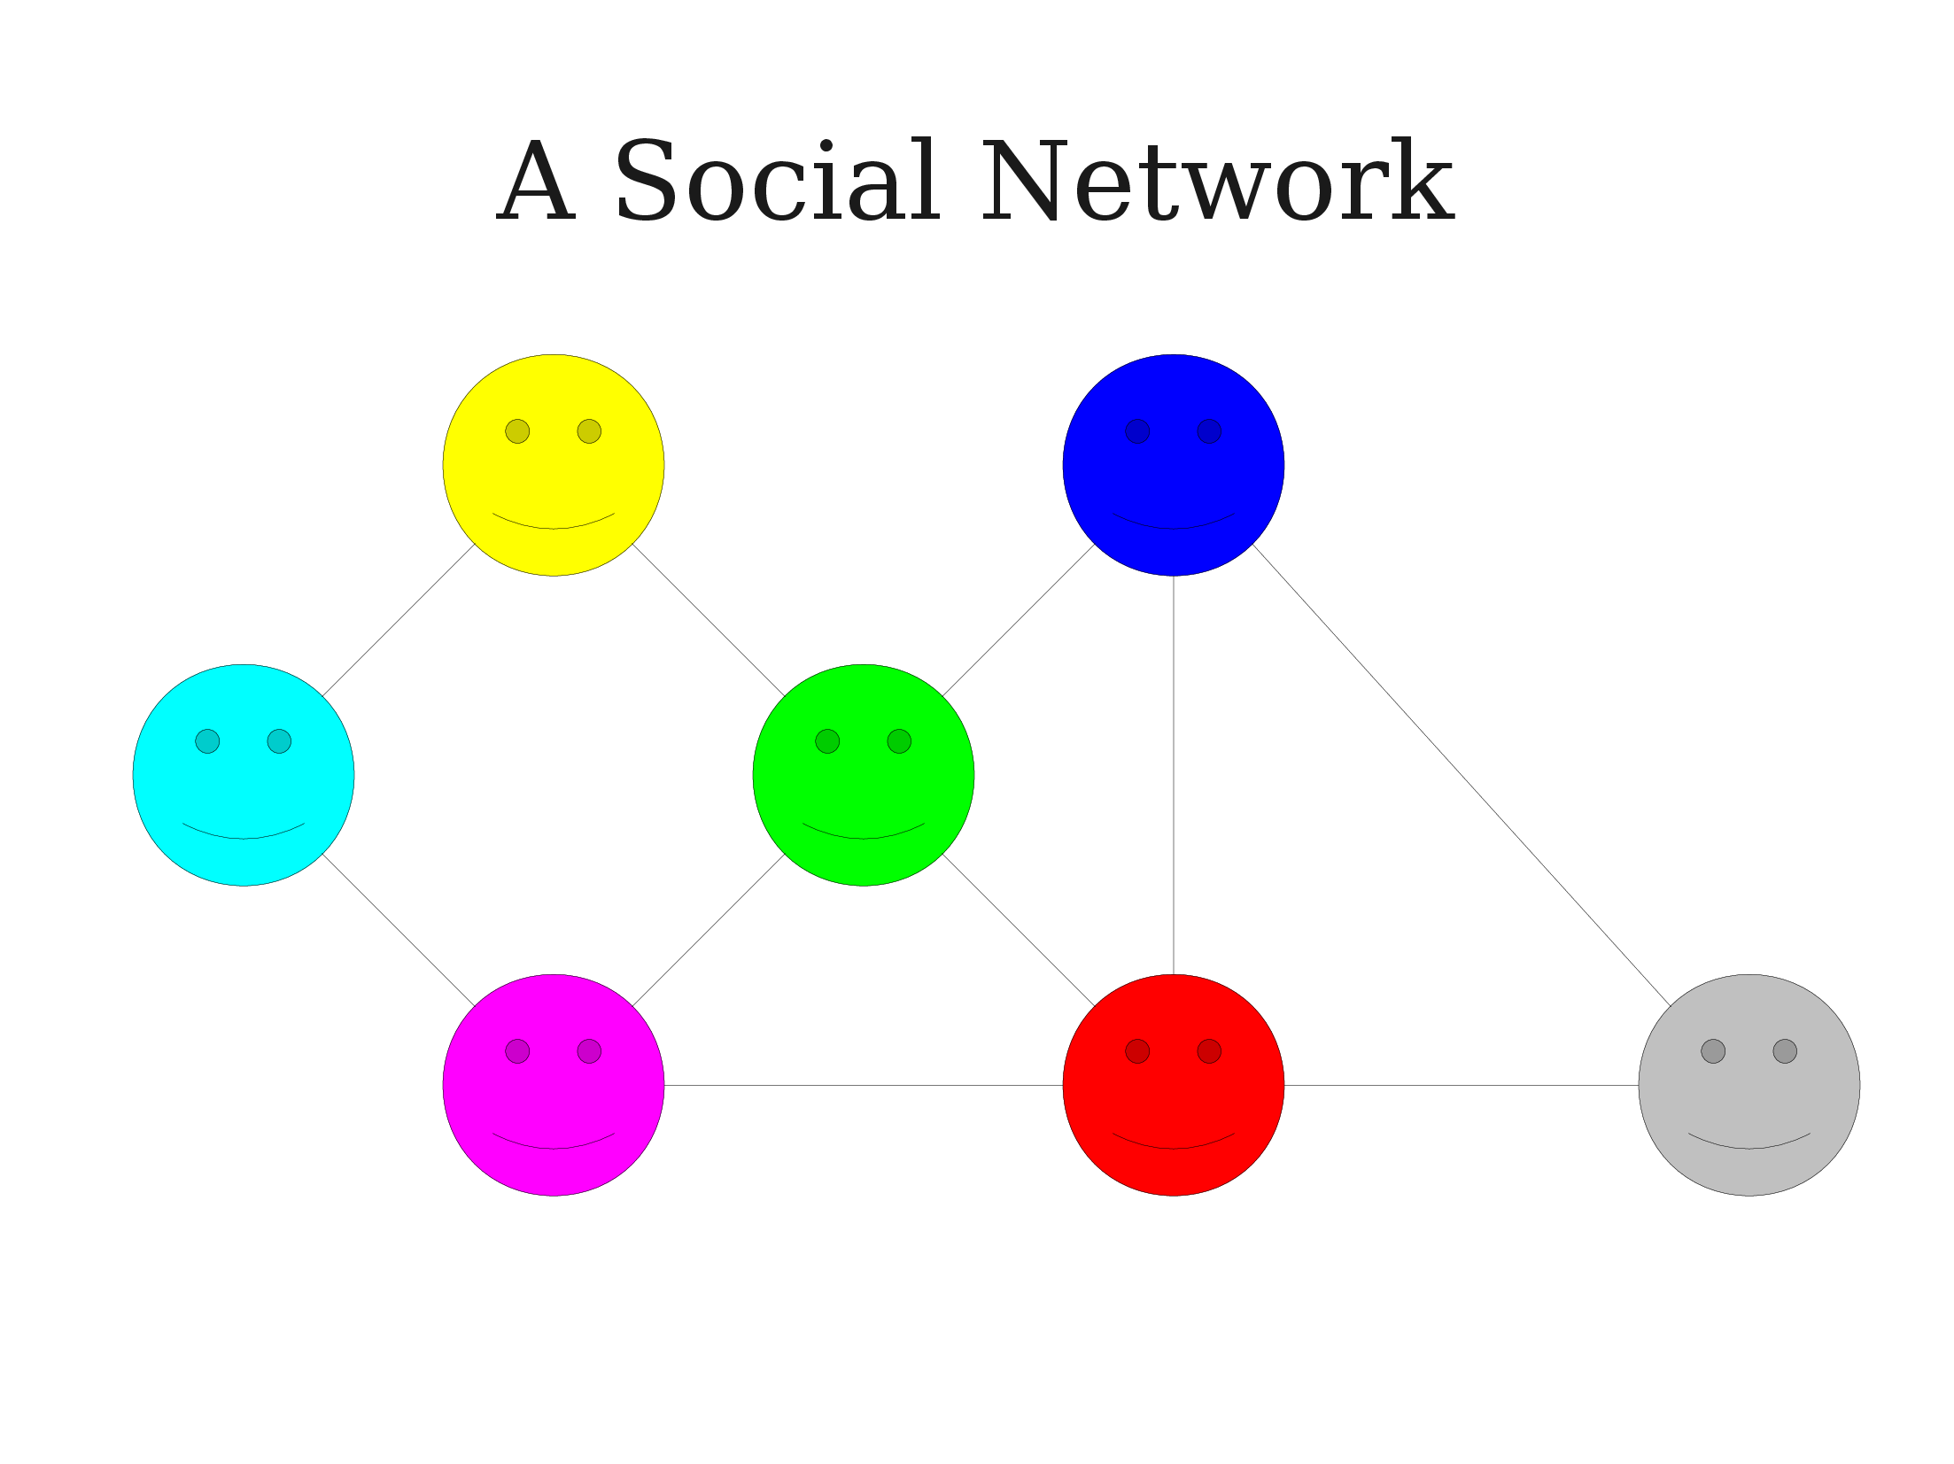

Social Media ⬄ Social Network

Slide 7
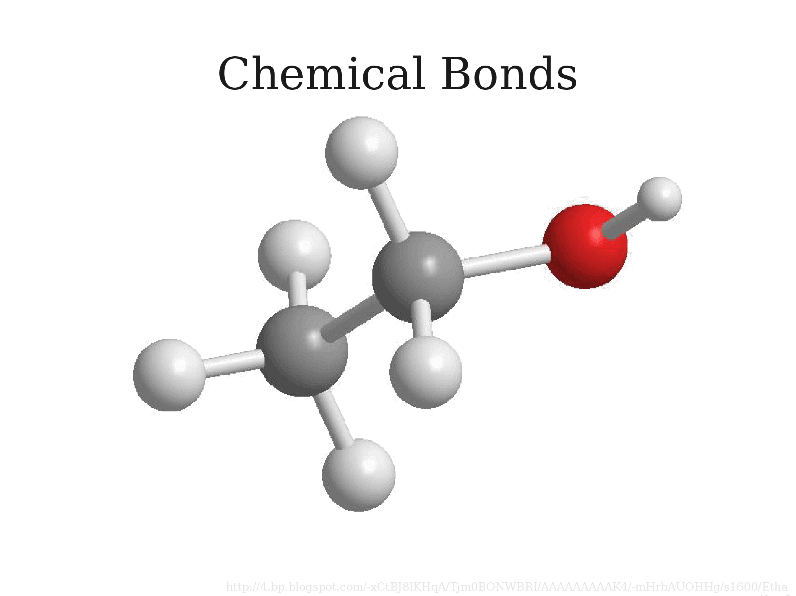

Another Example
Together => Connected to Each Other ⬄ Chemical bonds

Slide 8
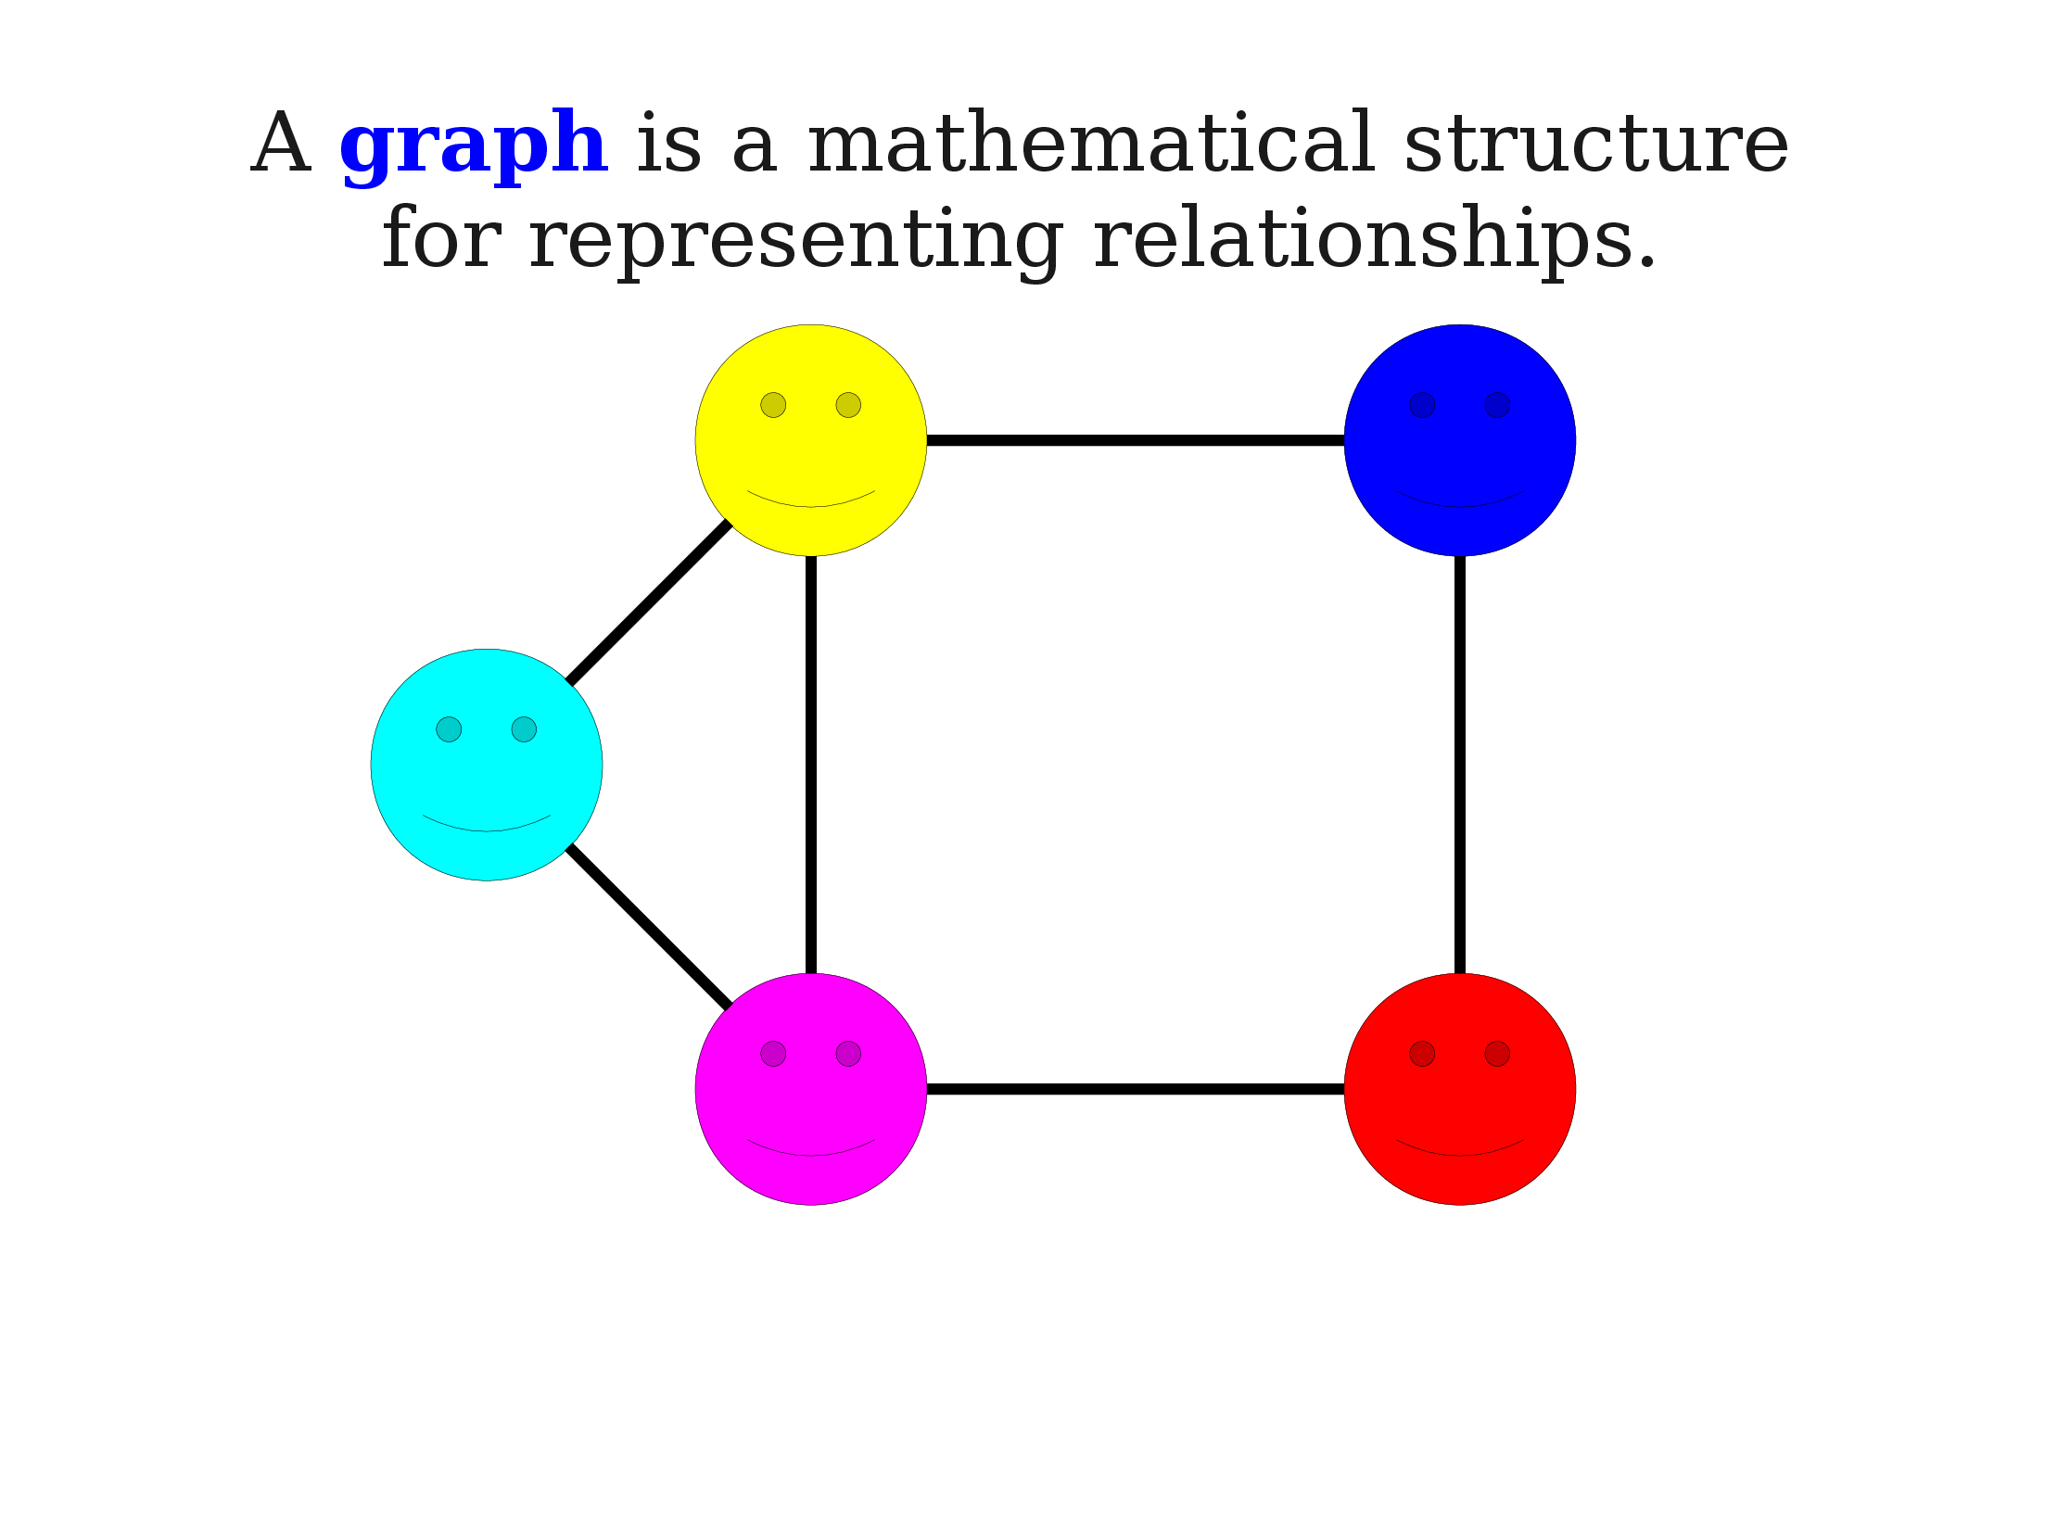

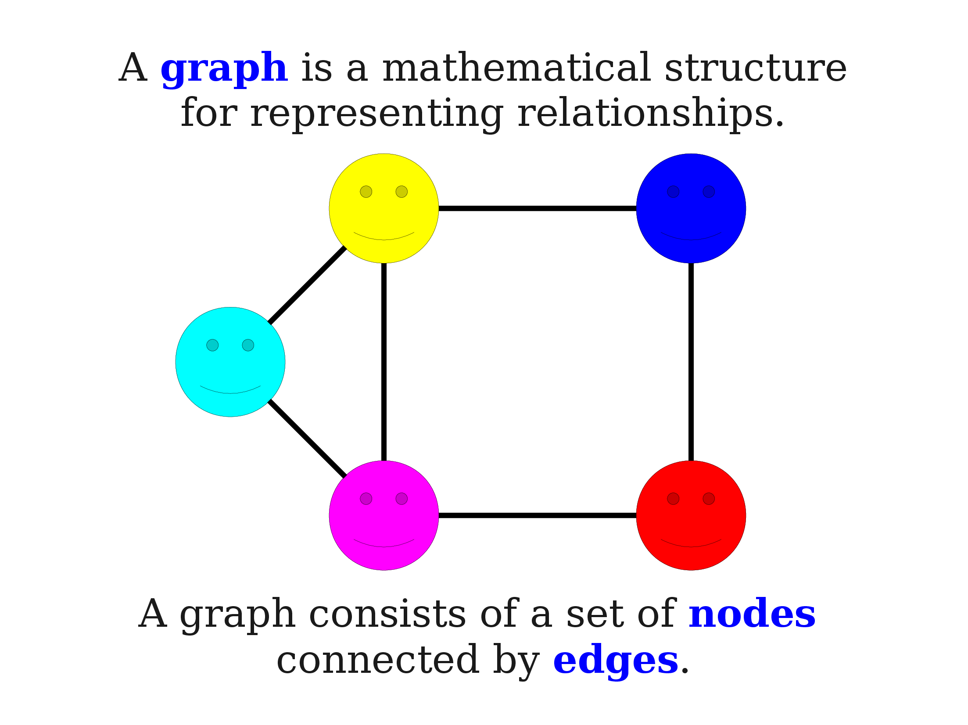
Social Network ⬄ Graph

Slide 9
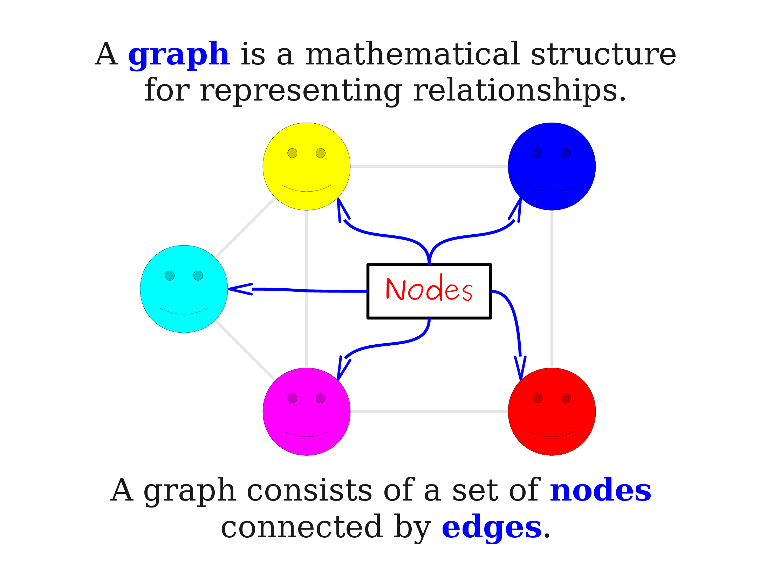

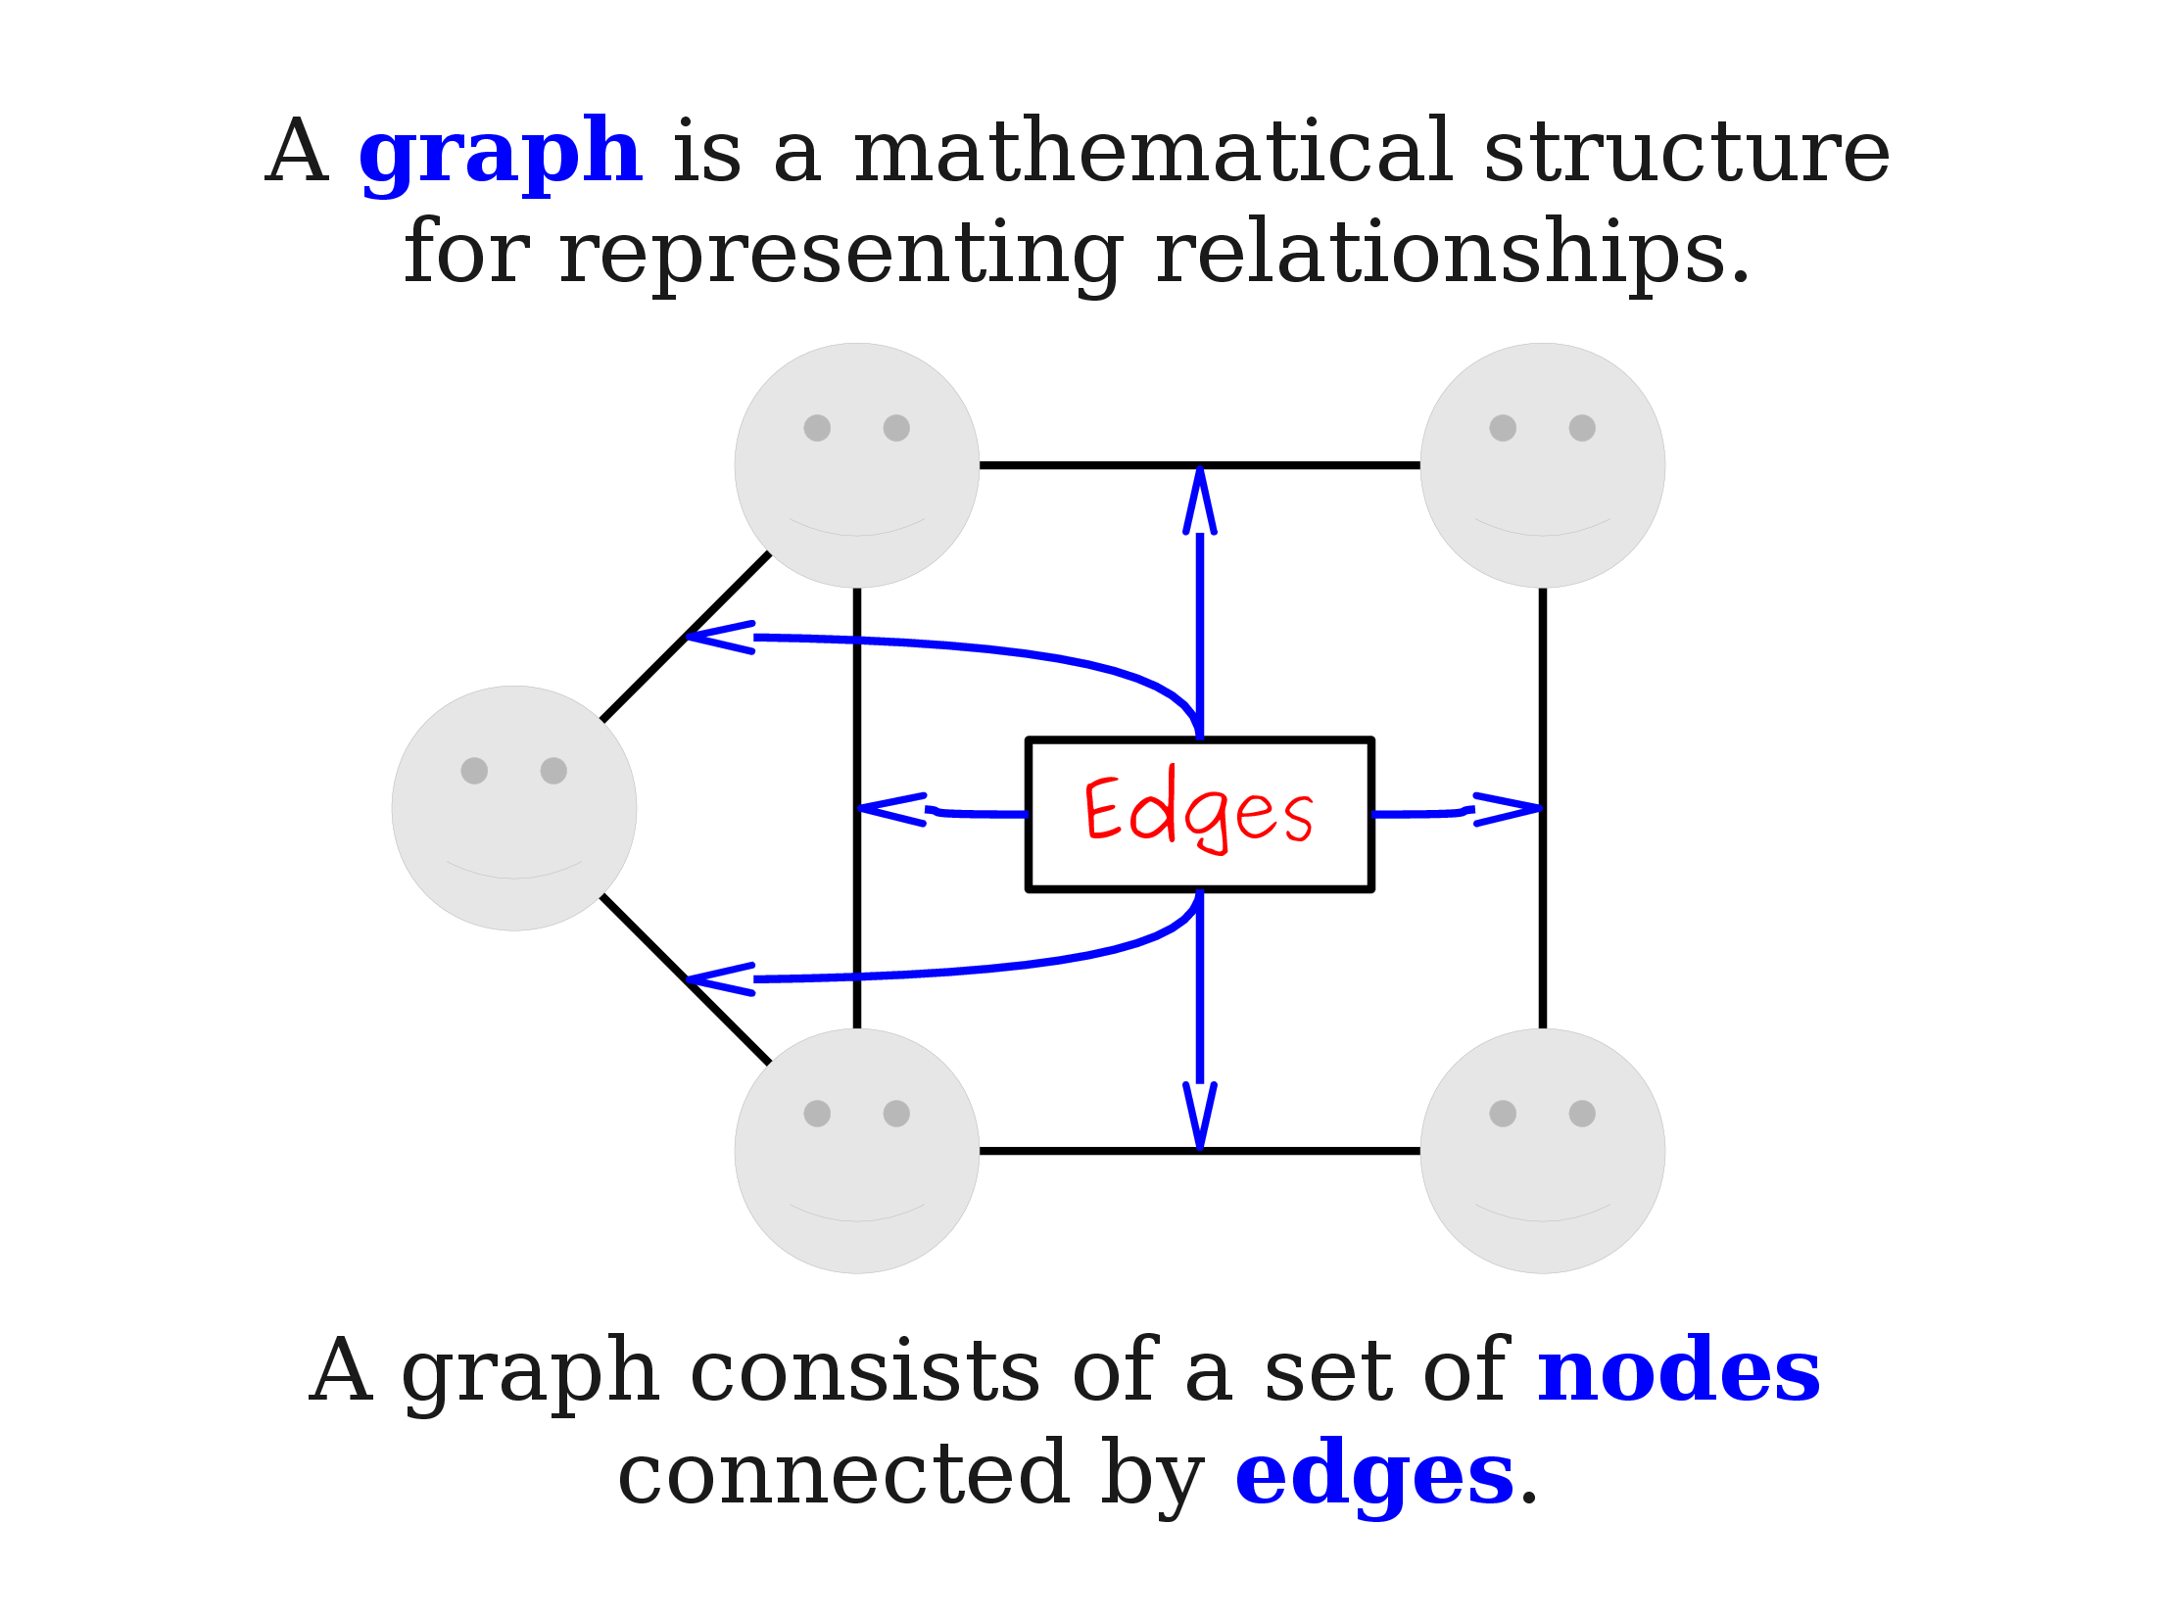
Nodes are also called Vertex
Edges are also called Arc

Slide 10

How Graphs represented?
Graphs are commonly represented in two ways:
Adjacency matrix
Adjacency list

Slide 11

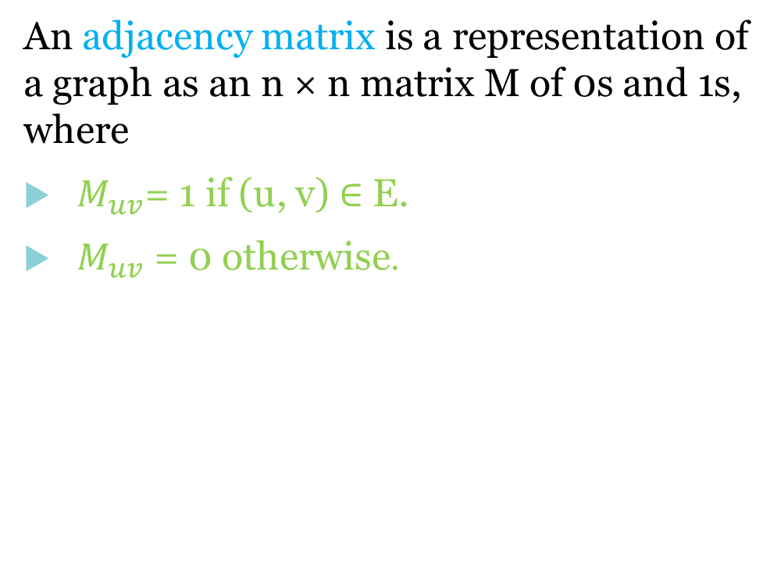
What is Adjacency Matrix?
An adjacency matrix is a representation of a graph as an n × n matrix M of 0s and 1s, where
$M_{uv}$= 1 if (u, v) ∈ E.
$M_{uv}$ = 0 otherwise.
 | A | B | C | D
A | 0 | 1 | 0 | 0
B | 1 | 0 | 0 | 0
C | 0 | 1 | 0 | 1
D | 0 | 0 | 0 | 0
A
B
C
D

Slide 12

What is Adjacency List?
An adjacency list is a representation of a graph which is a collection of unordered lists. Each unordered list describes the set of neighbors of a particular vertex in the graph within an adjacency list.
A
B
/
A
B
B
A
/
C
D
B
/
C
D
/
D

Slide 13
Operations on Graphs in Data
Structure
Insert vertex
Delete vertex
Insert edge
Delete edge

Slide 14

Insert Vertex
Add a vertex or node that after introducing one or more vertices or nodes, the graph's size grows by one, increasing the matrix's size by one at the row and column levels.
A
B
 | A | B | C | D | E
A | 0 | 1 | 0 | 0 | 0
B | 1 | 0 | 0 | 0 | 0
C | 0 | 1 | 0 | 1 | 0
D | 0 | 0 | 0 | 0 | 1
E | 0 | 0 | 0 | 0 | 0
 | A | B | C | D
A | 0 | 1 | 0 | 0
B | 1 | 0 | 0 | 0
C | 0 | 1 | 0 | 1
D | 0 | 0 | 0 | 0
C
D
E

Slide 15

Delete Vertex
Removing a specific node or vertex from a graph. Decreasing the matrix's size by one at the row and column levels.
A
B
C
D
 | A | B | C | D
A | 0 | 1 | 0 | 0
B | 1 | 0 | 0 | 0
C | 0 | 1 | 0 | 1
D | 0 | 0 | 0 | 0
 | A | B | C
A | 0 | 1 | 0
B | 1 | 0 | 0
C | 0 | 1 | 0
A
B
C

Slide 16

Insert Edge
Add an arc or edge. Then Matrix also effect.
A
B
 | A | B | C | D
A | 0 | 1 | 0 | 0
B | 1 | 0 | 0 | 0
C | 0 | 1 | 0 | 1
D | 0 | 0 | 0 | 0
C
D
A
B
1
C
D

Slide 17

Delete Edge
Delete an arc or edge. Then Matrix also effect.
A
B
 | A | B | C | D
A | 0 | 1 | 0 | 0
B | 1 | 0 | 0 | 0
C | 0 | 1 | 0 | 1
D | 0 | 0 | 1 | 0
C
D
A
B
0
C
D

Slide 18

Types of Graphs
Here we describe the few Types
Directed
Undirected or Bi Directed

Slide 19
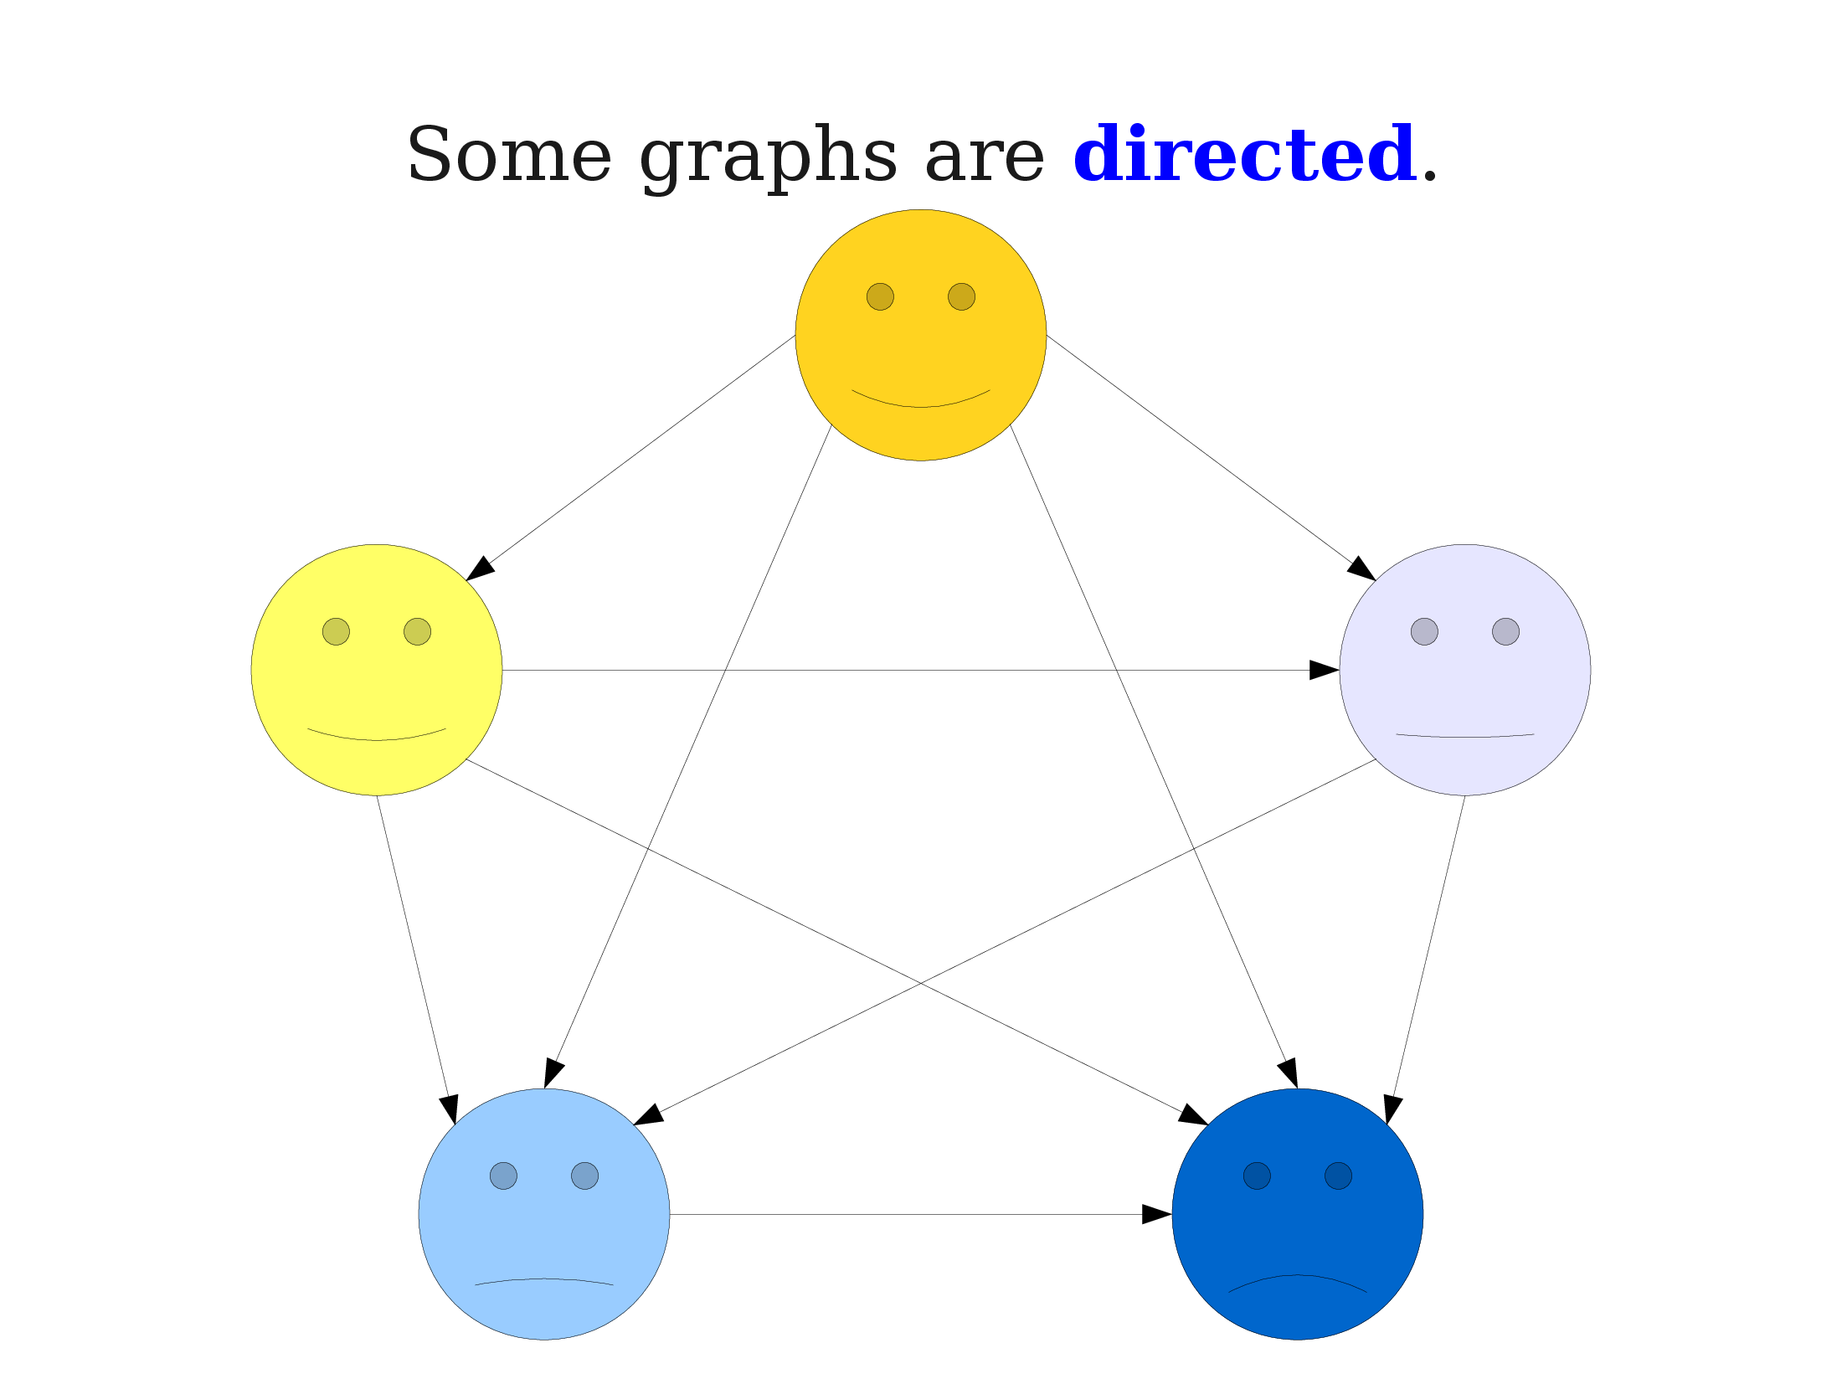

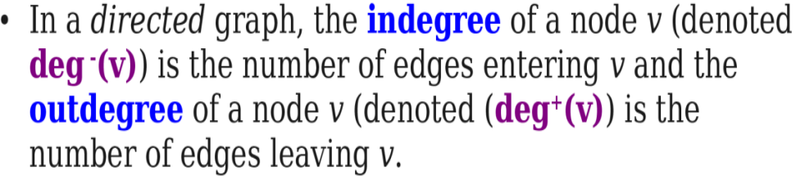
A
B
C
e.g.
Node A:
deg-(v): Indegree=0
deg+(v) :Outdegree=2
D
E

Slide 20
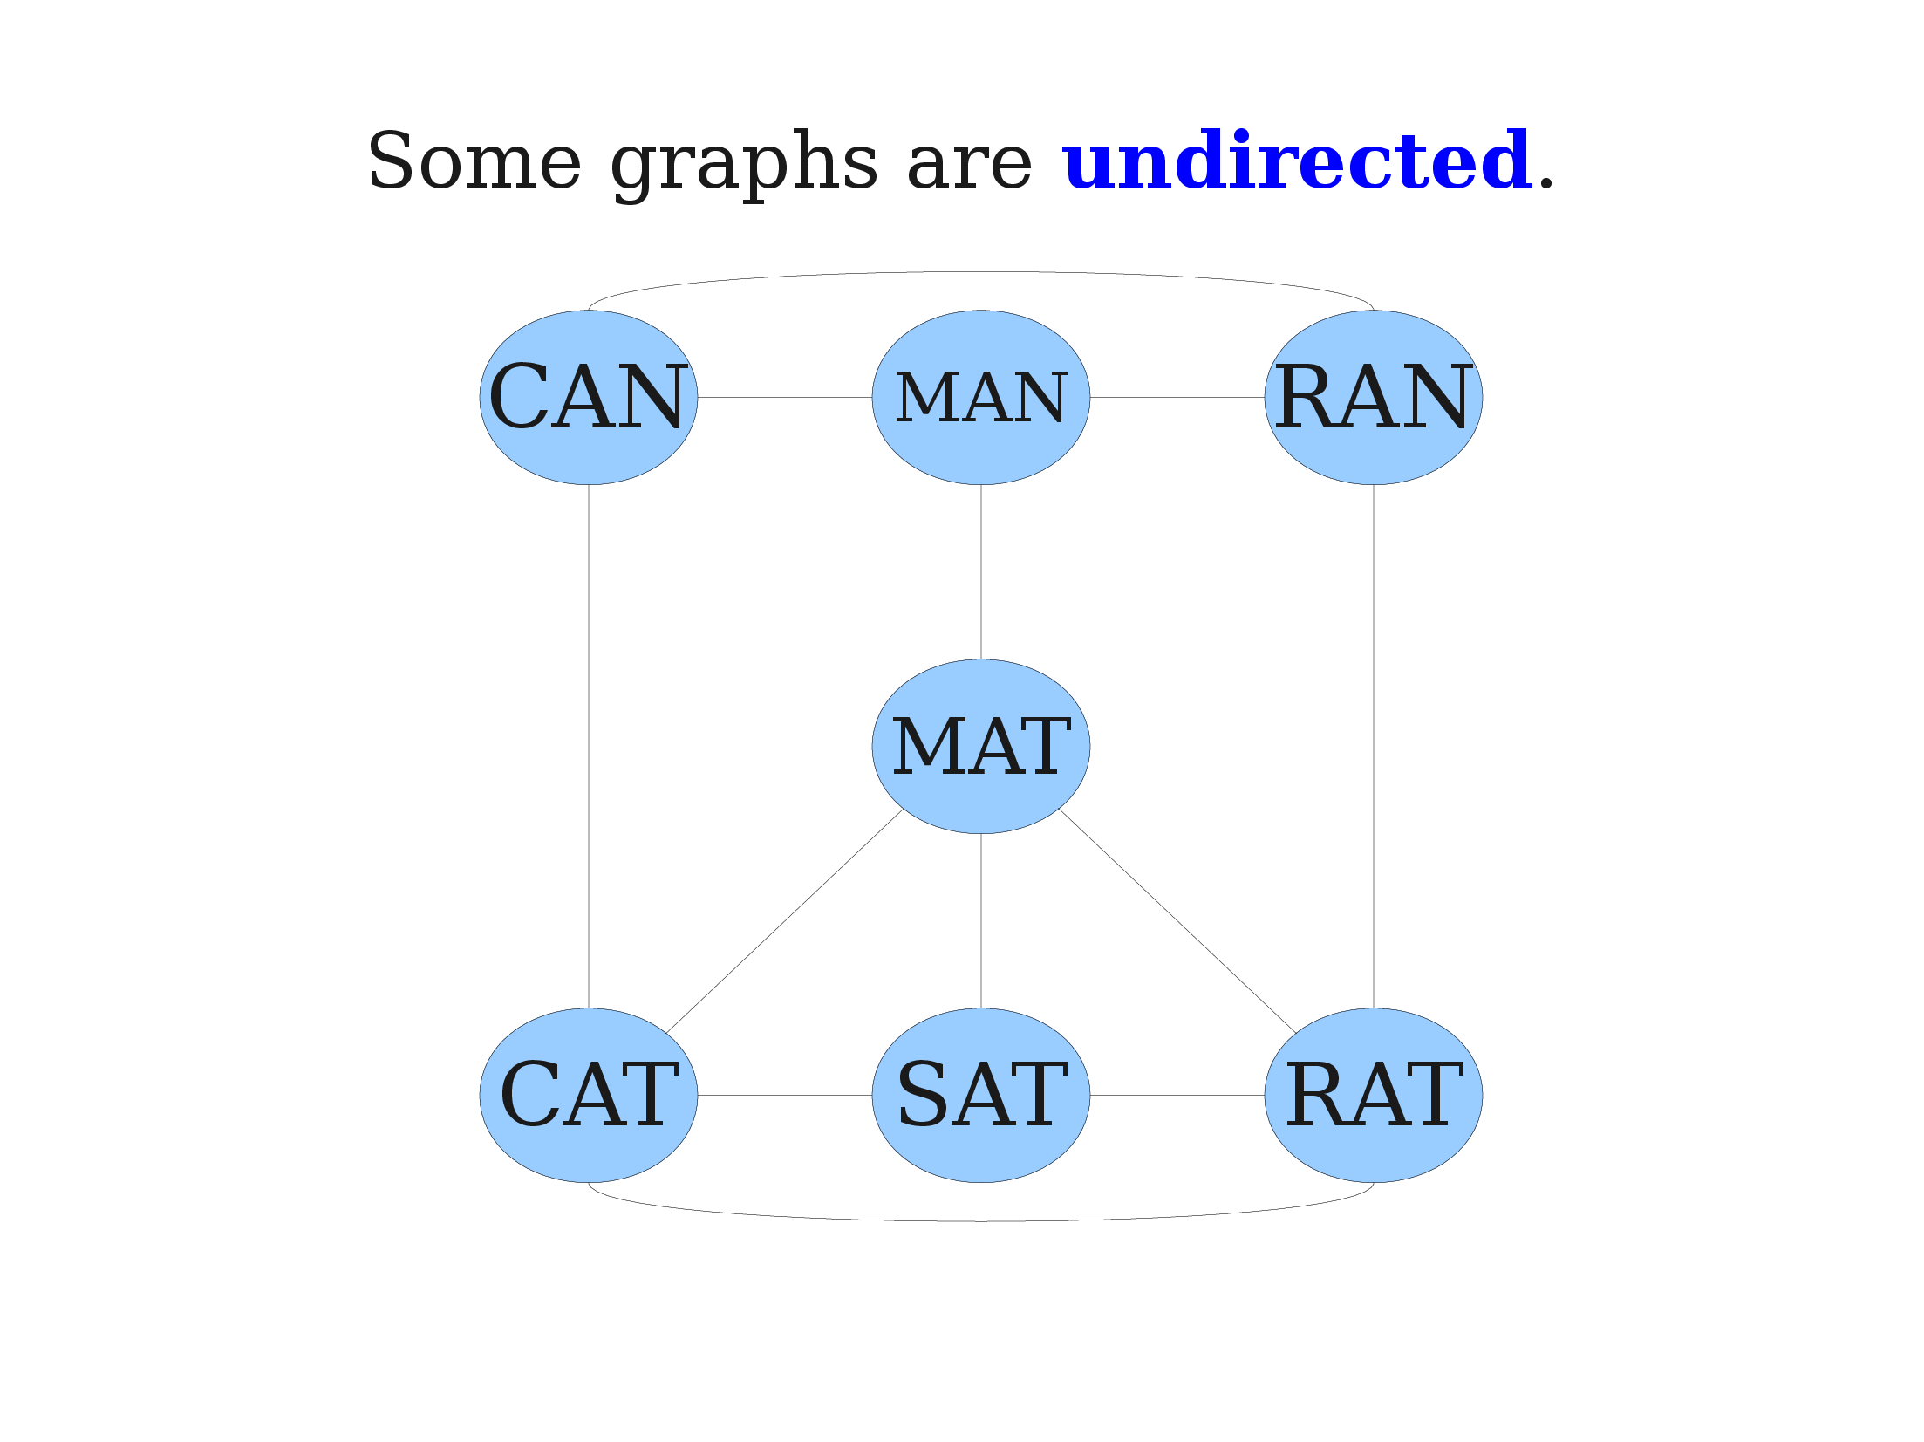

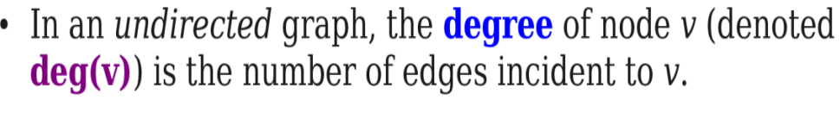
e.g.
Node A:
deg(v) degree=4
A
B
C
D
E

Slide 21

Properties of Graph
Here we describe the few Types
Cyclic Graph
Acyclic Graph

Slide 22
A Cyclic Graph has cycles meaning you can start from some node and follow a path such that you arrive at the same node you began.
A
B
1 cycle exist A to B
C
D
Acyclic Graph that doesn’t contain any cycle.
A
B
C
D

Slide 23
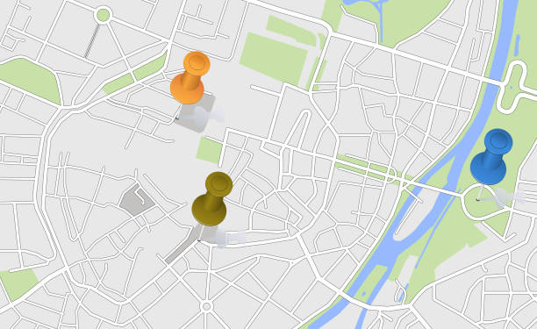

Applications
Google Map
From Diana to Marvie’s House

Slide 24
Find the Neighbour Location from Diana’s To Marvie’s House.
By Using these Algorithms
BFS(Breath First Search)
OR
DFS (Depth First Search)

Slide 25

What Is BFs?
BFS is a traversing algorithm ,It traverse the graph layer wise & explore the neighbour nodes (nodes which are directly connected to source node) then move towards the next-level neighbour nodes.

Slide 26
Working !
Steps:
First move horizontally and visit all the nodes of the current layer
Move to the next layer
Often implemented by maintaining a queue of vertices to visit.

Slide 27
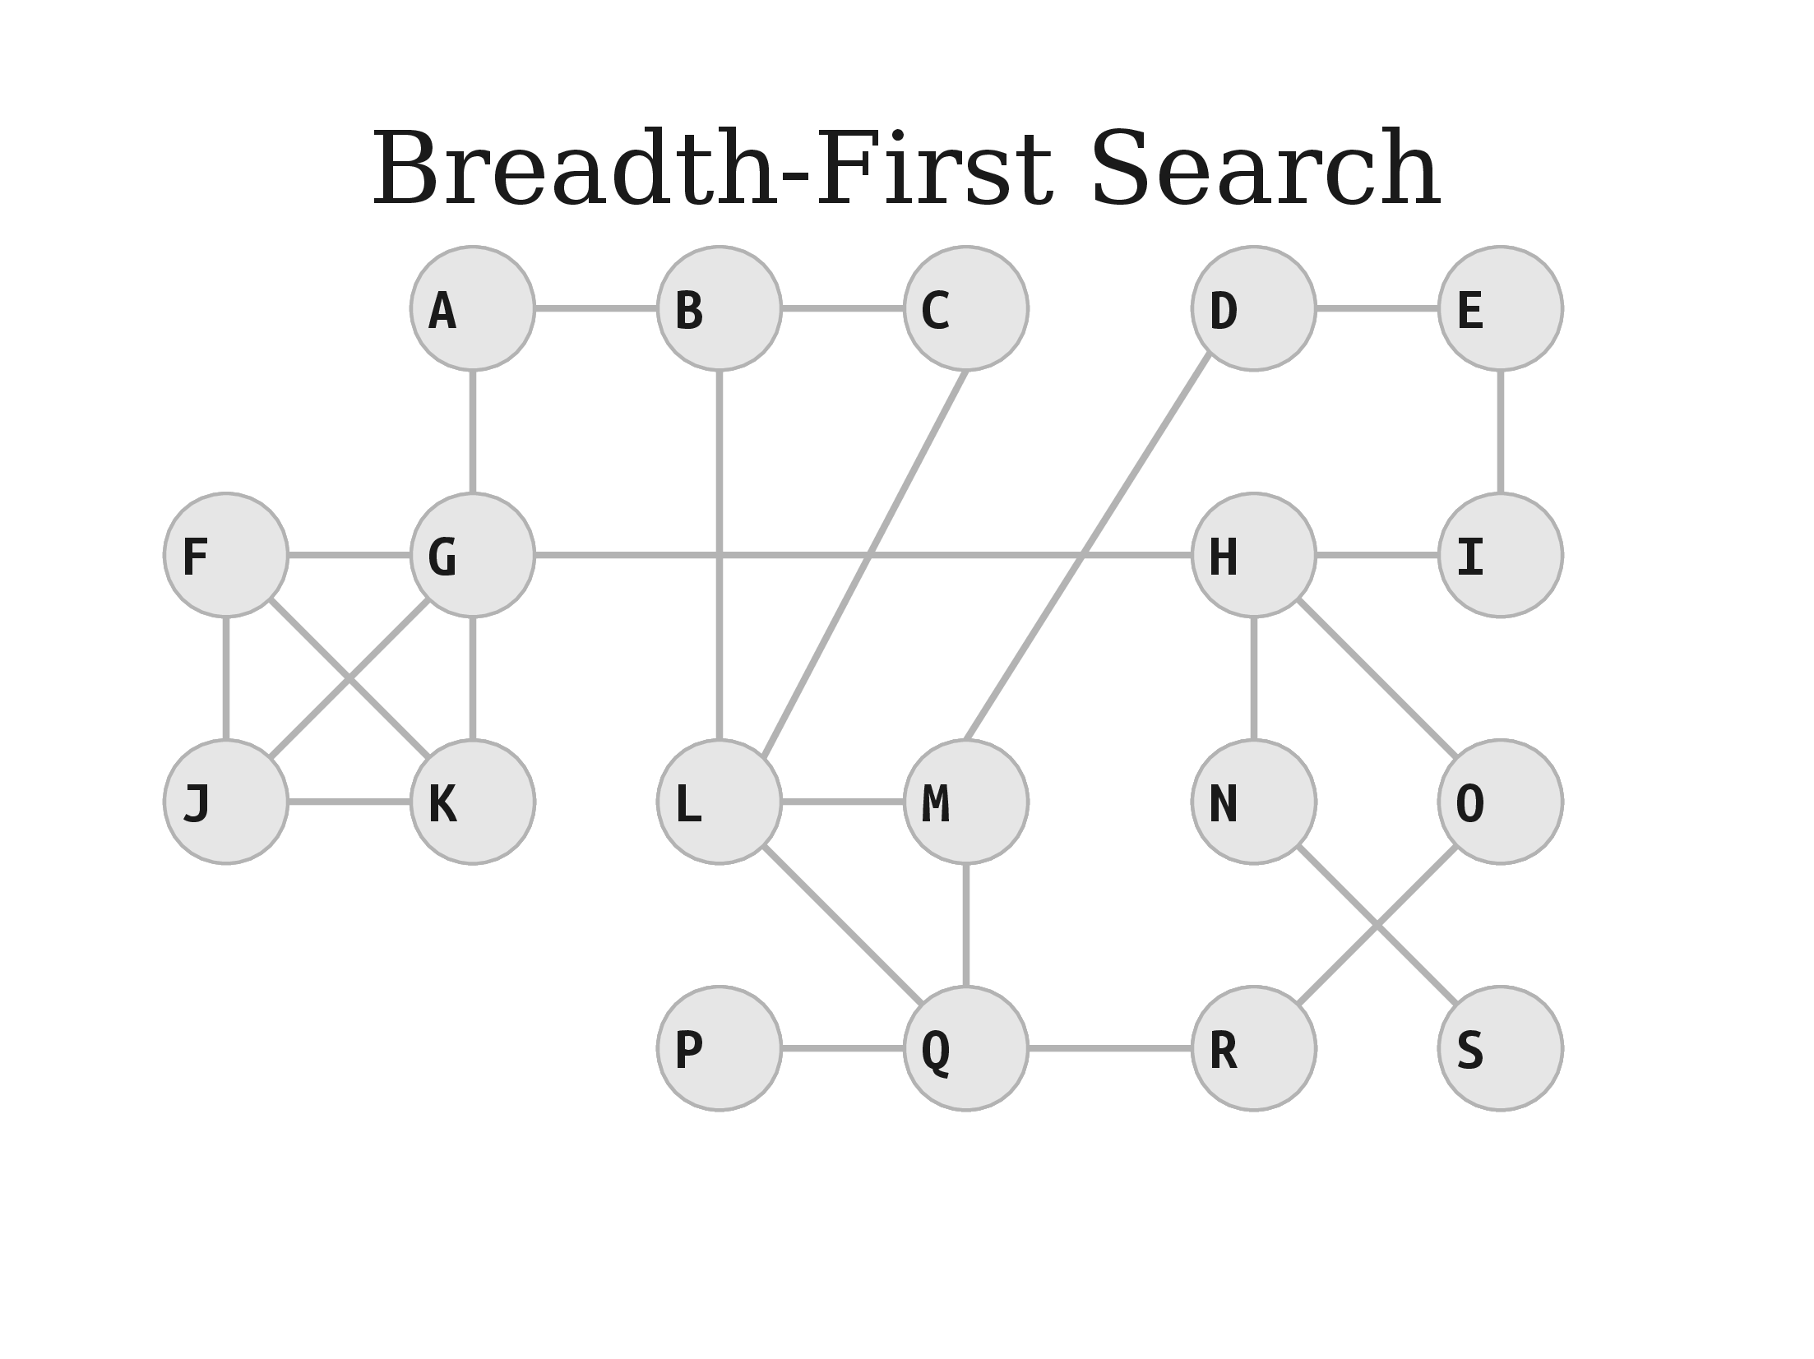

Slide 28
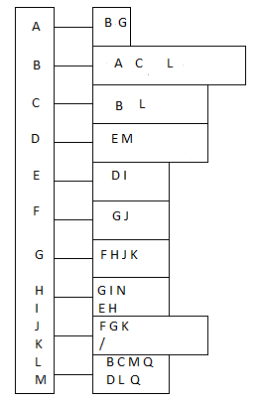
Adjacent List
Gray: Unvisited
Yellow: Start Visit
Green: Visited

Slide 29

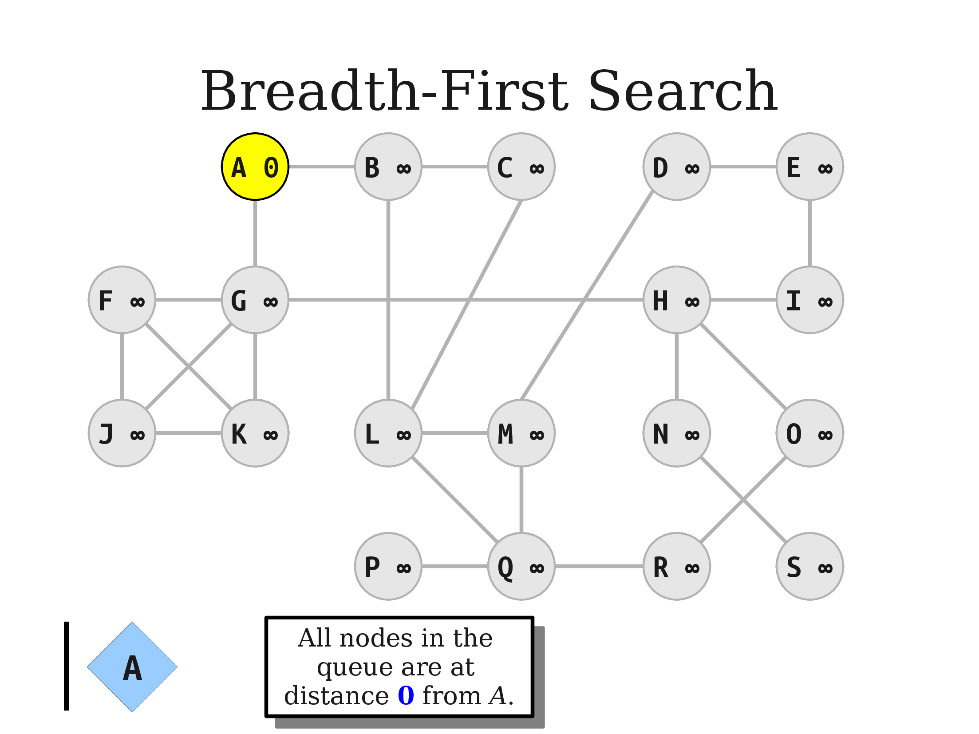

Slide 30
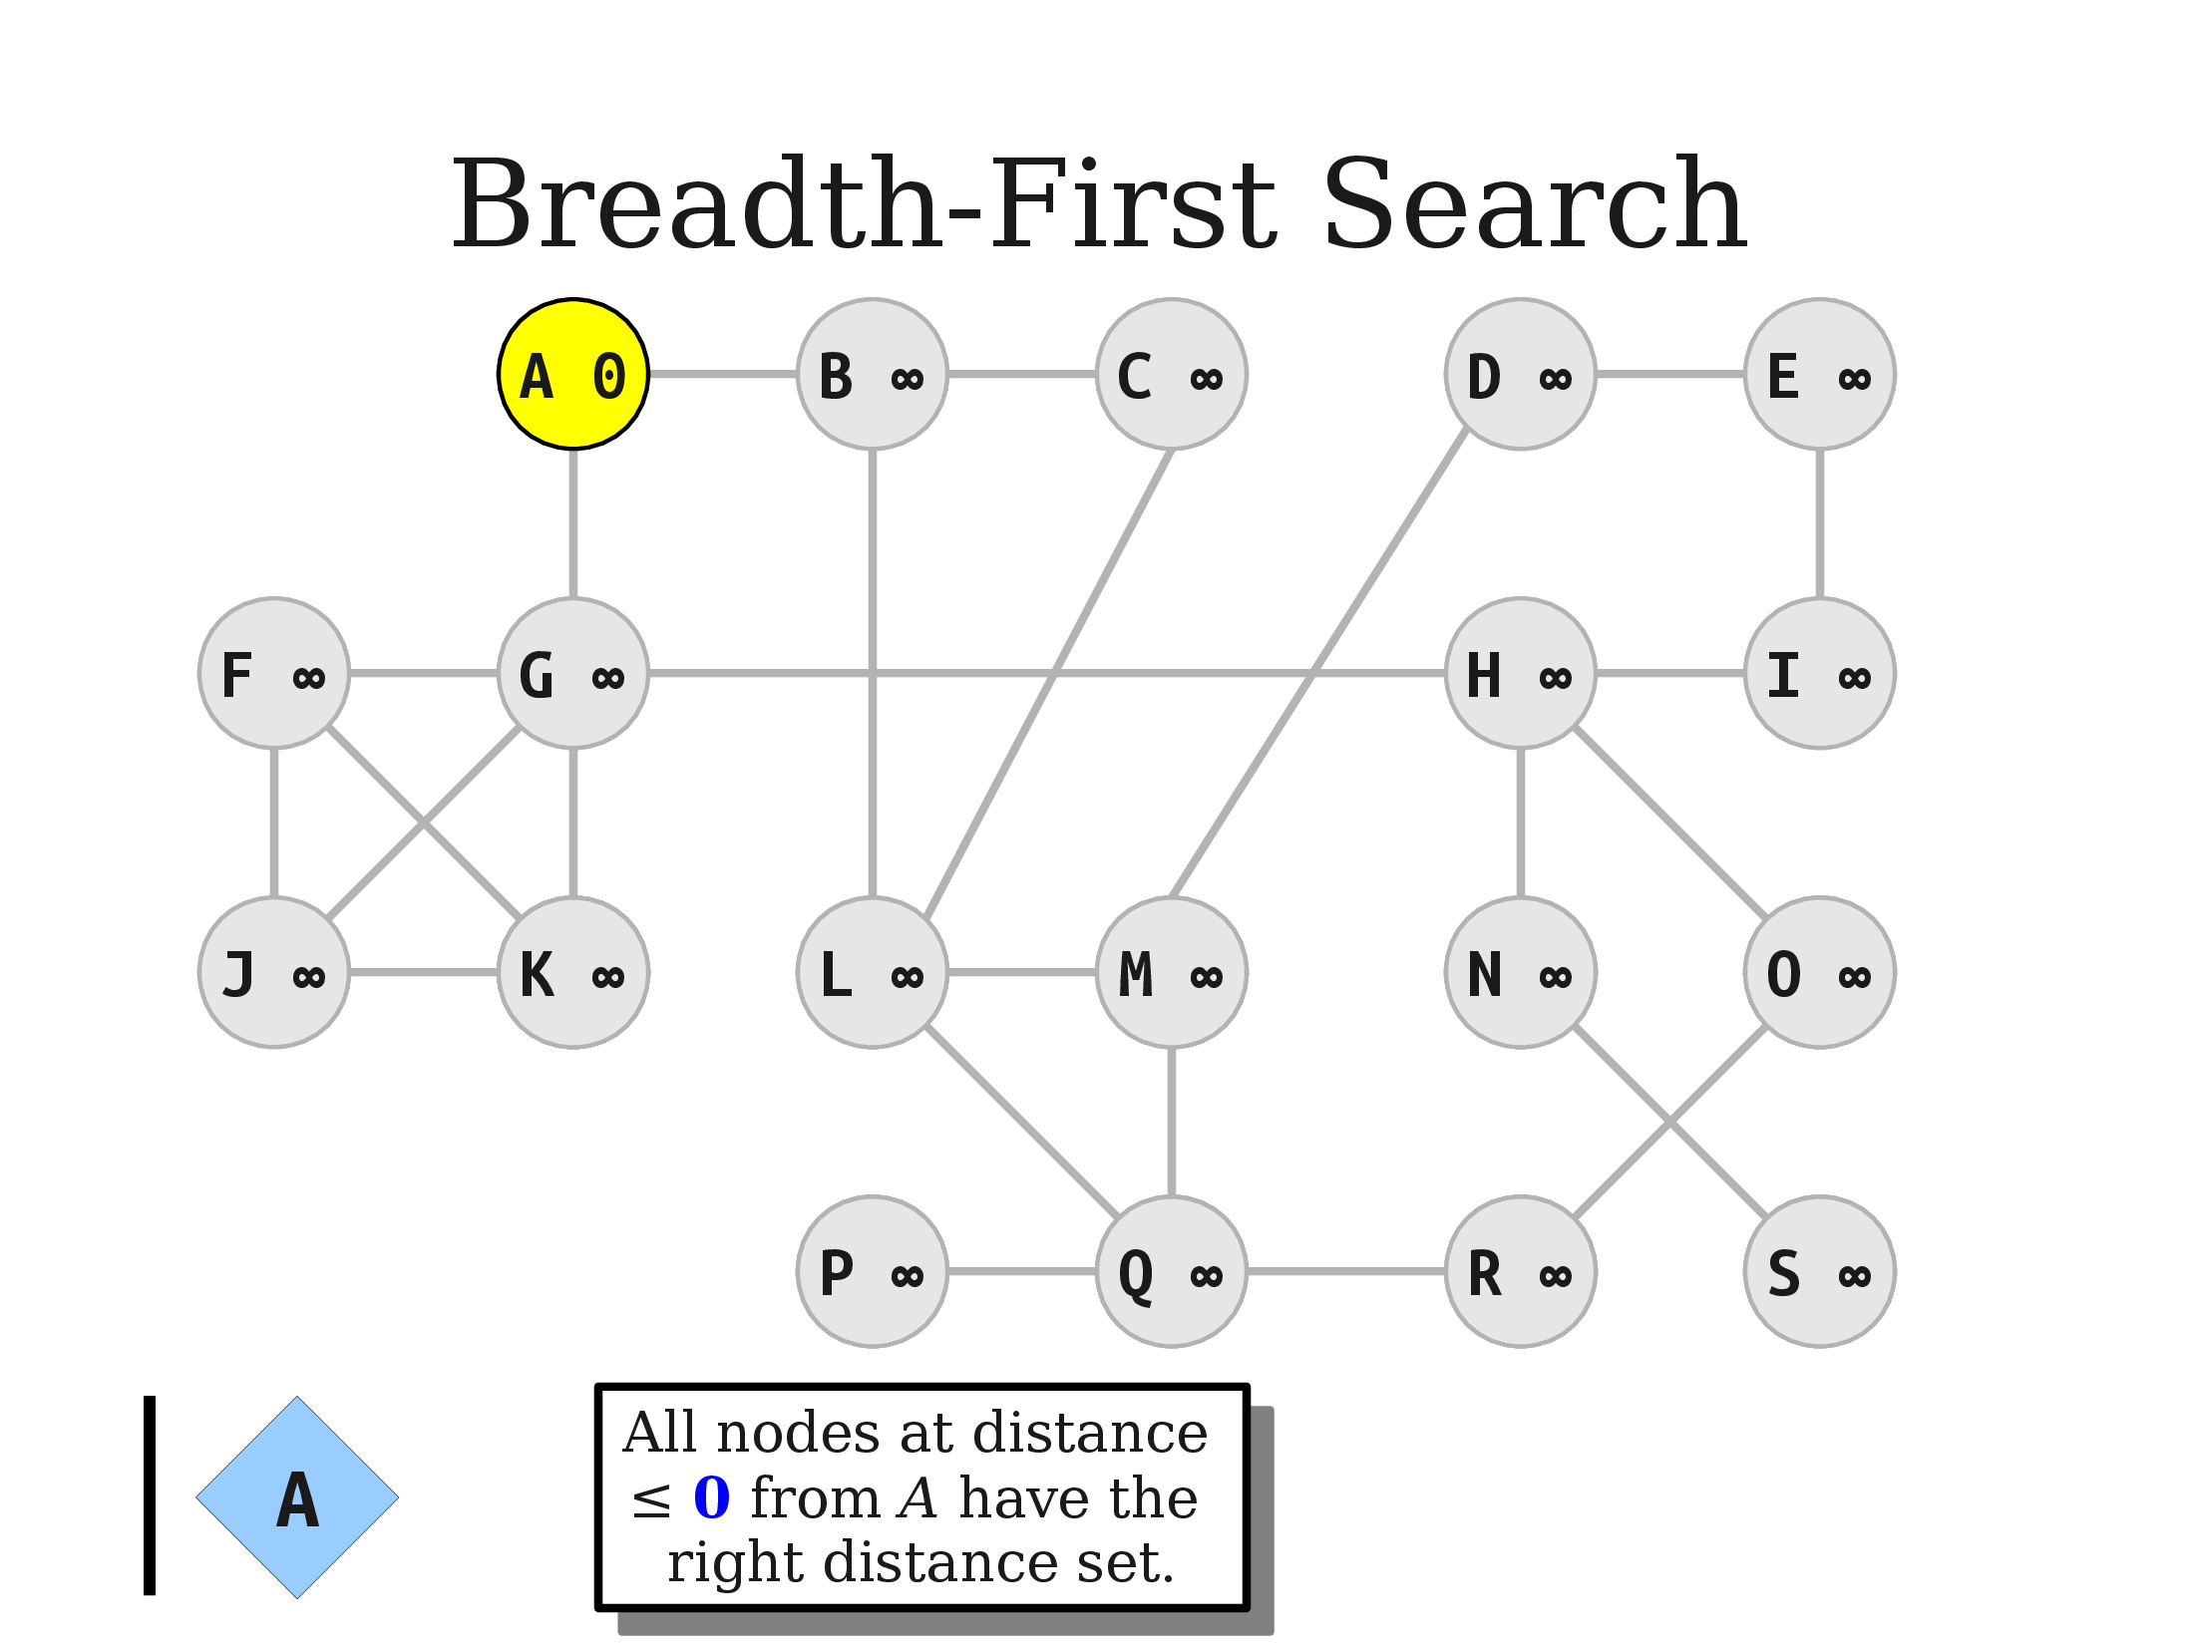
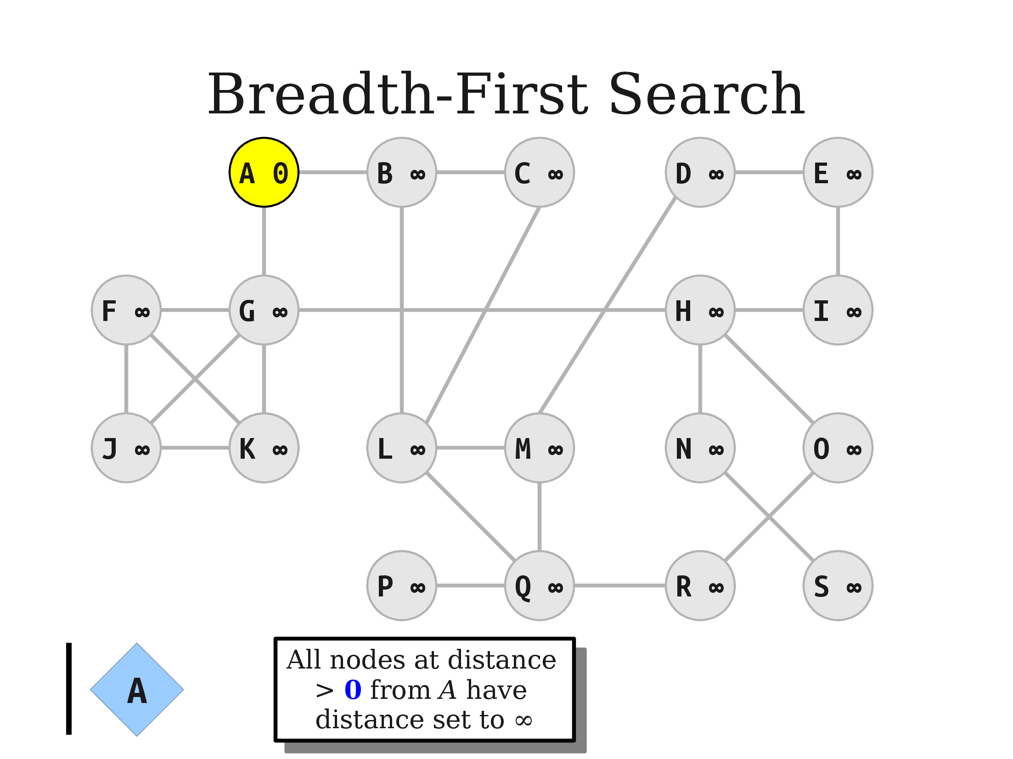

Slide 31
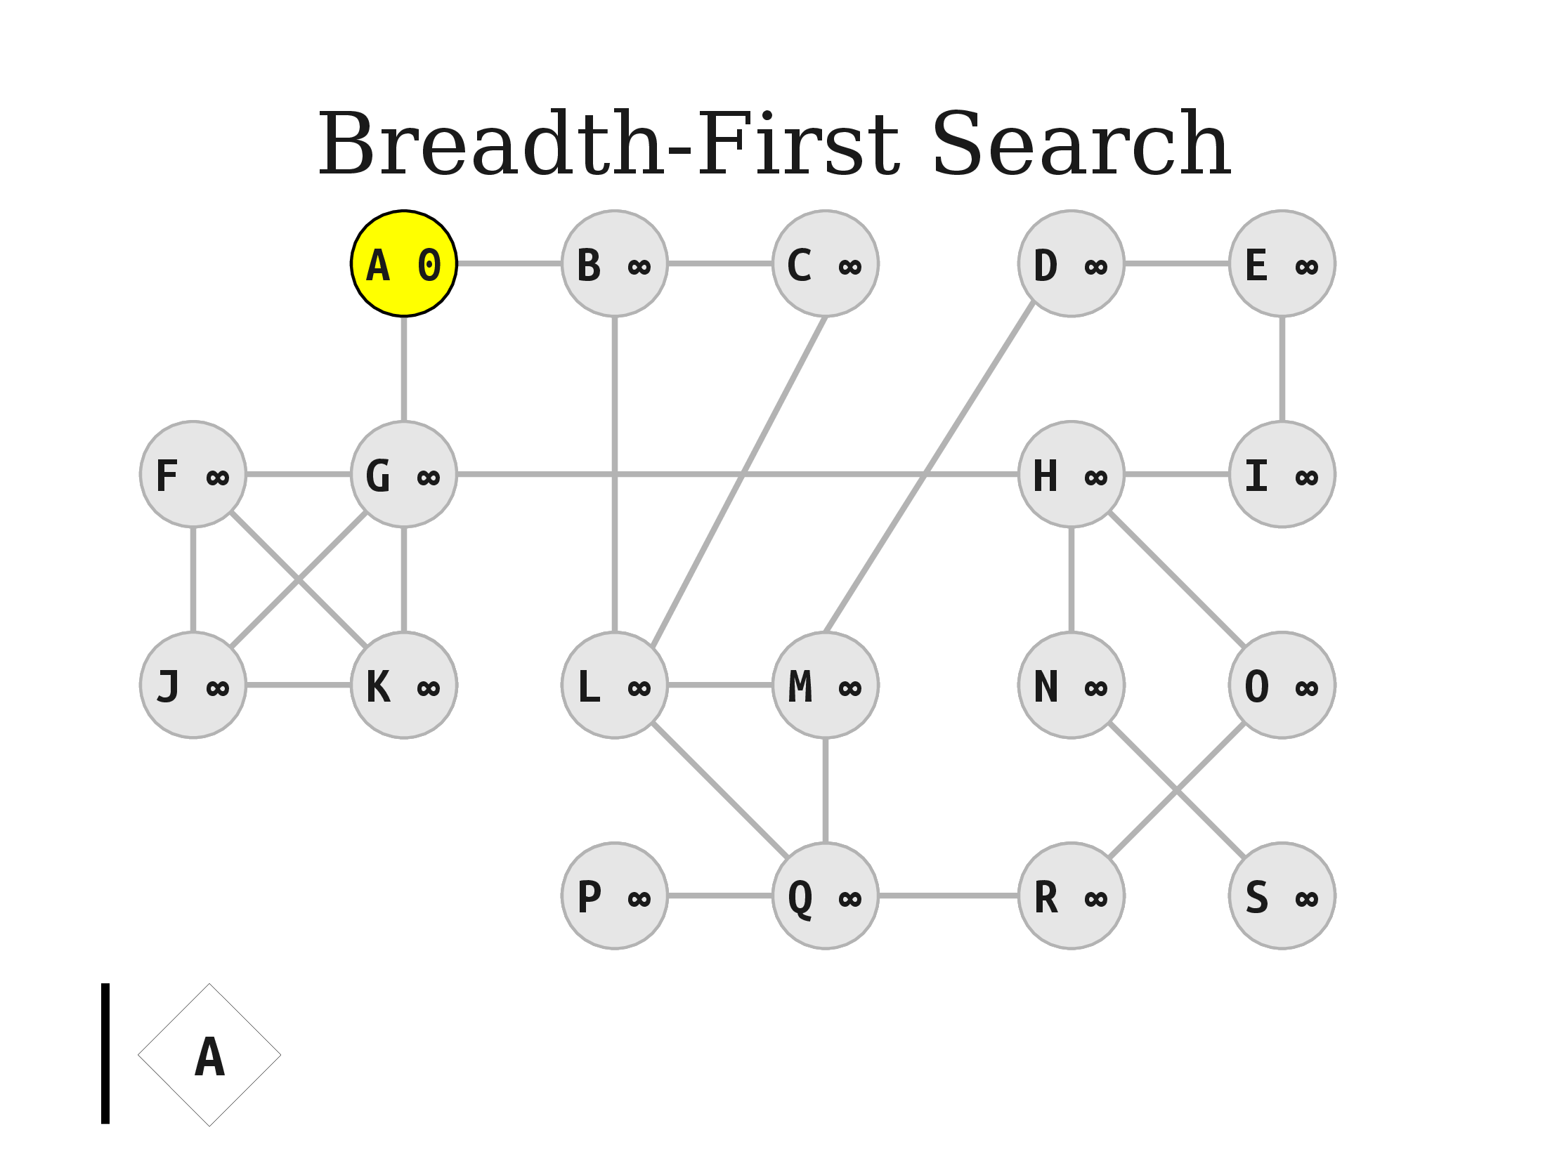
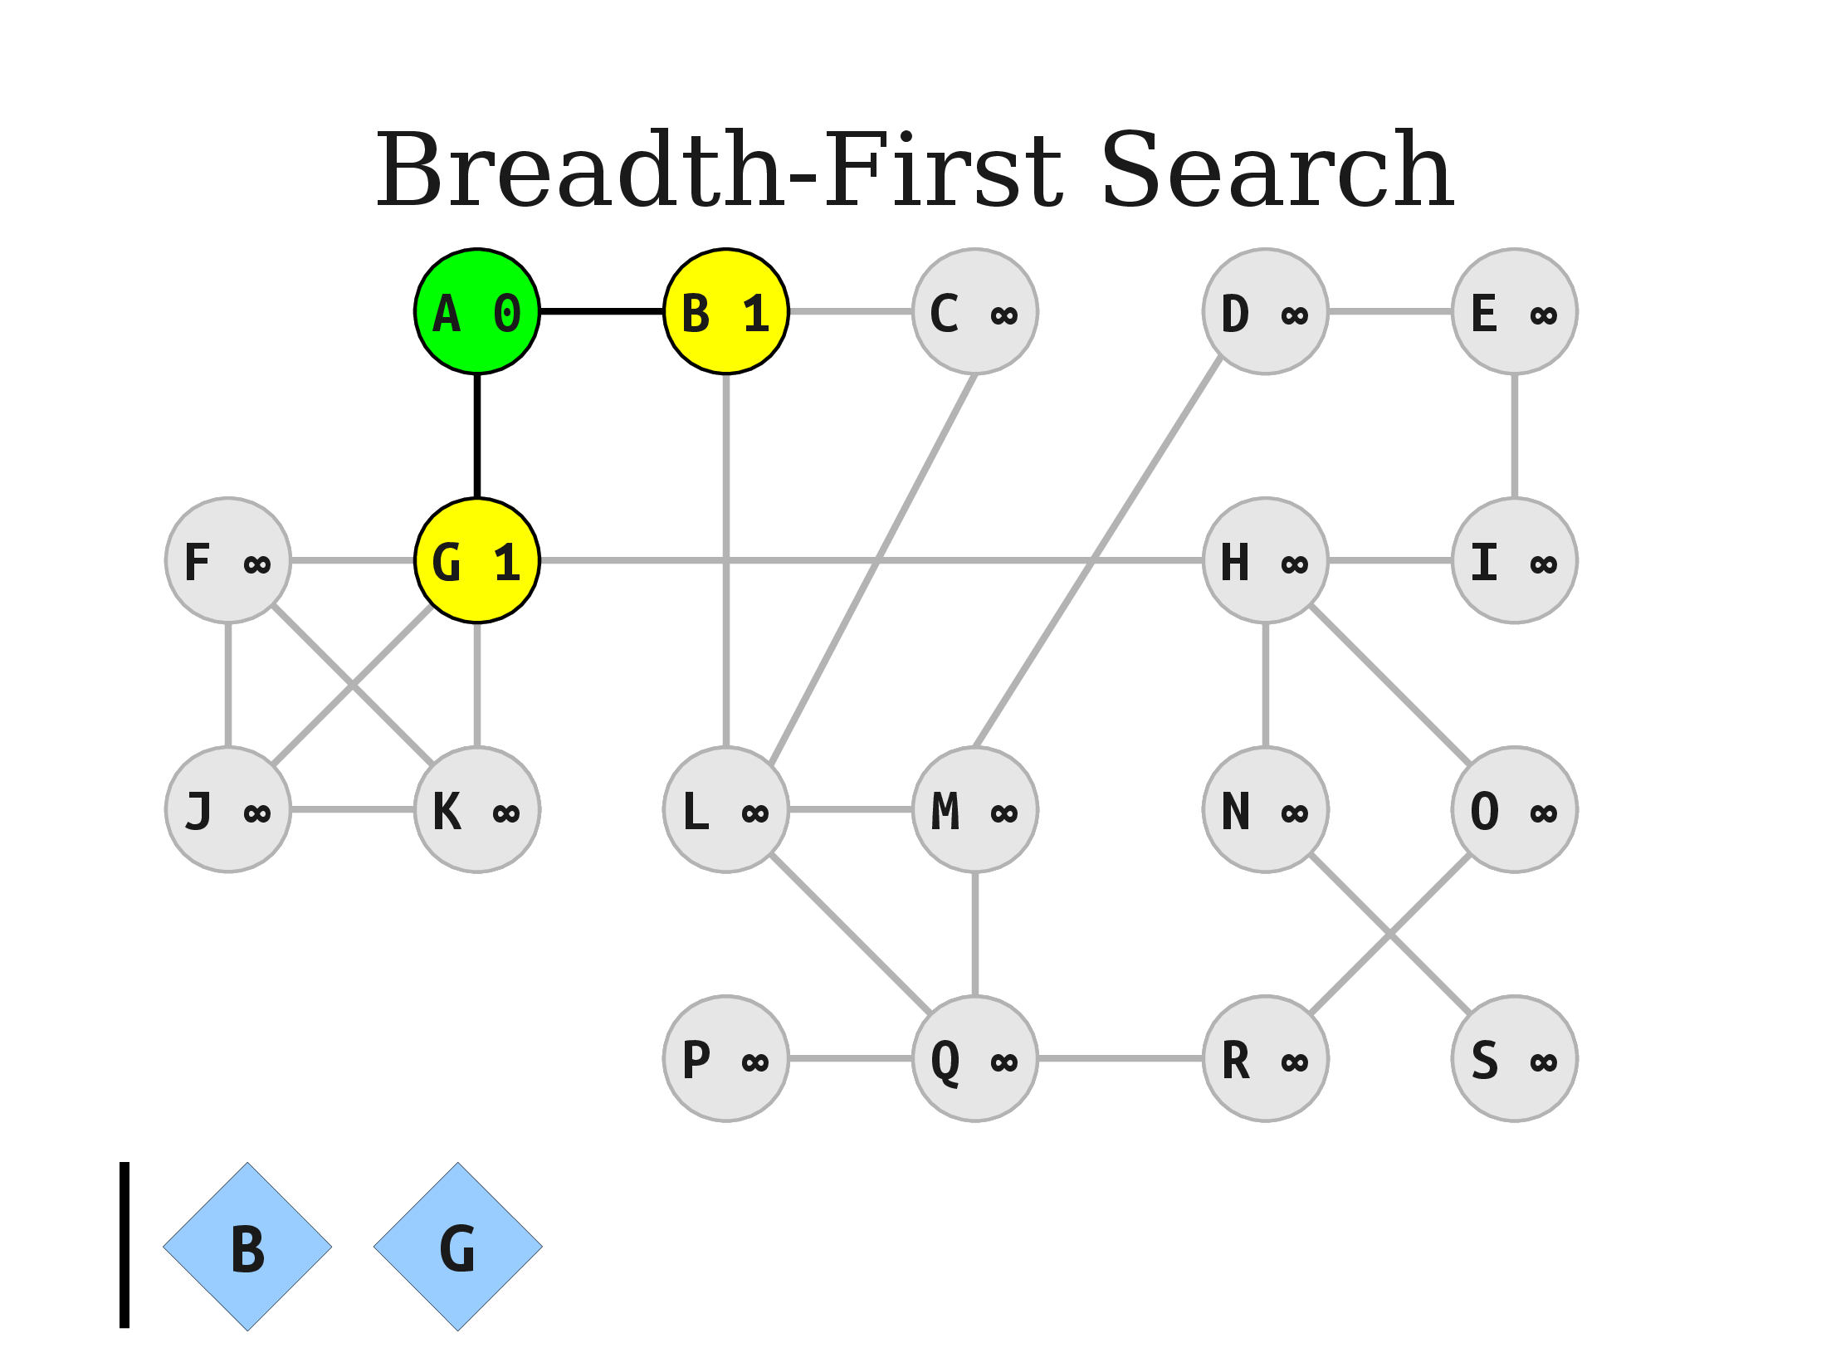
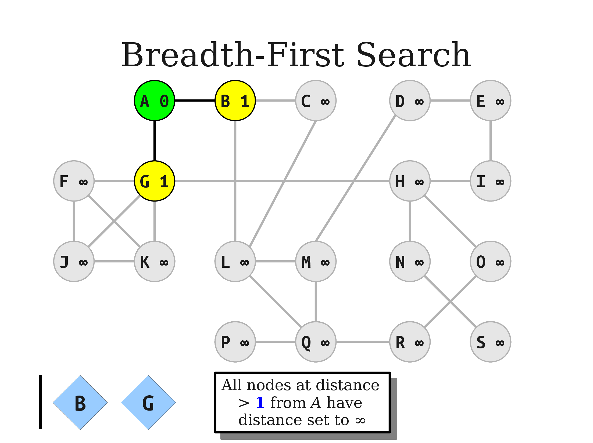


Slide 32
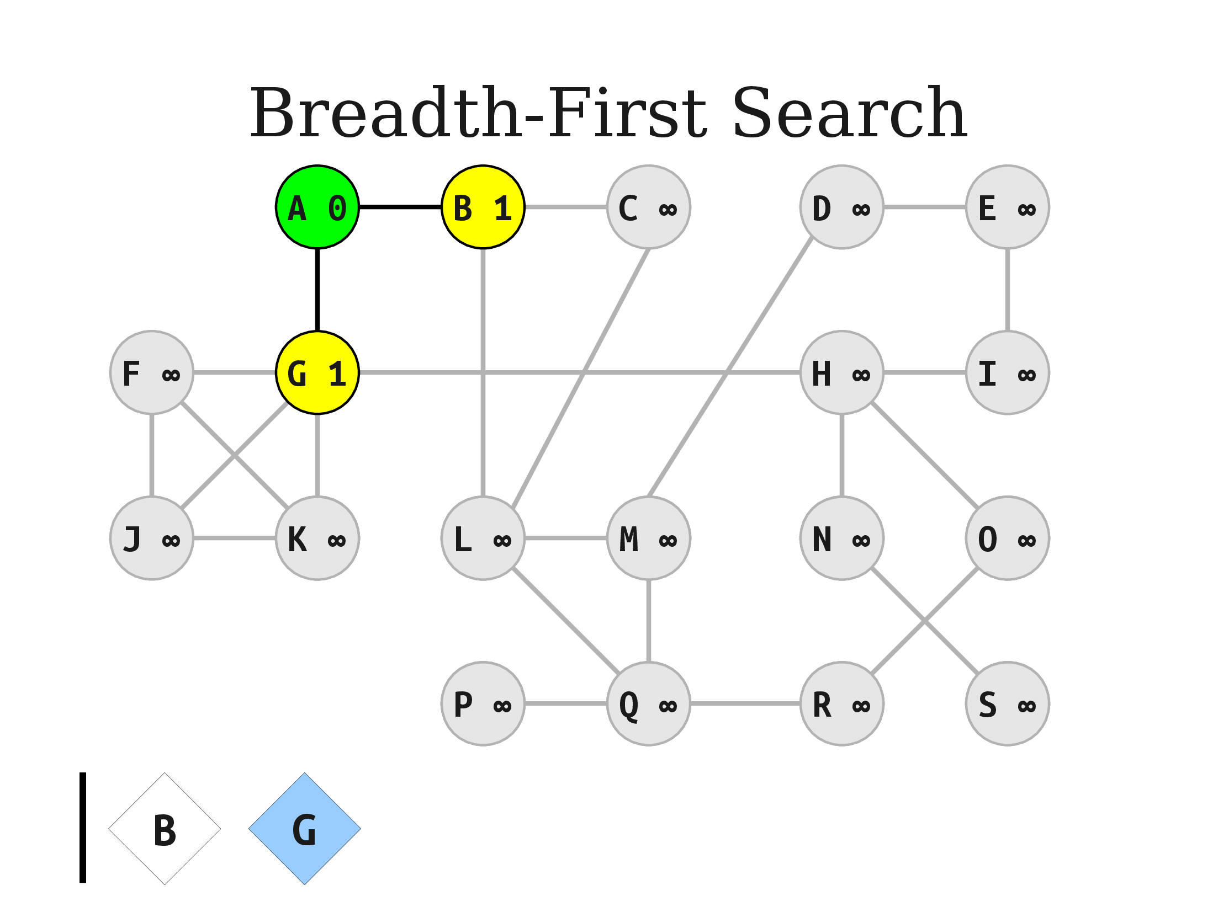
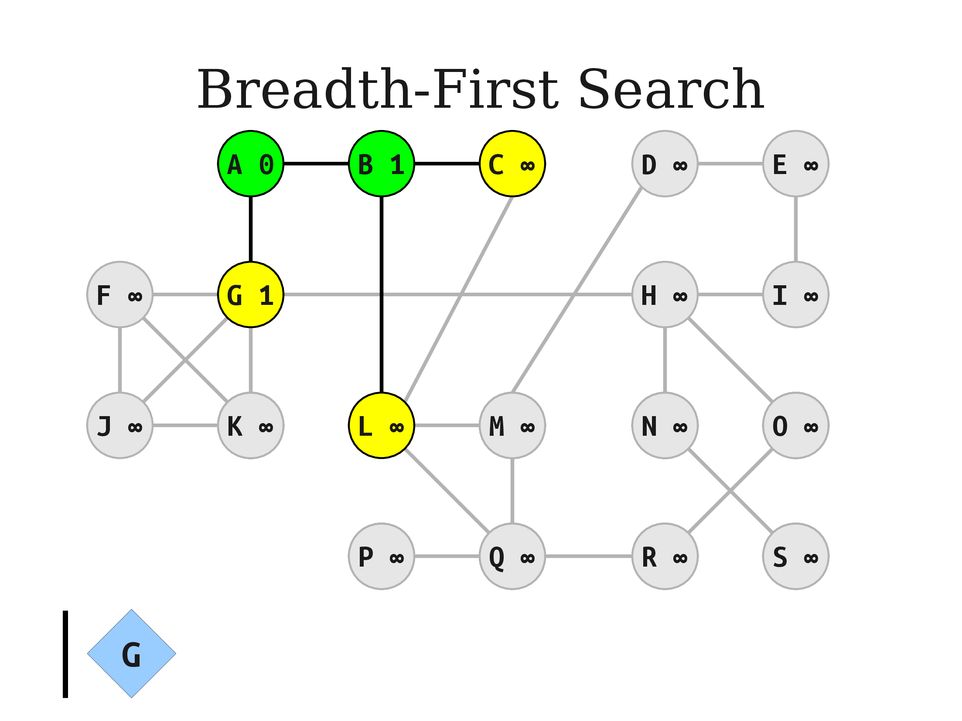

Slide 33
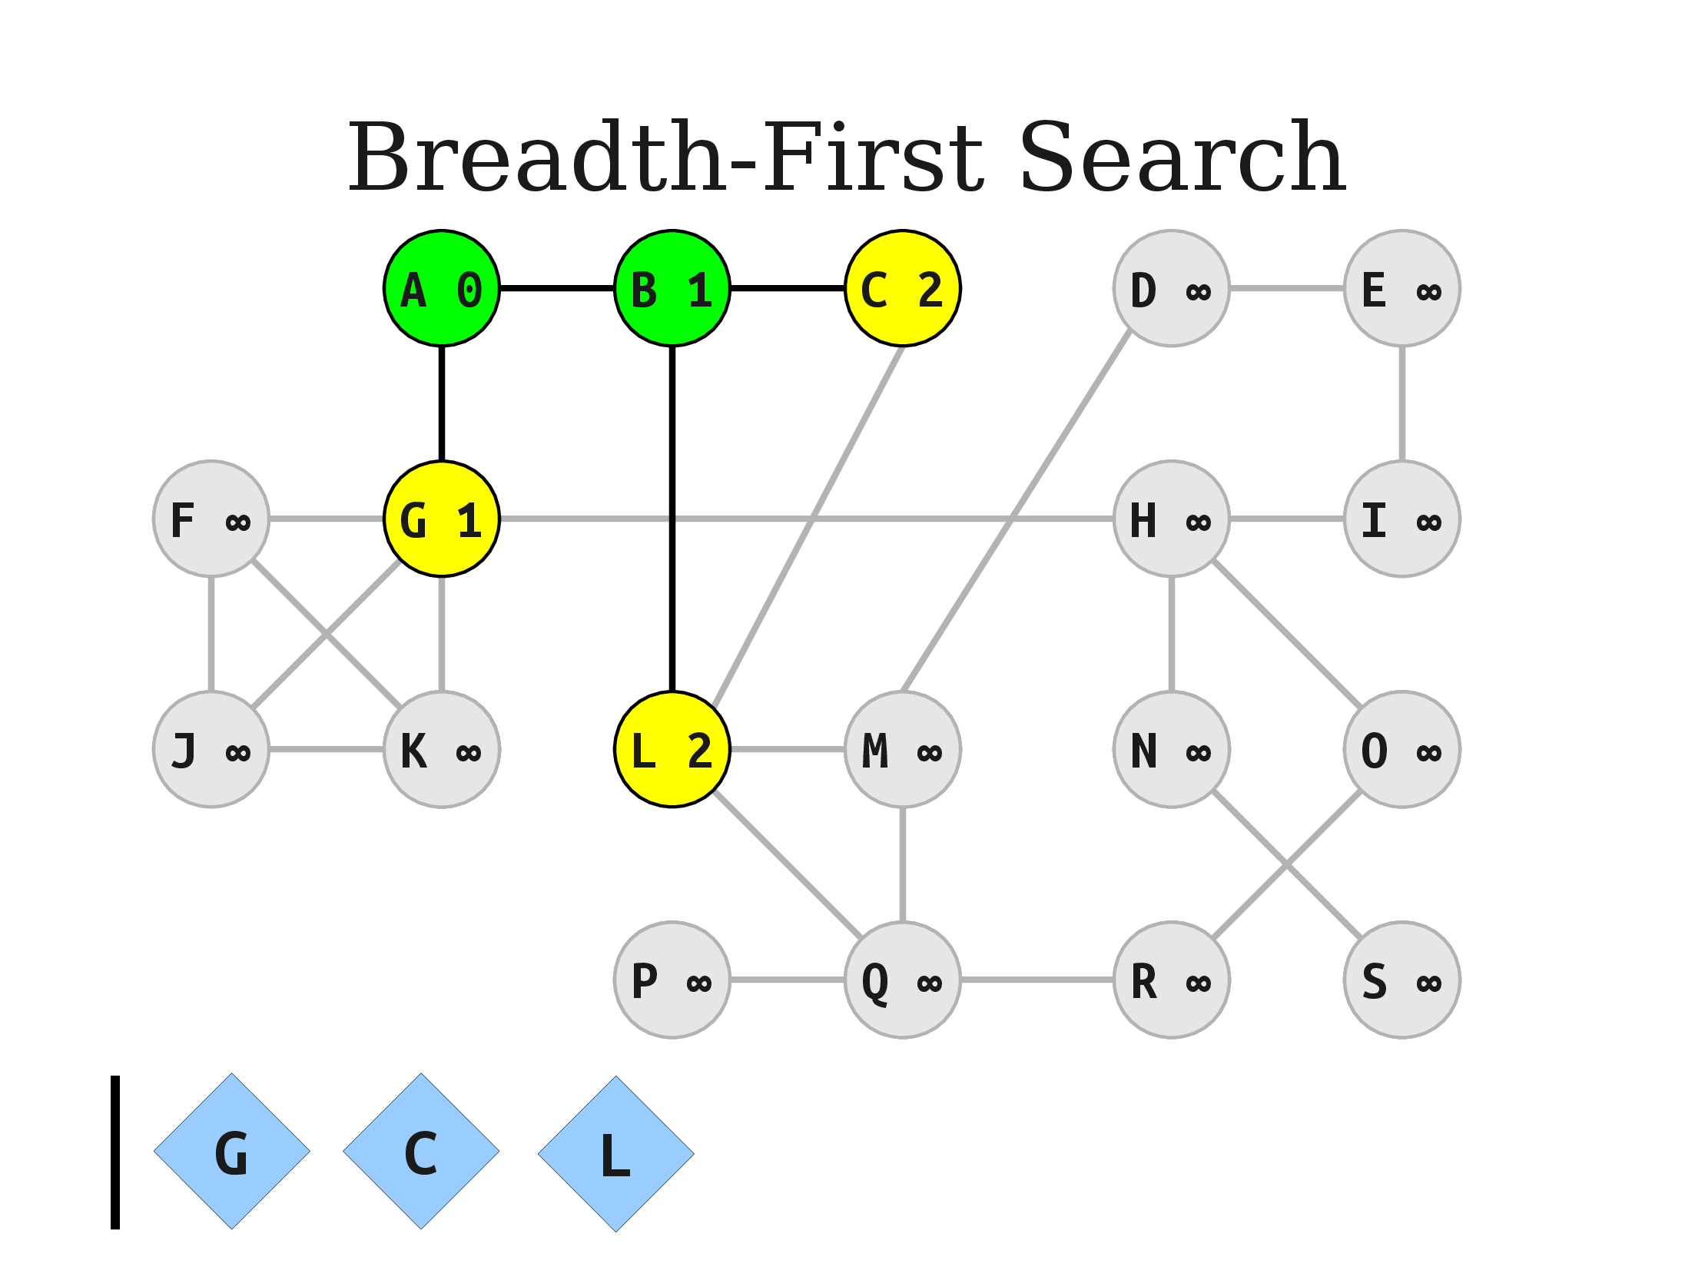
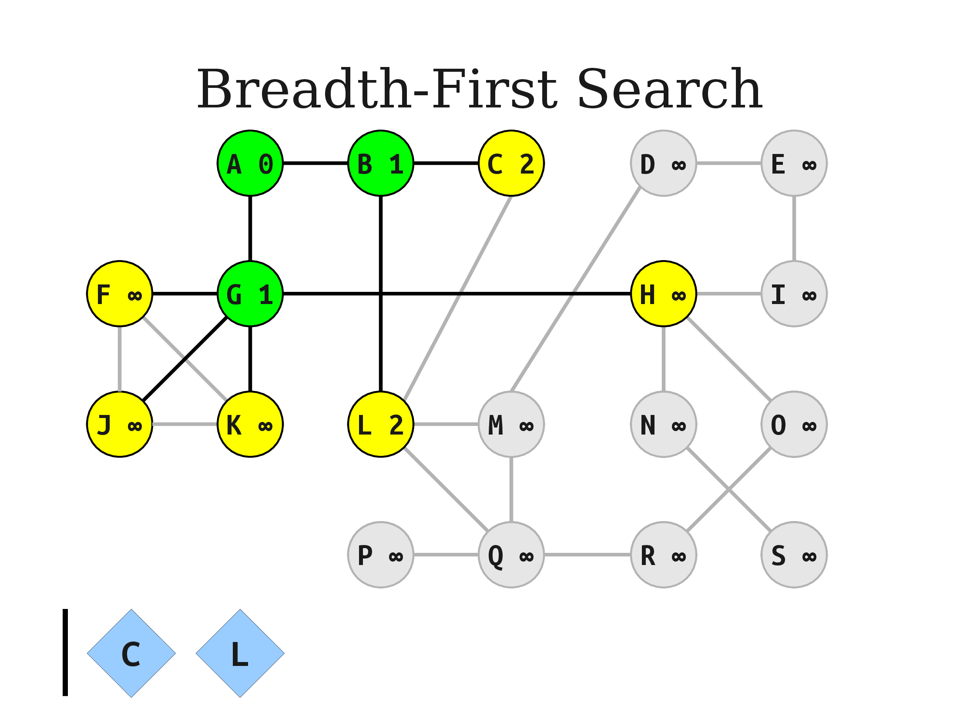
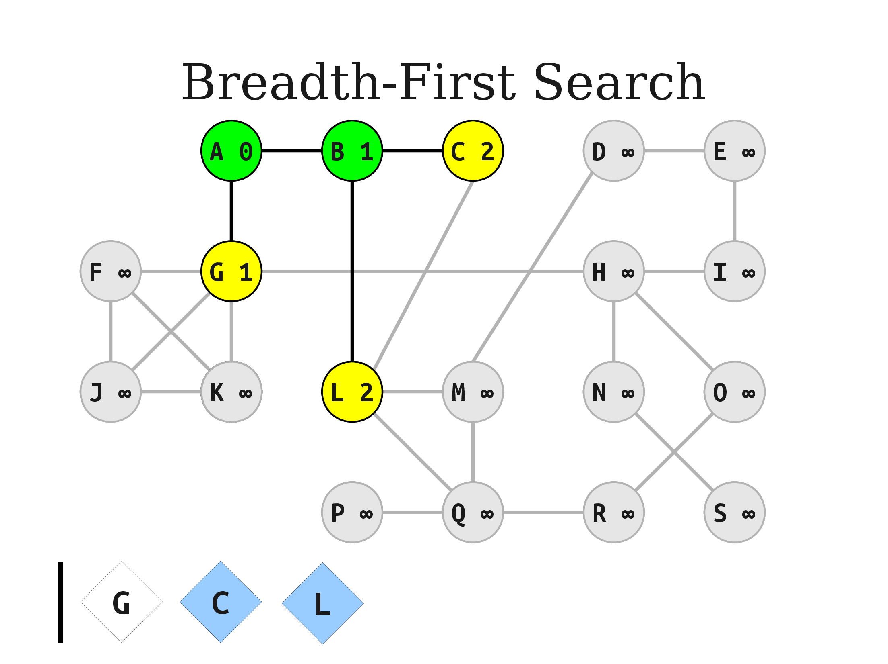

Slide 34
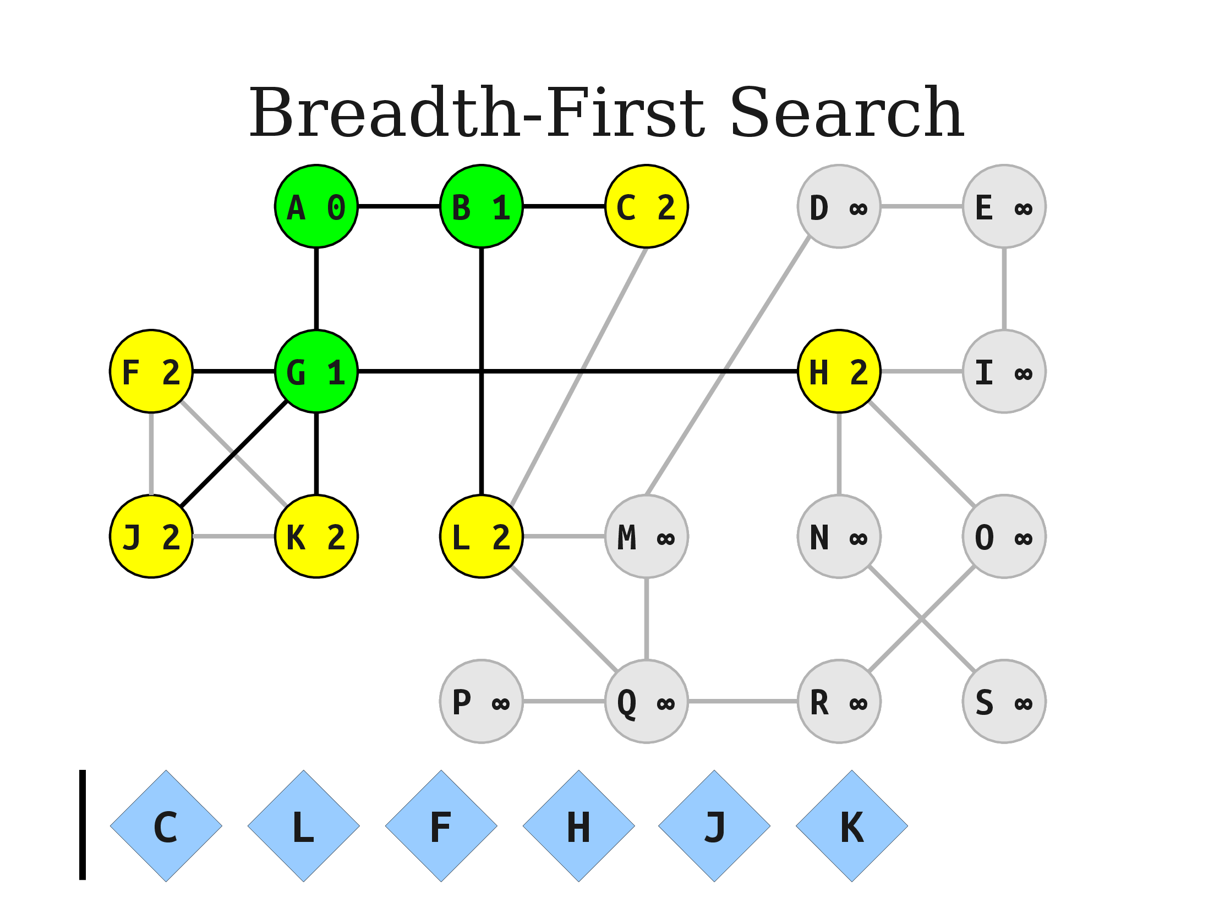
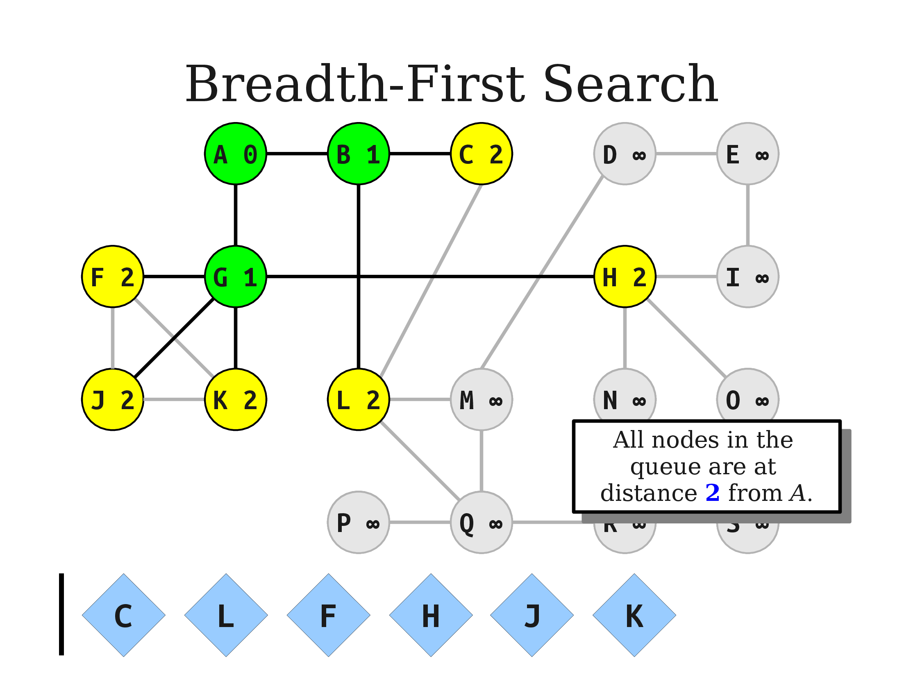


Slide 35
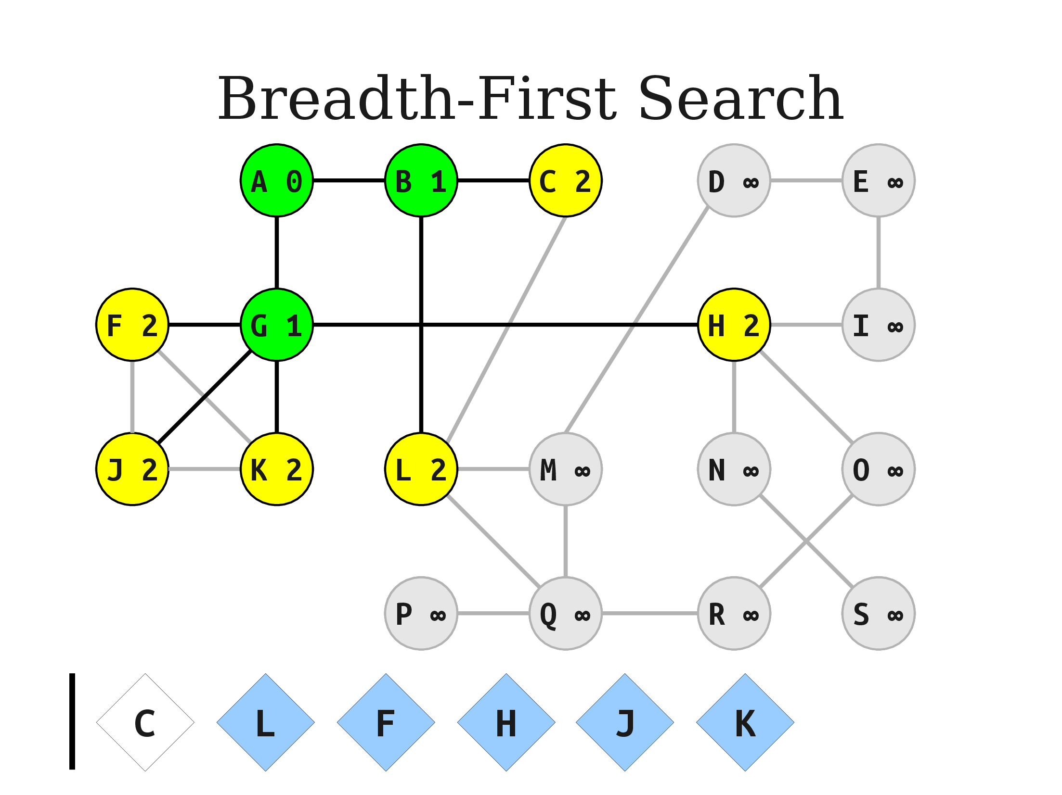
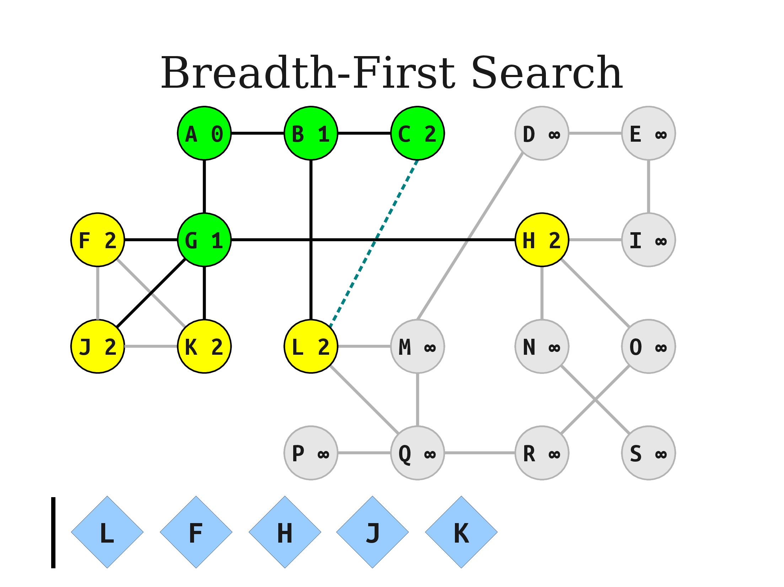
Its mean the child of this nod already exist in the Queue

Slide 36
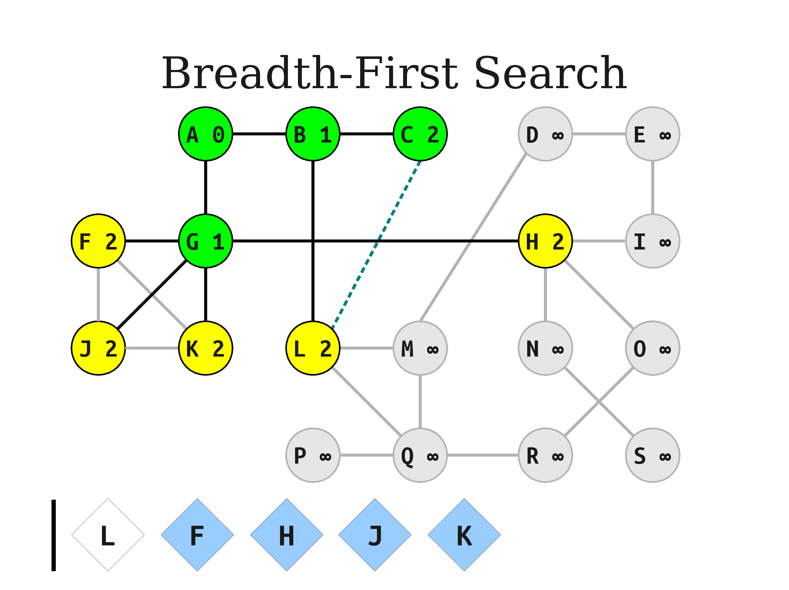
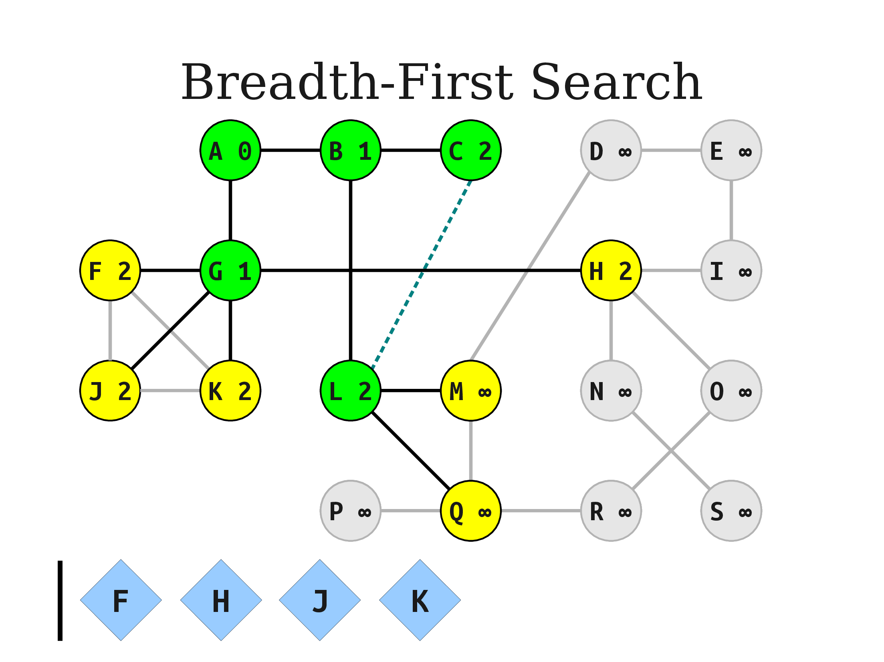
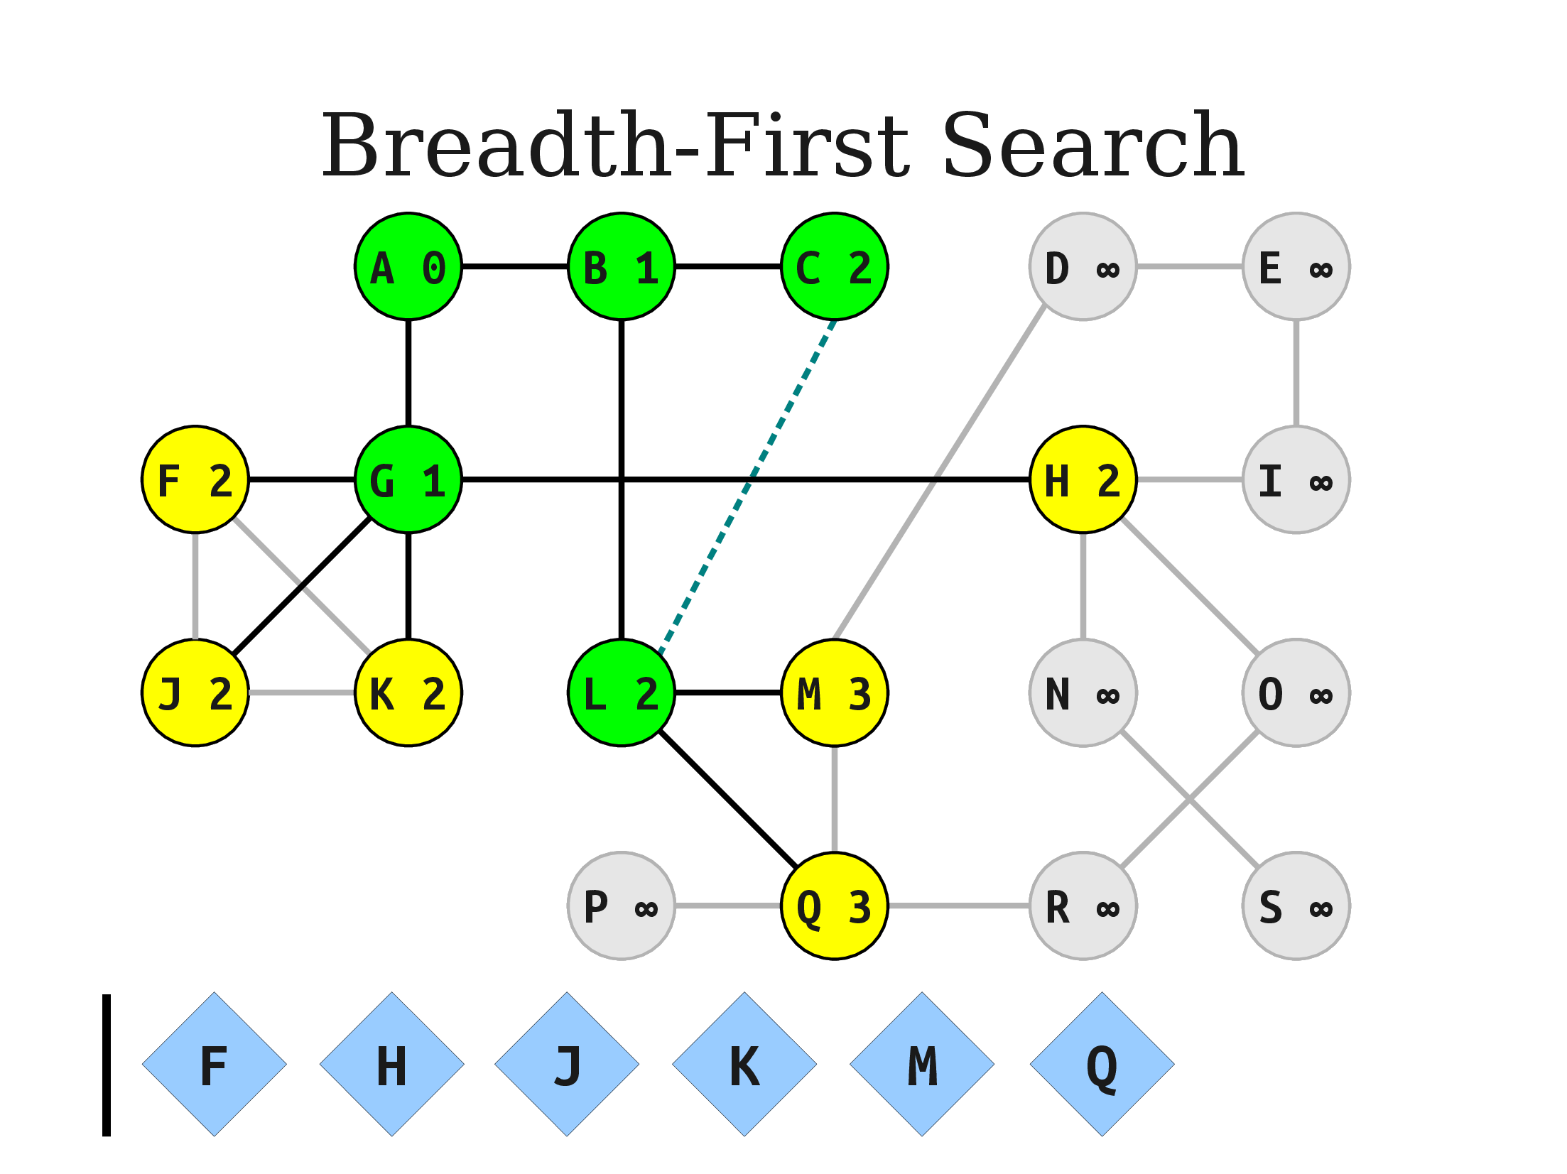

Slide 37
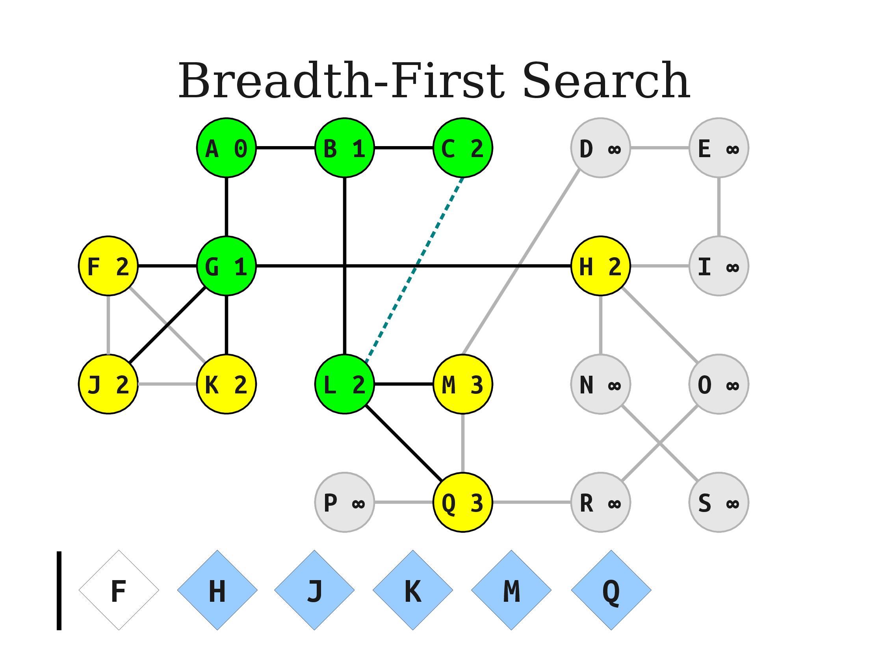
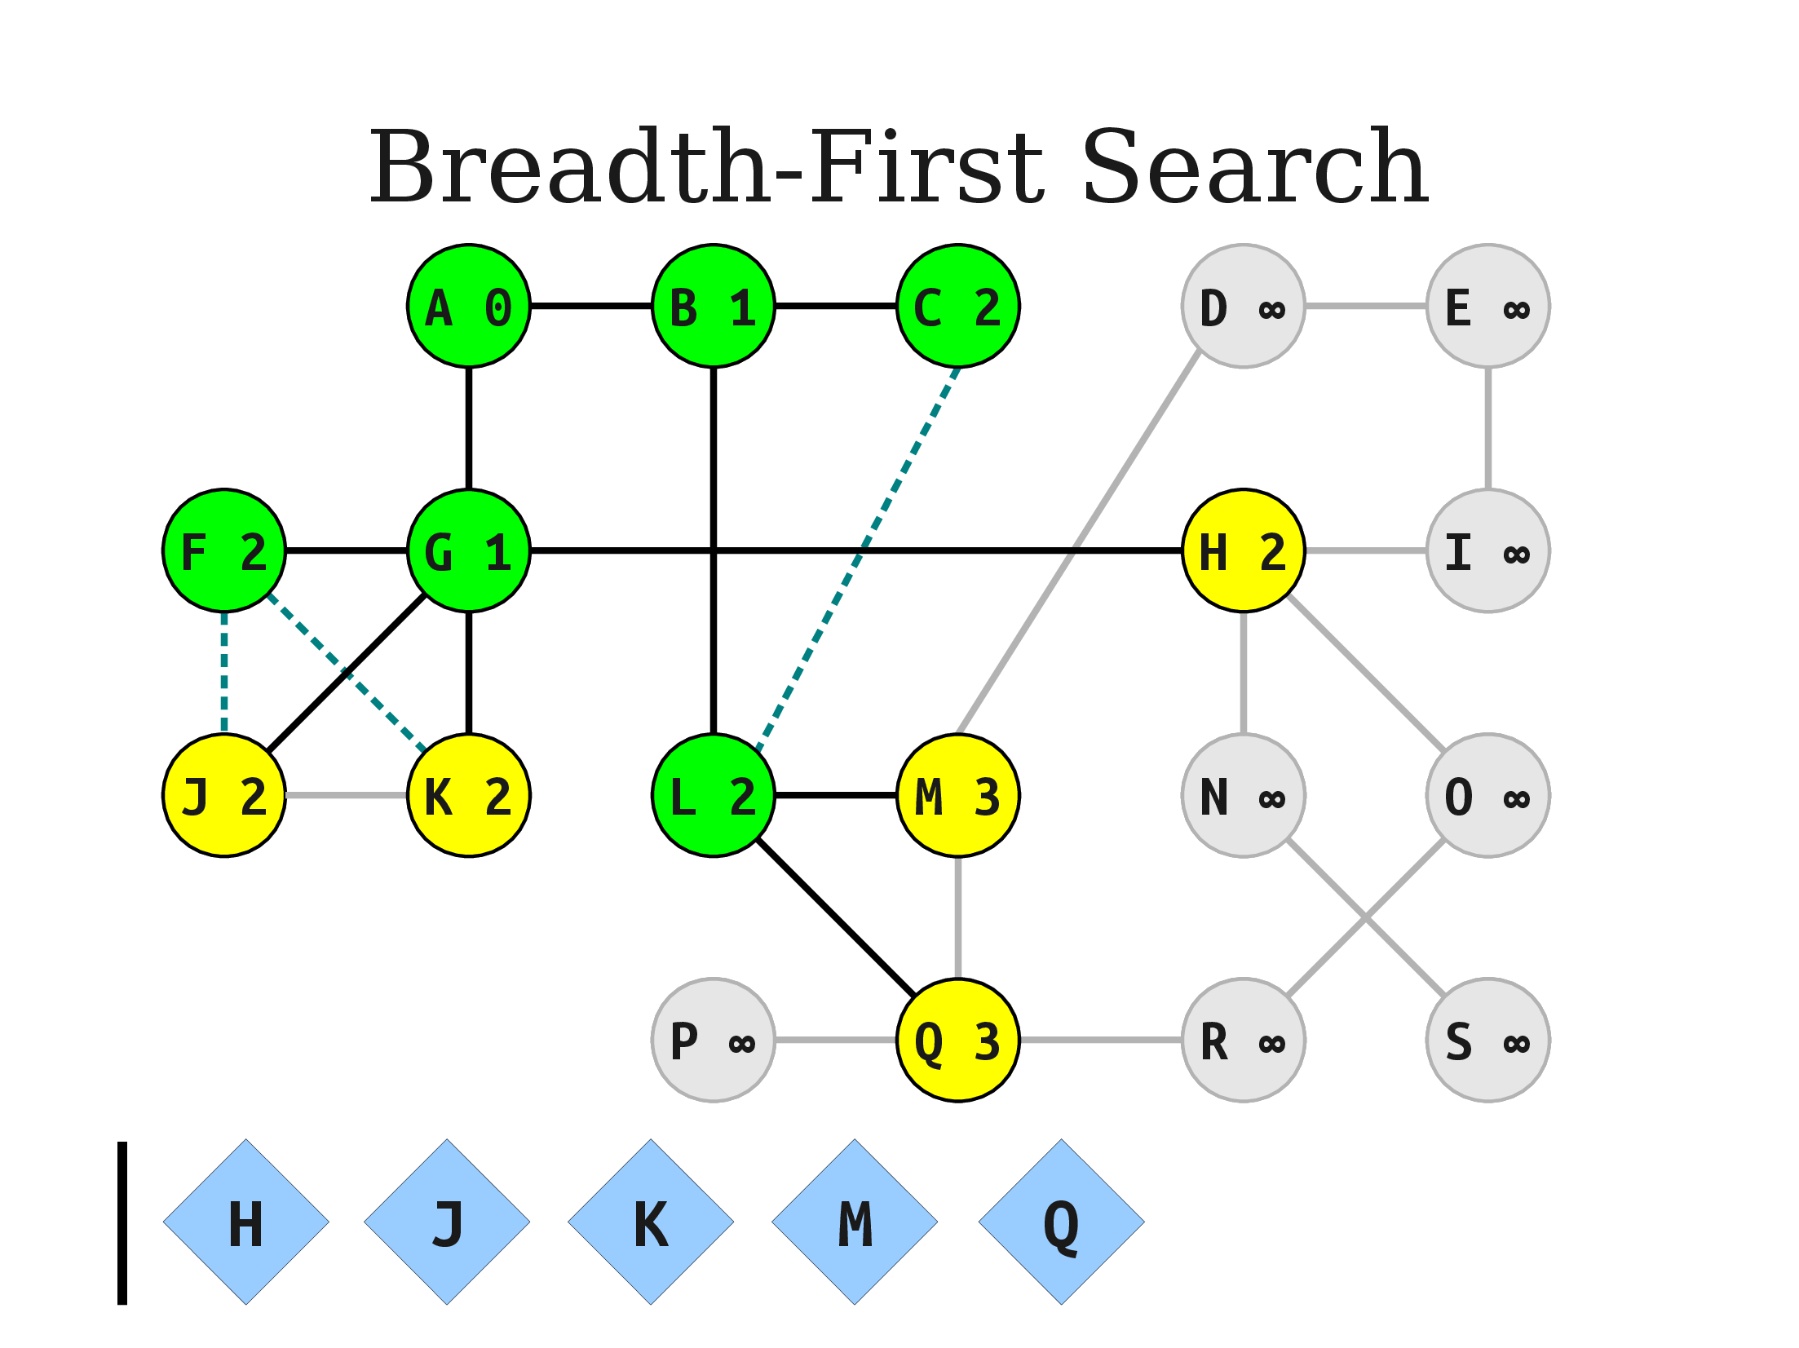

Slide 38
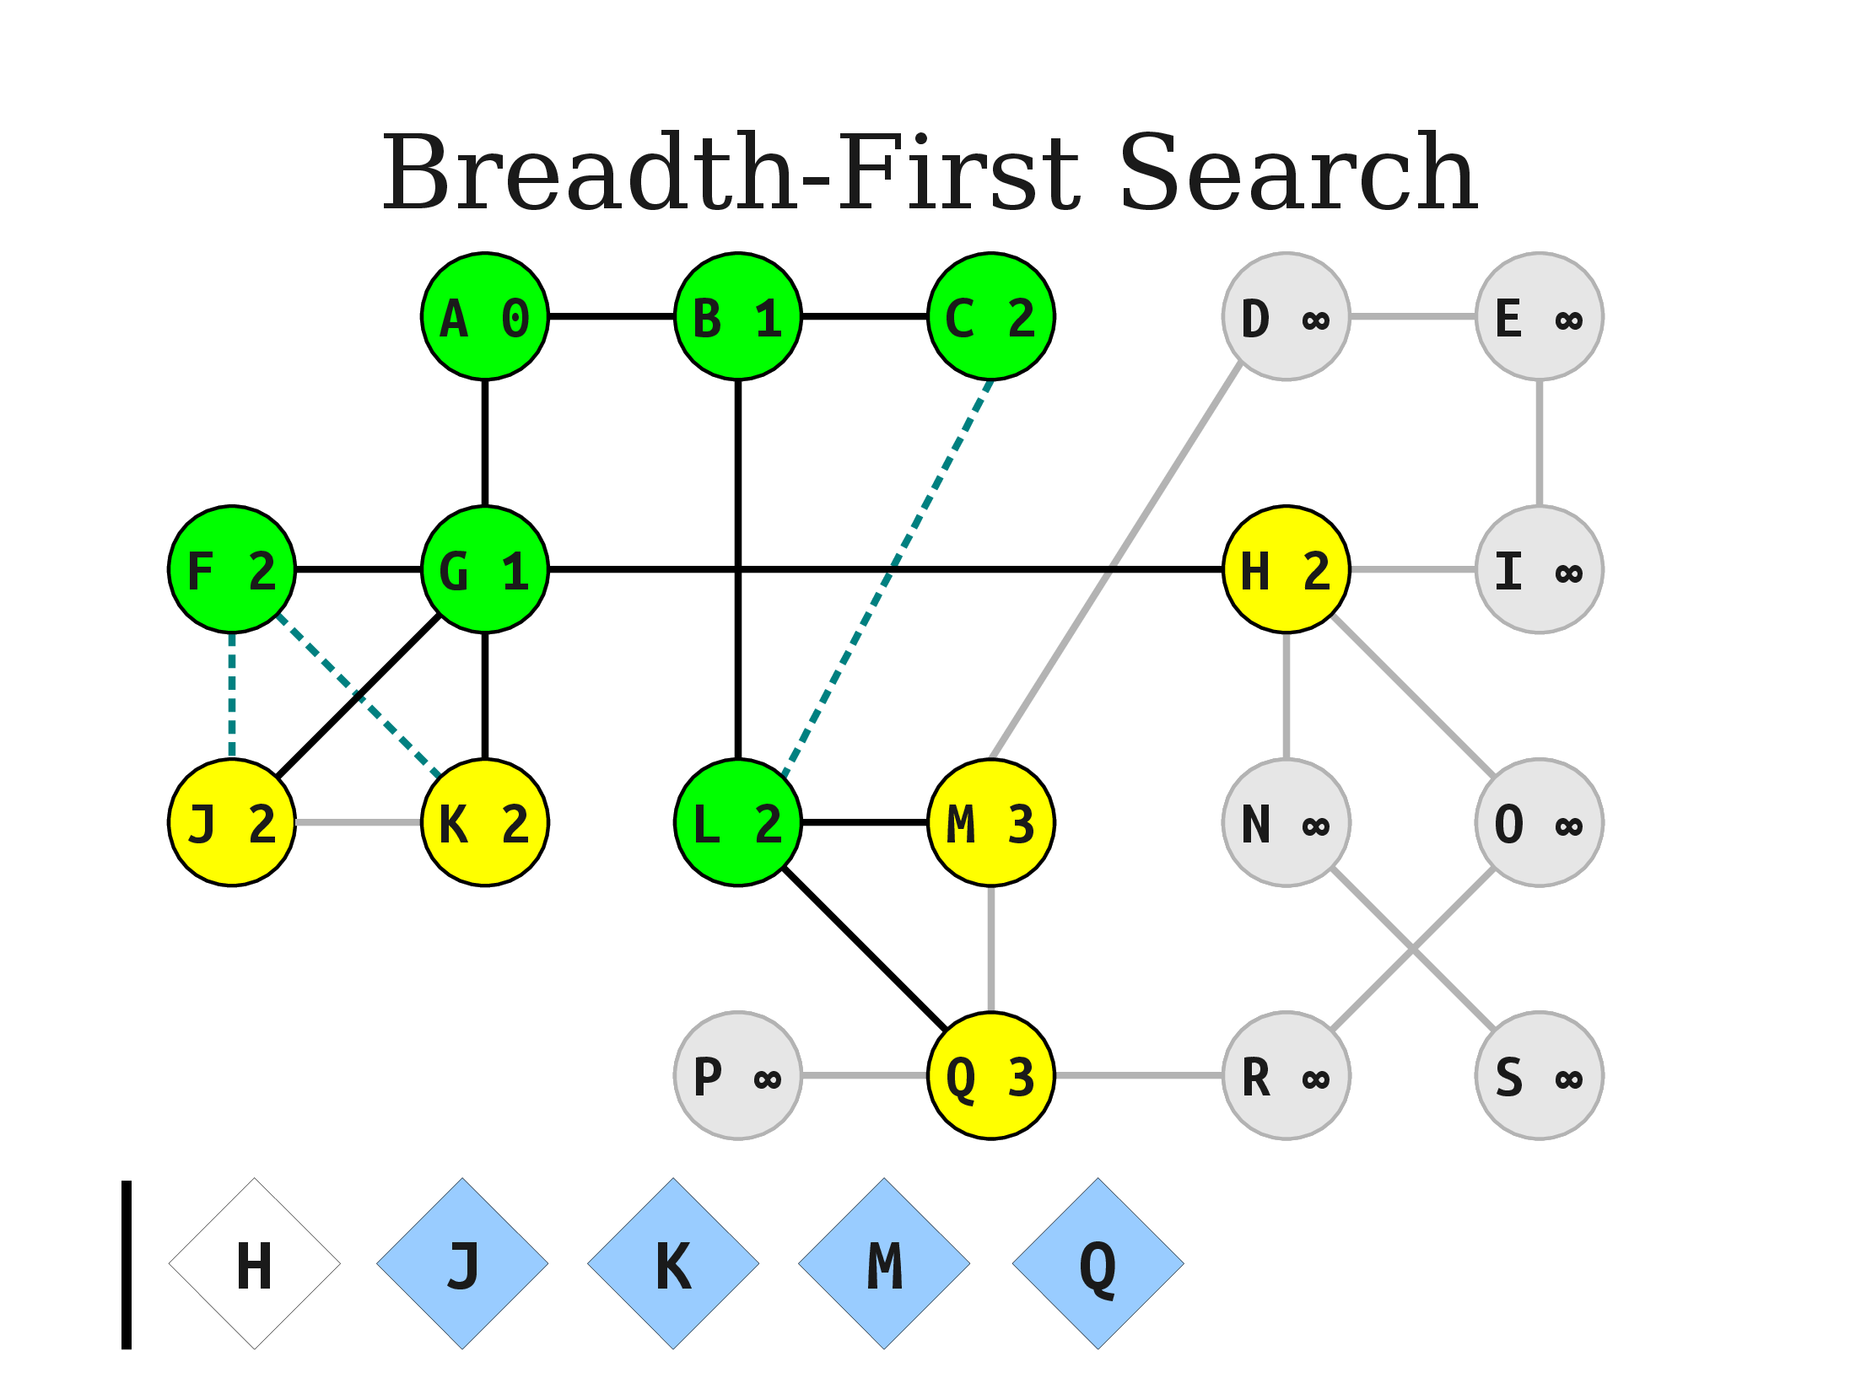
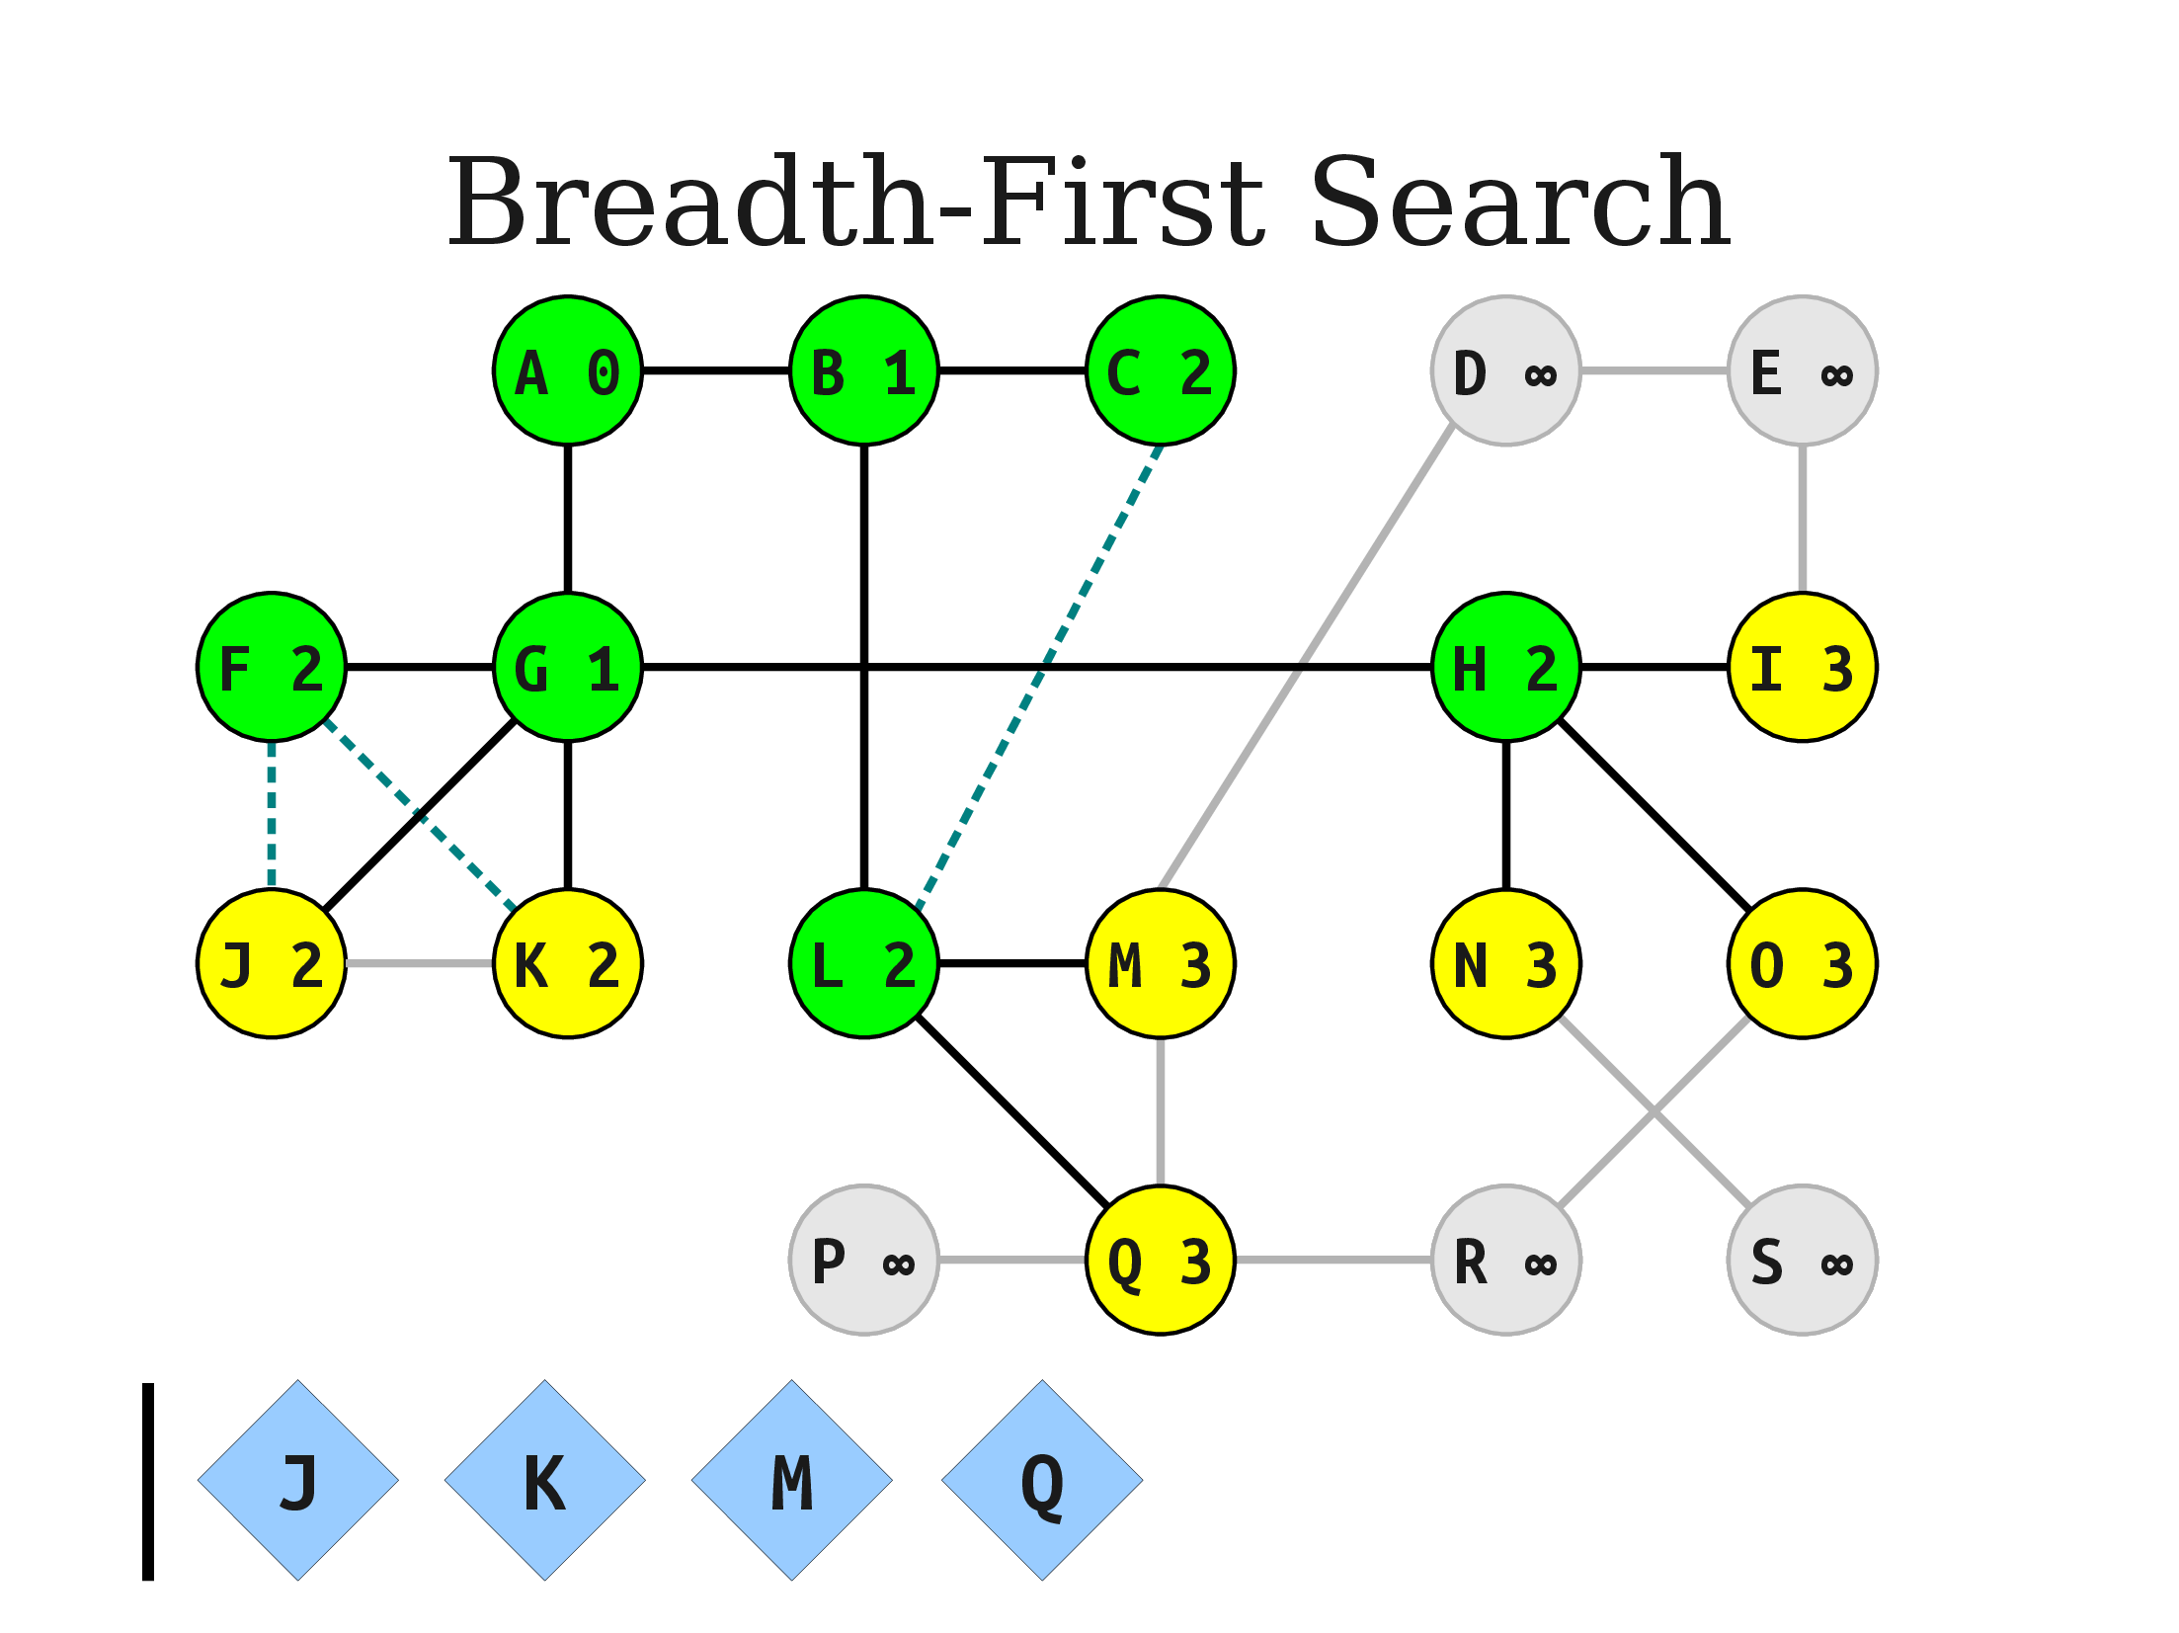
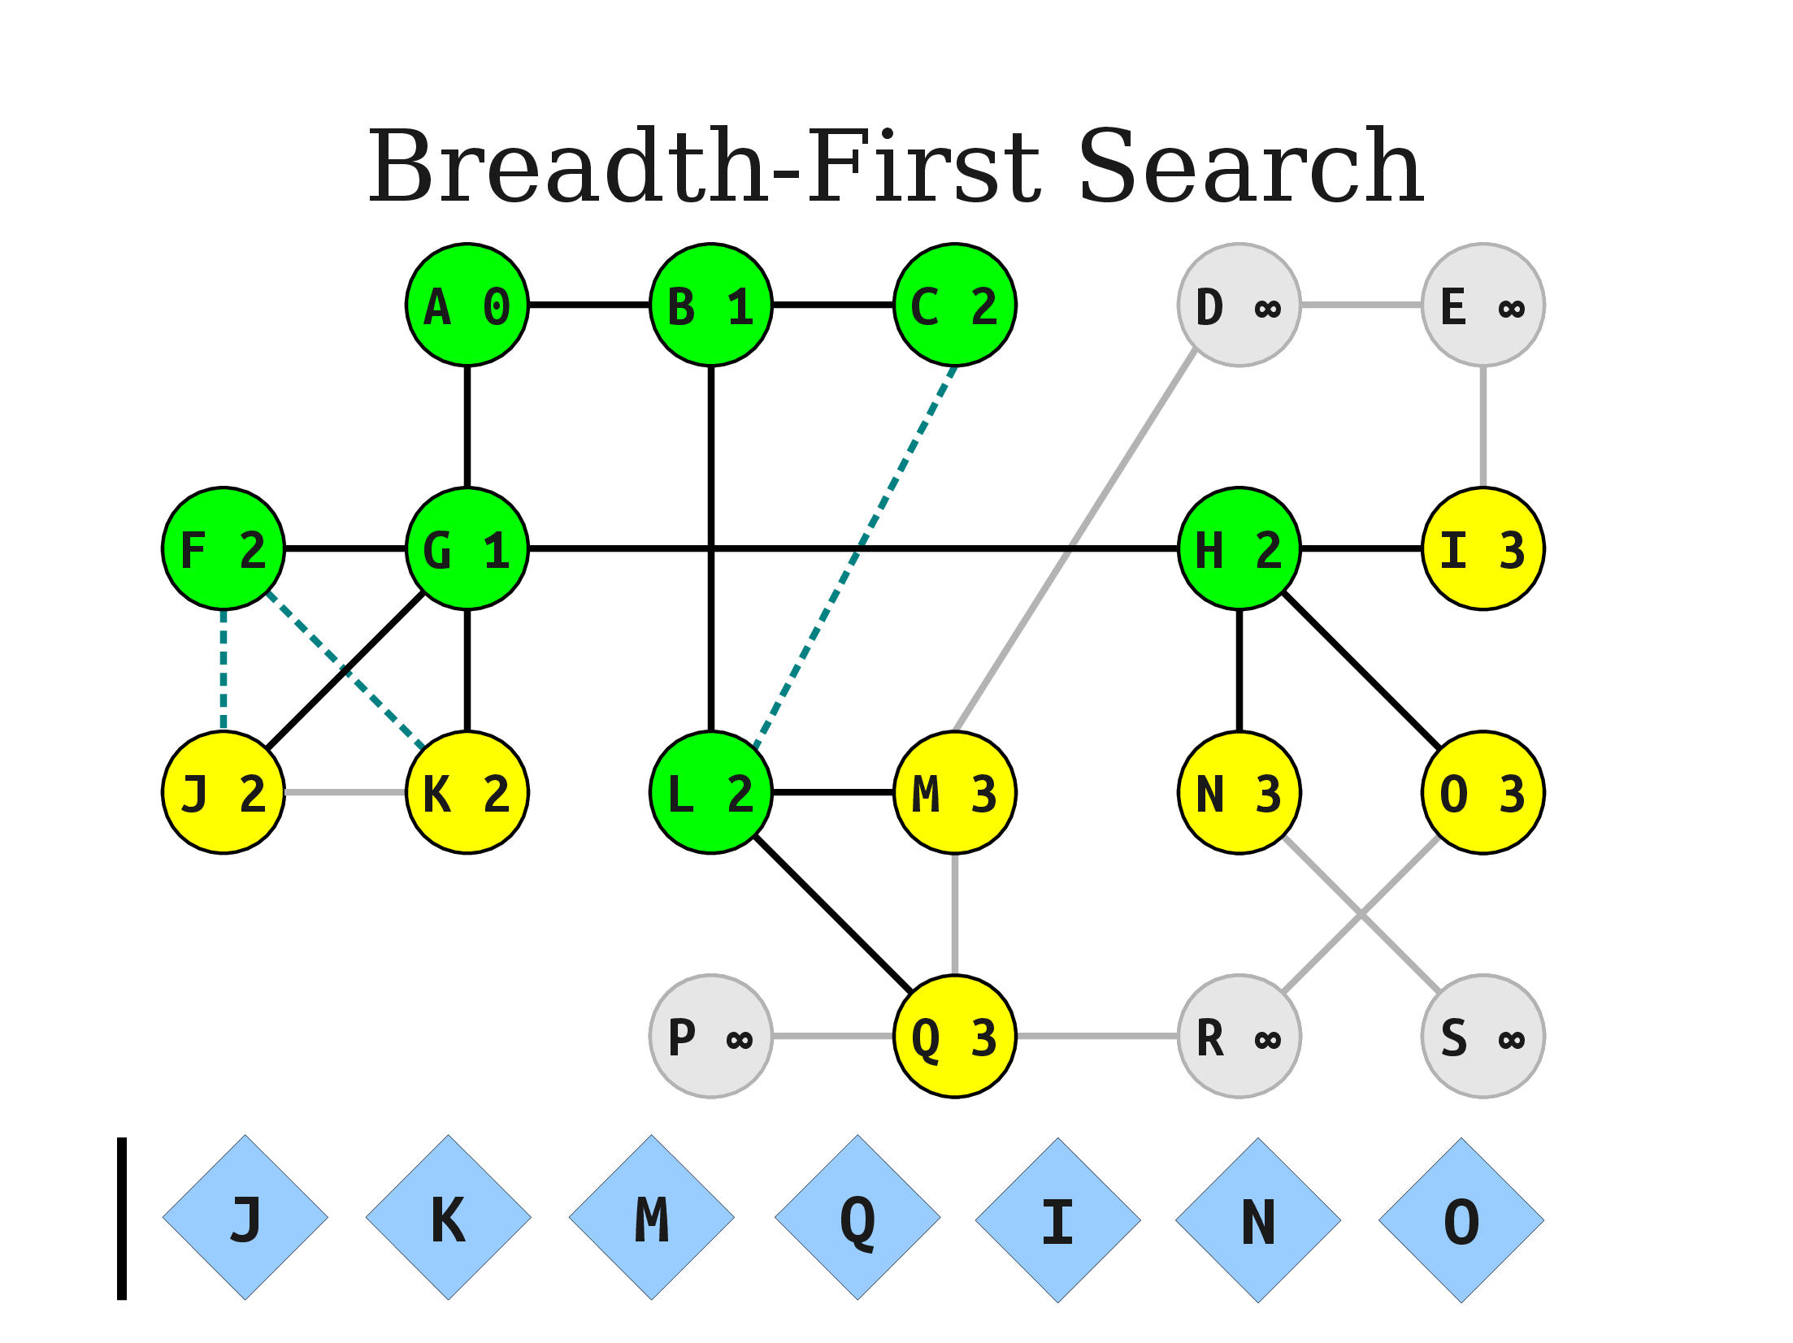

Slide 39
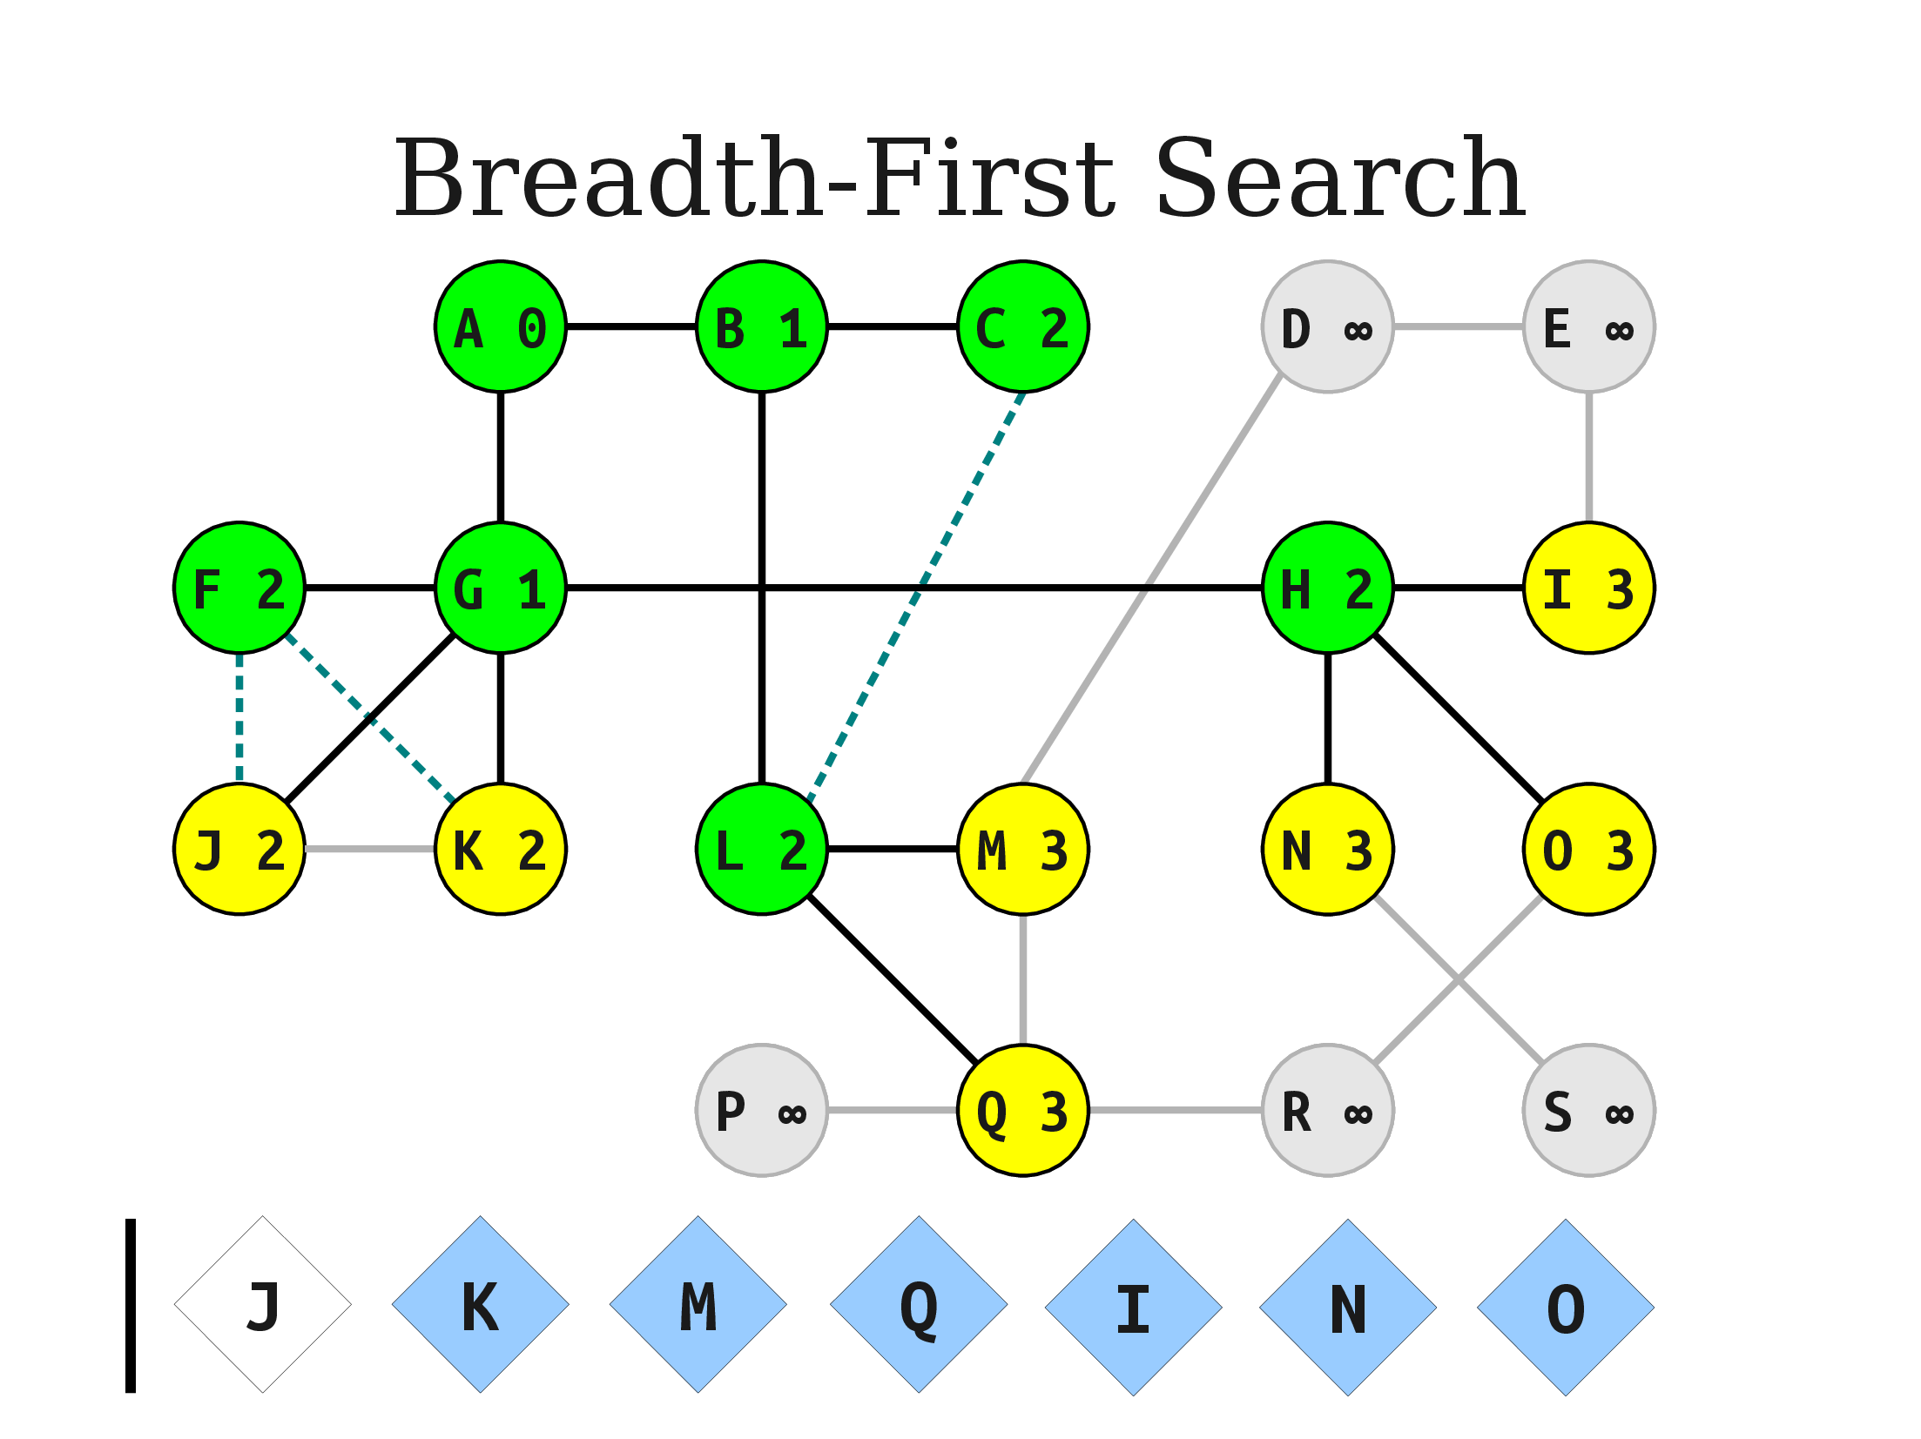
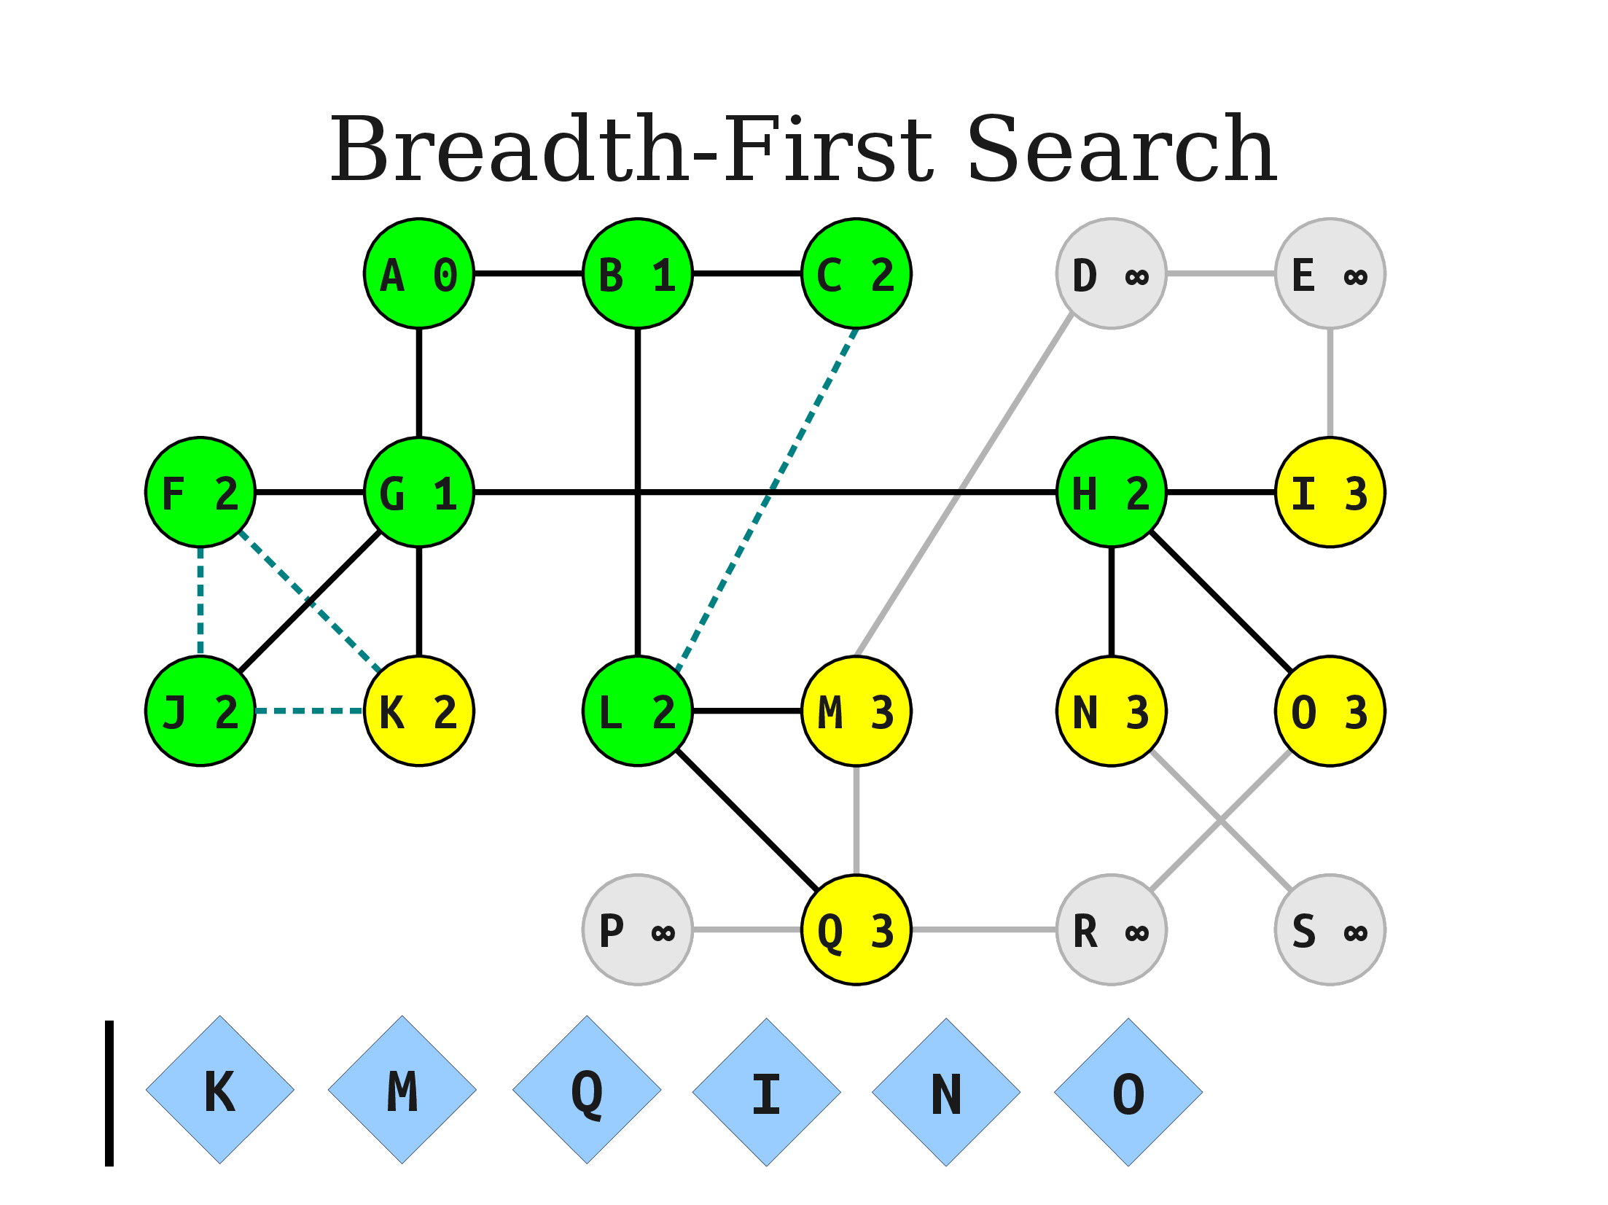

Slide 40
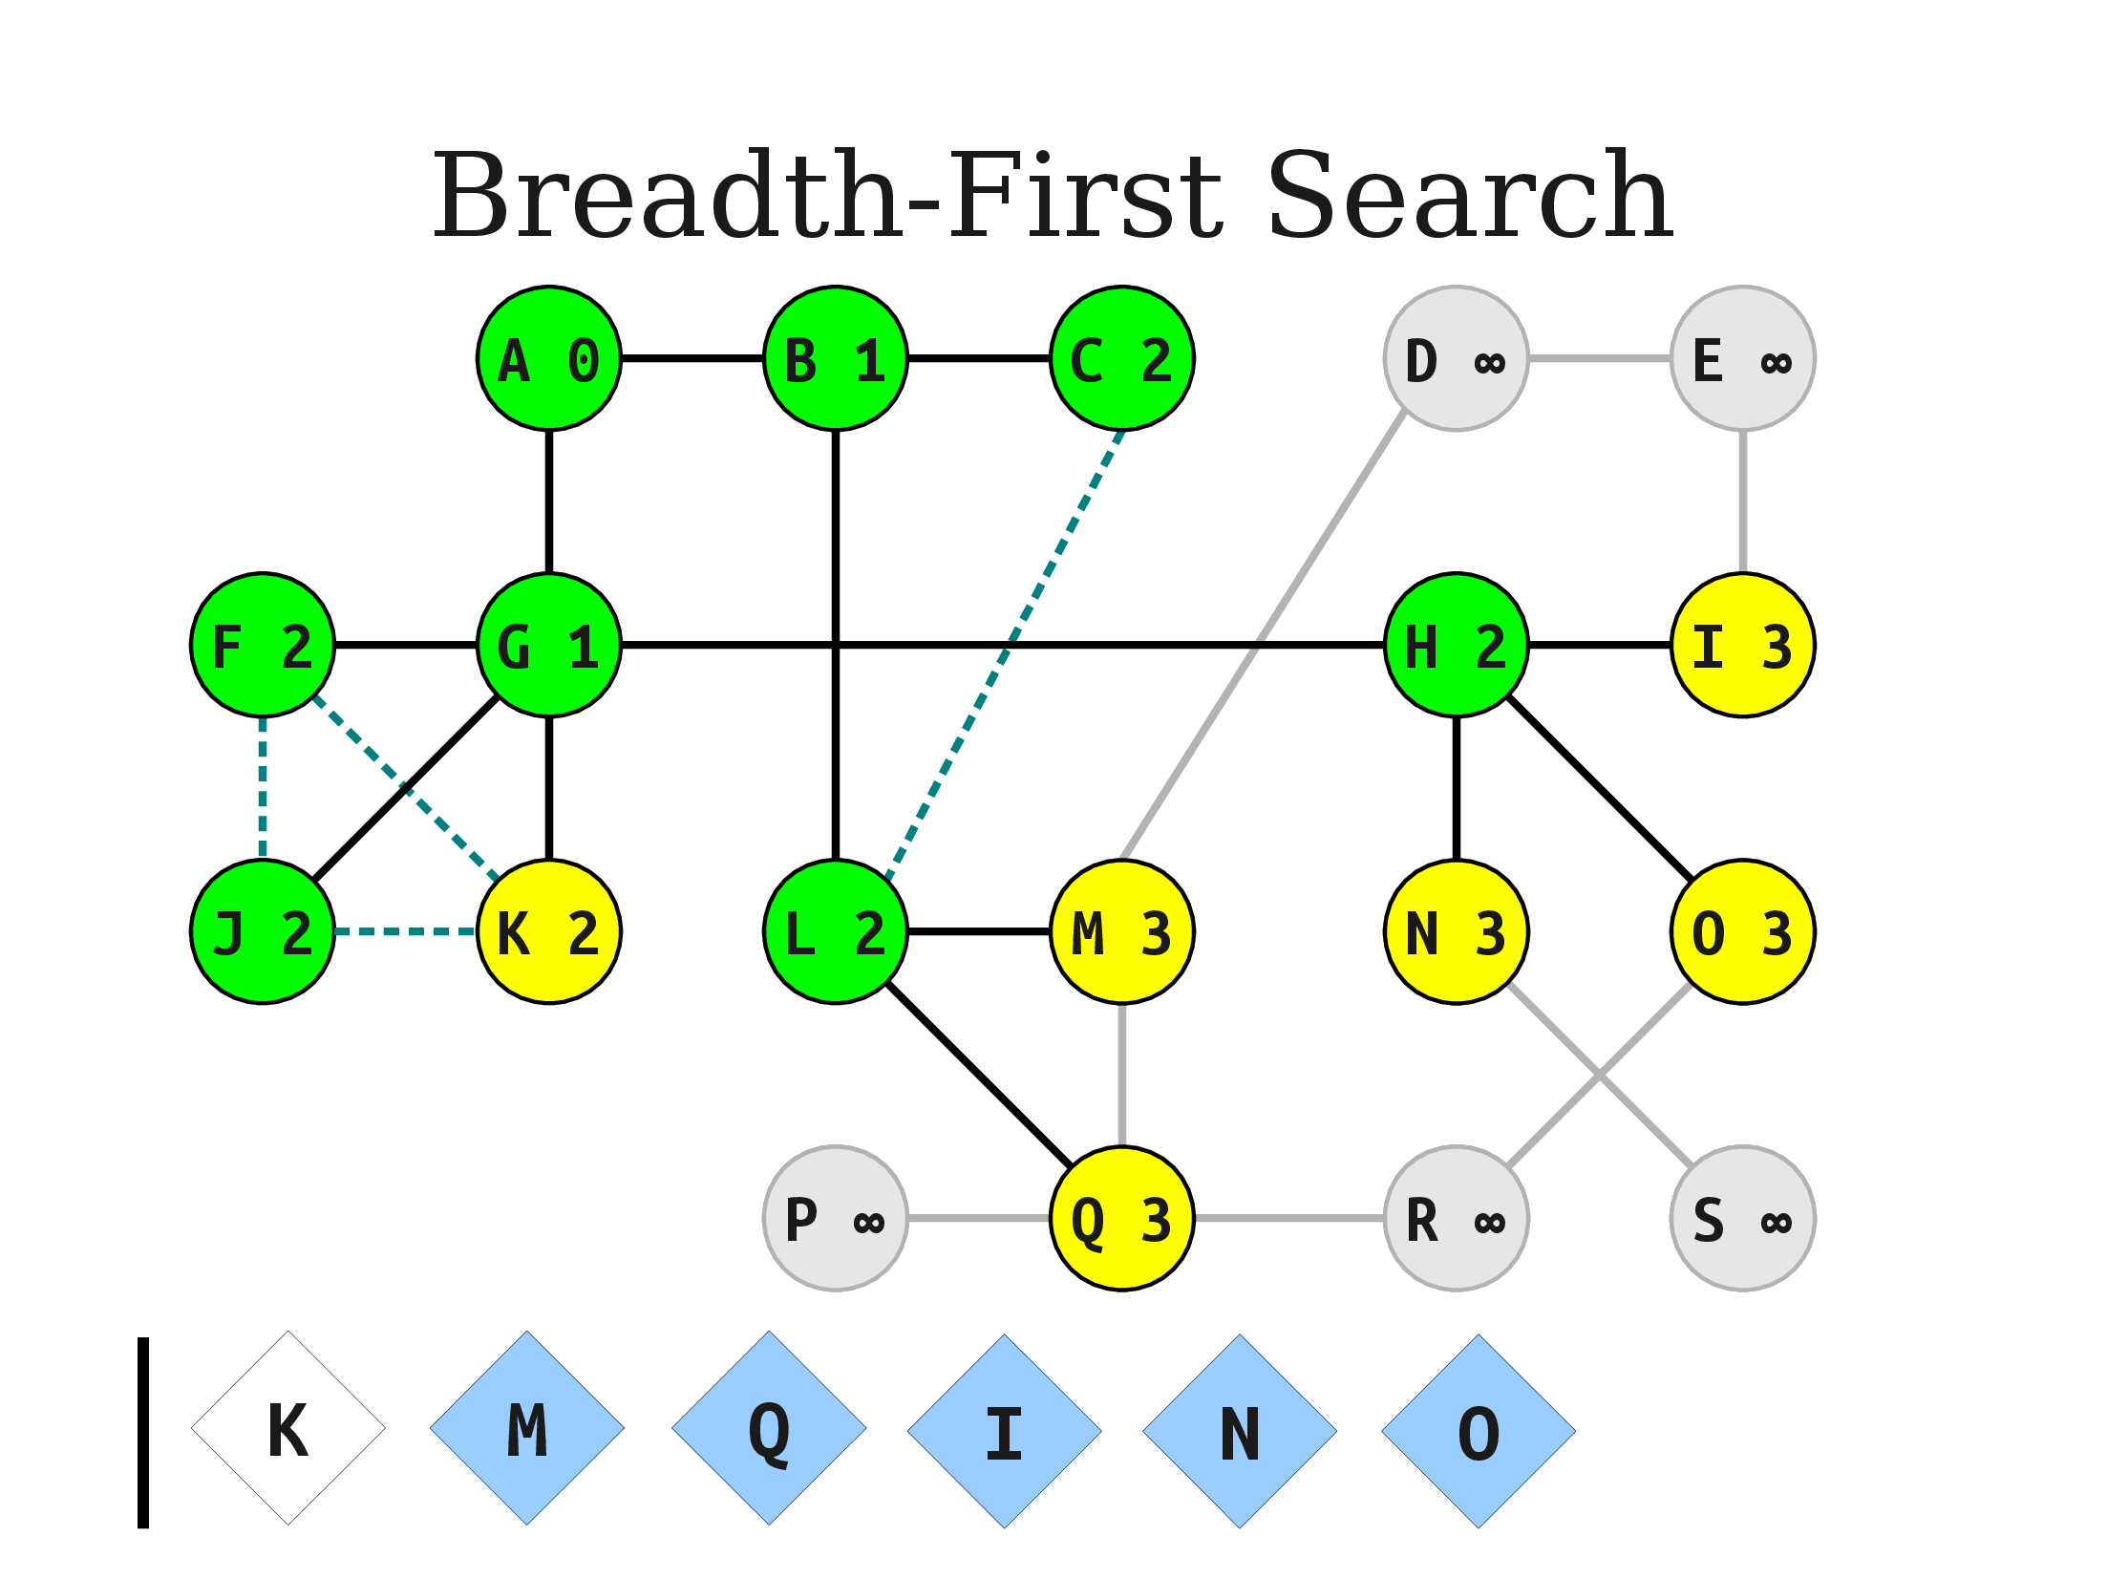
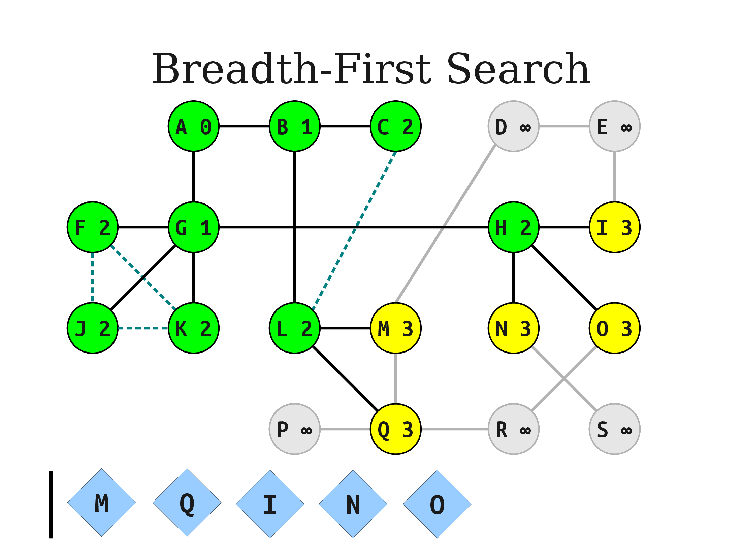
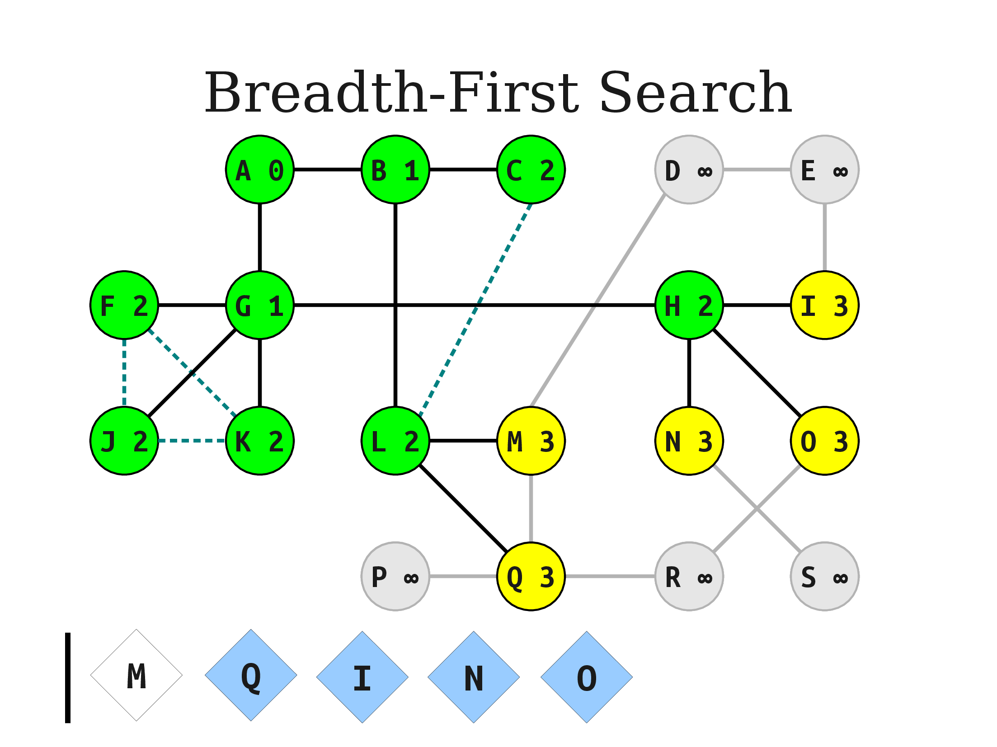

Slide 41
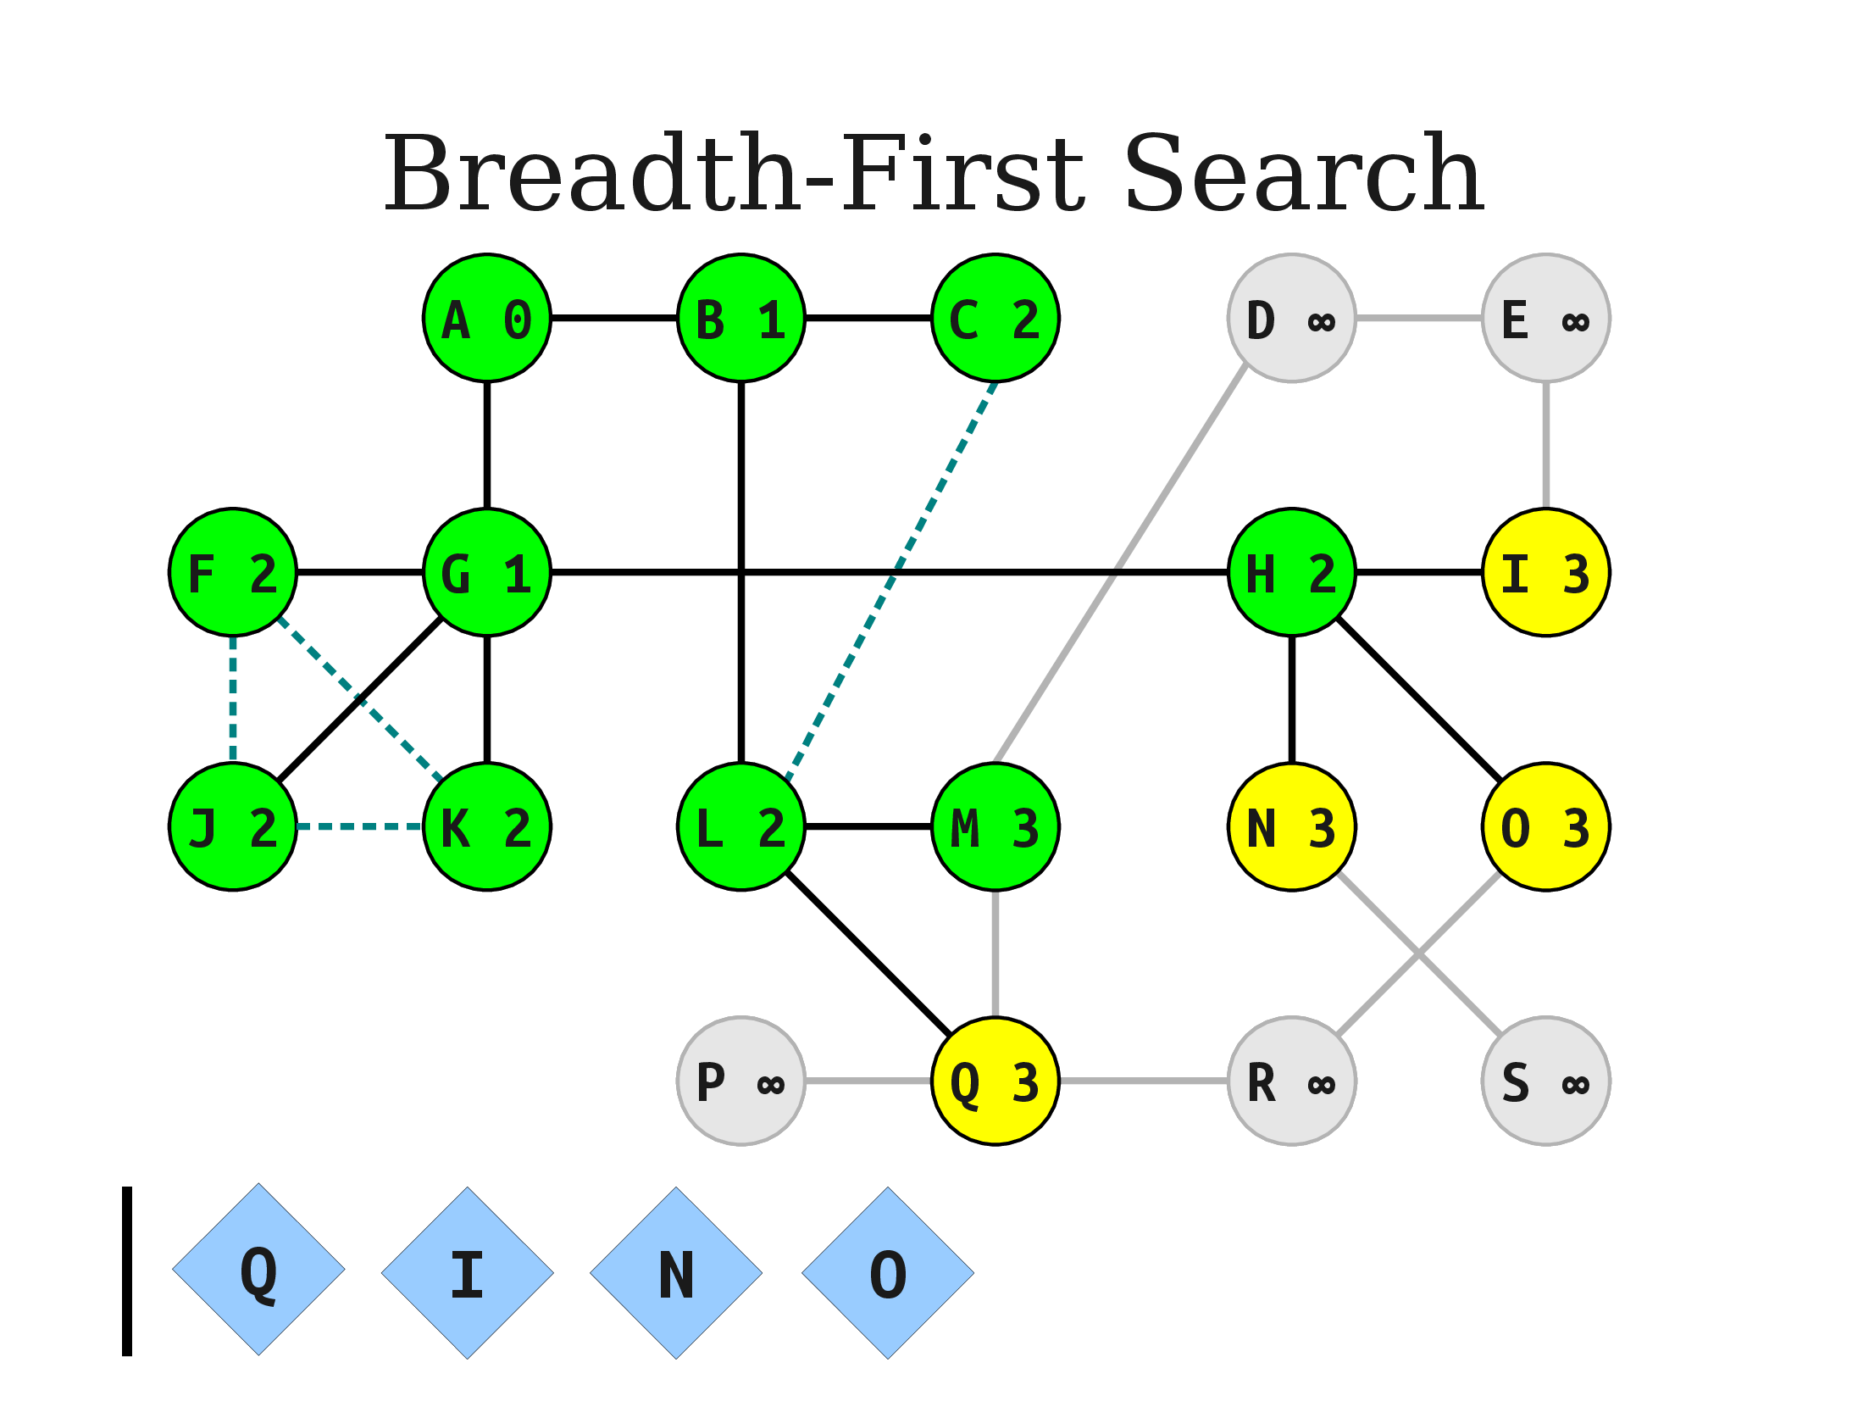
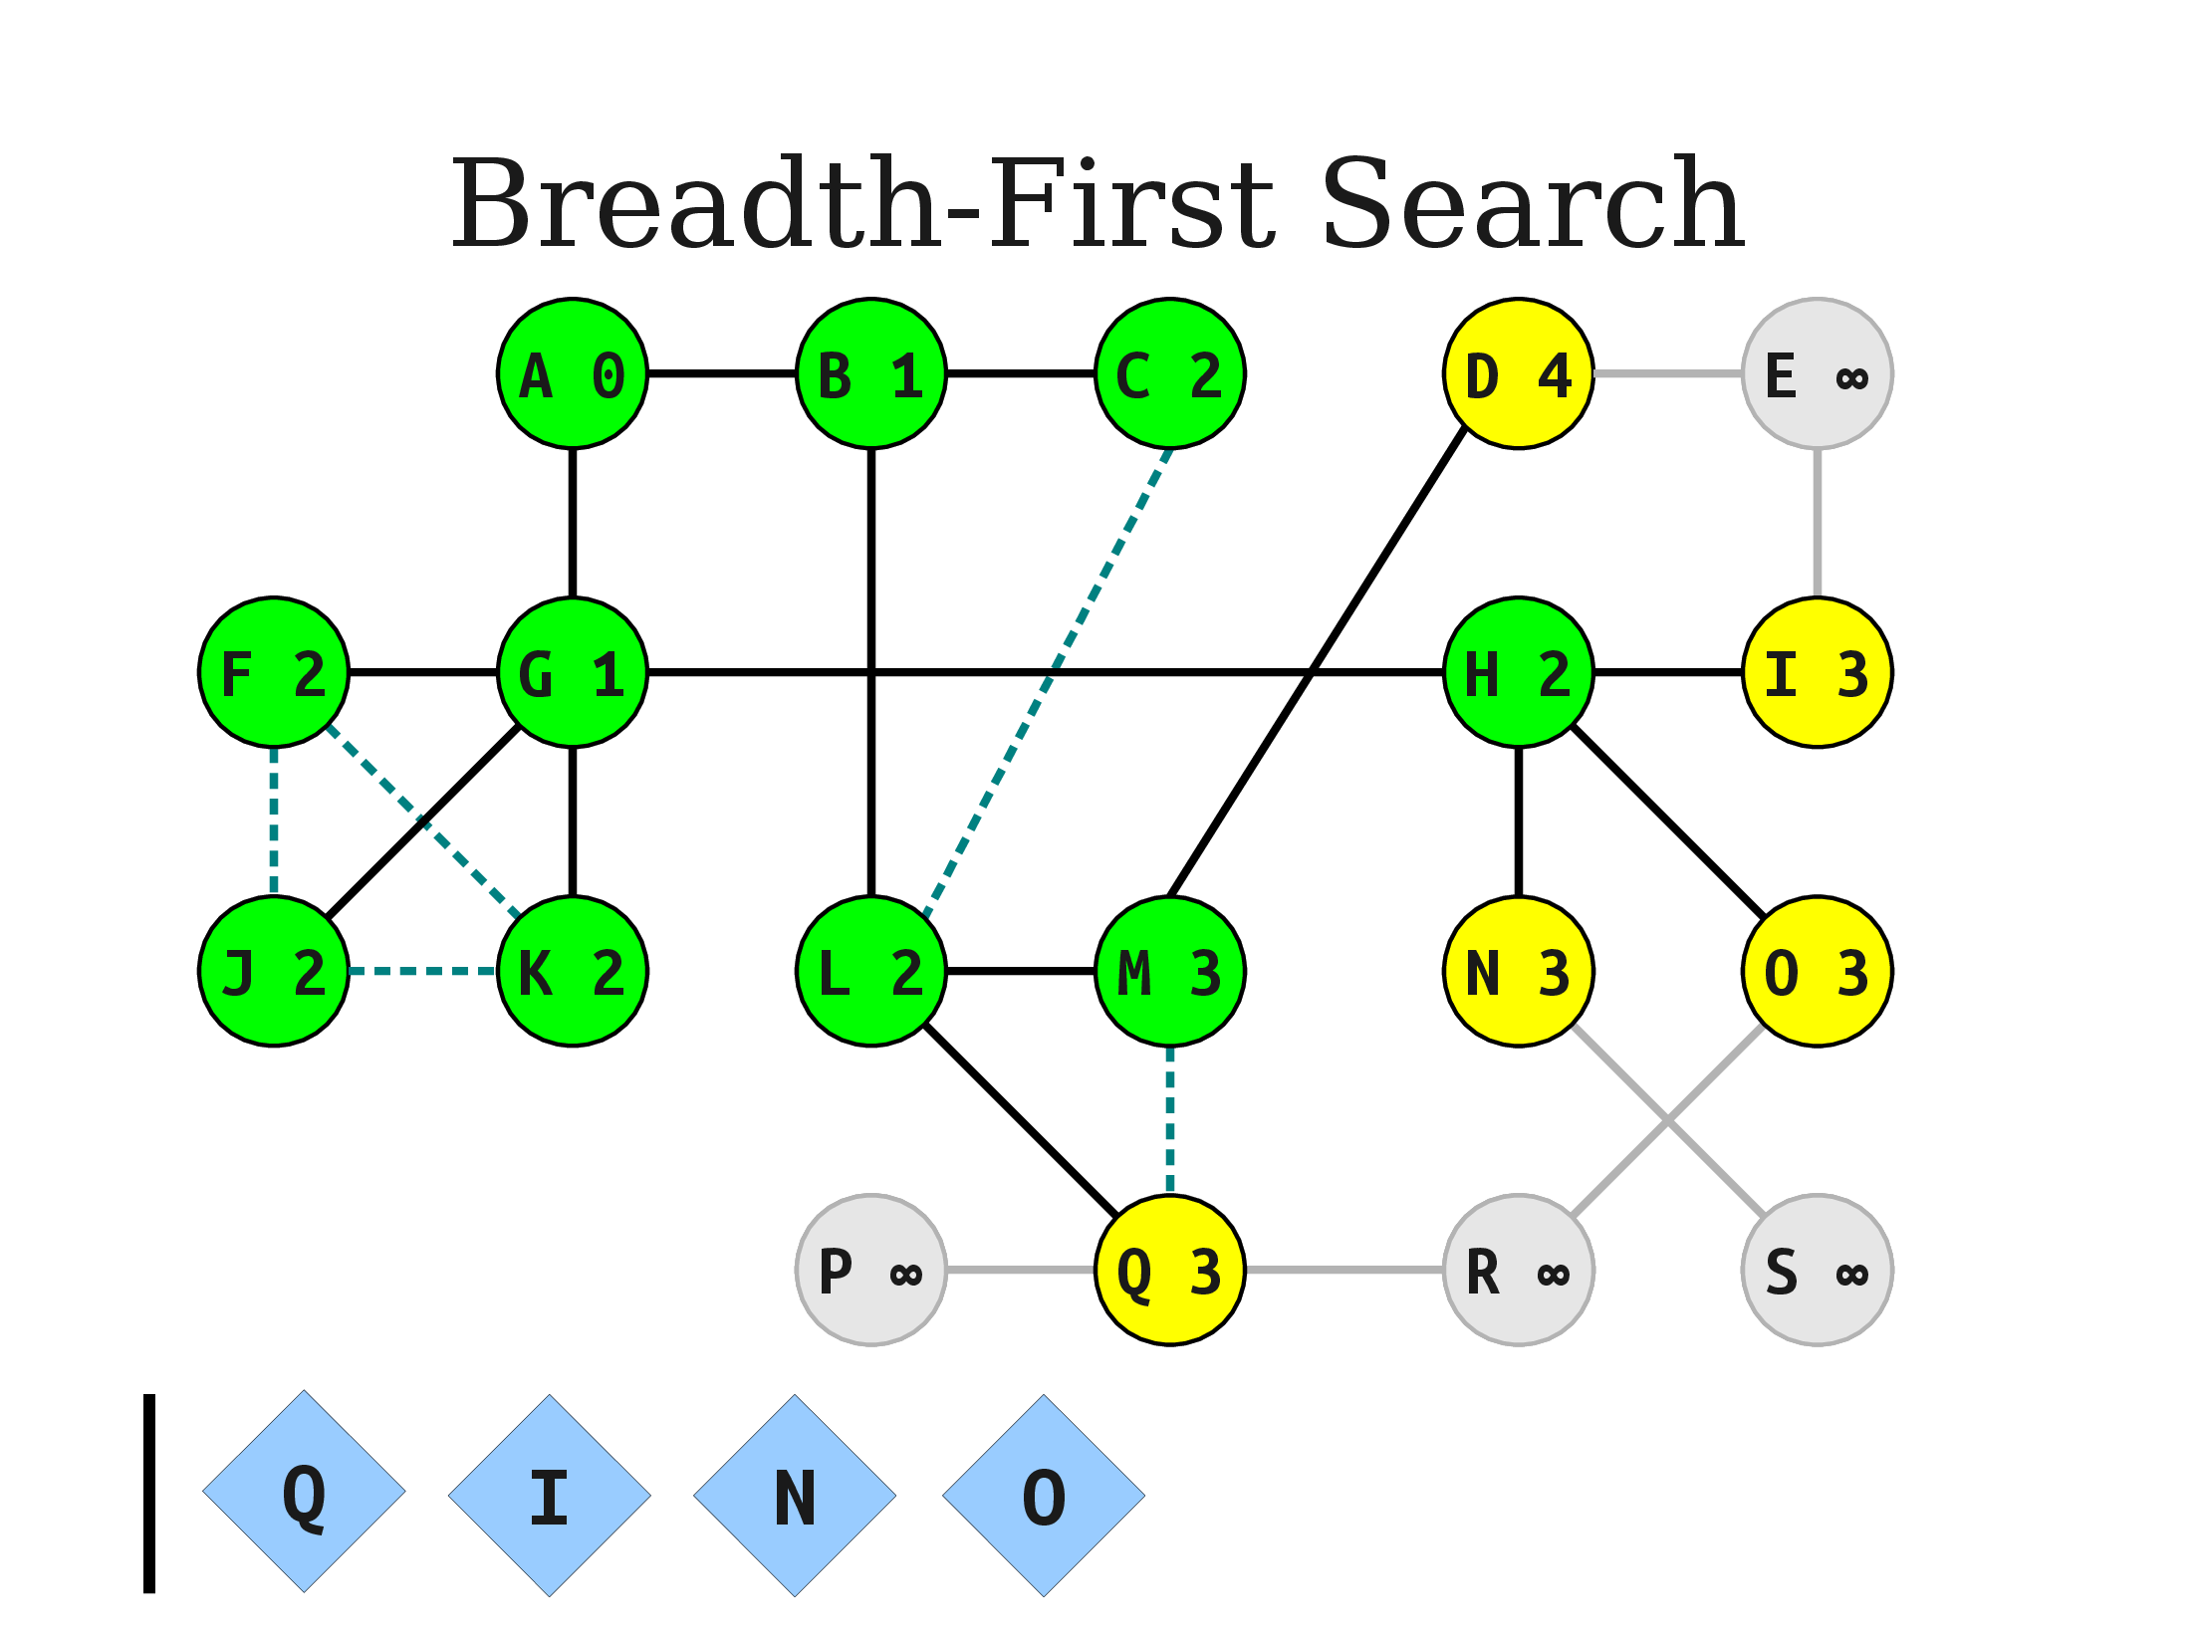
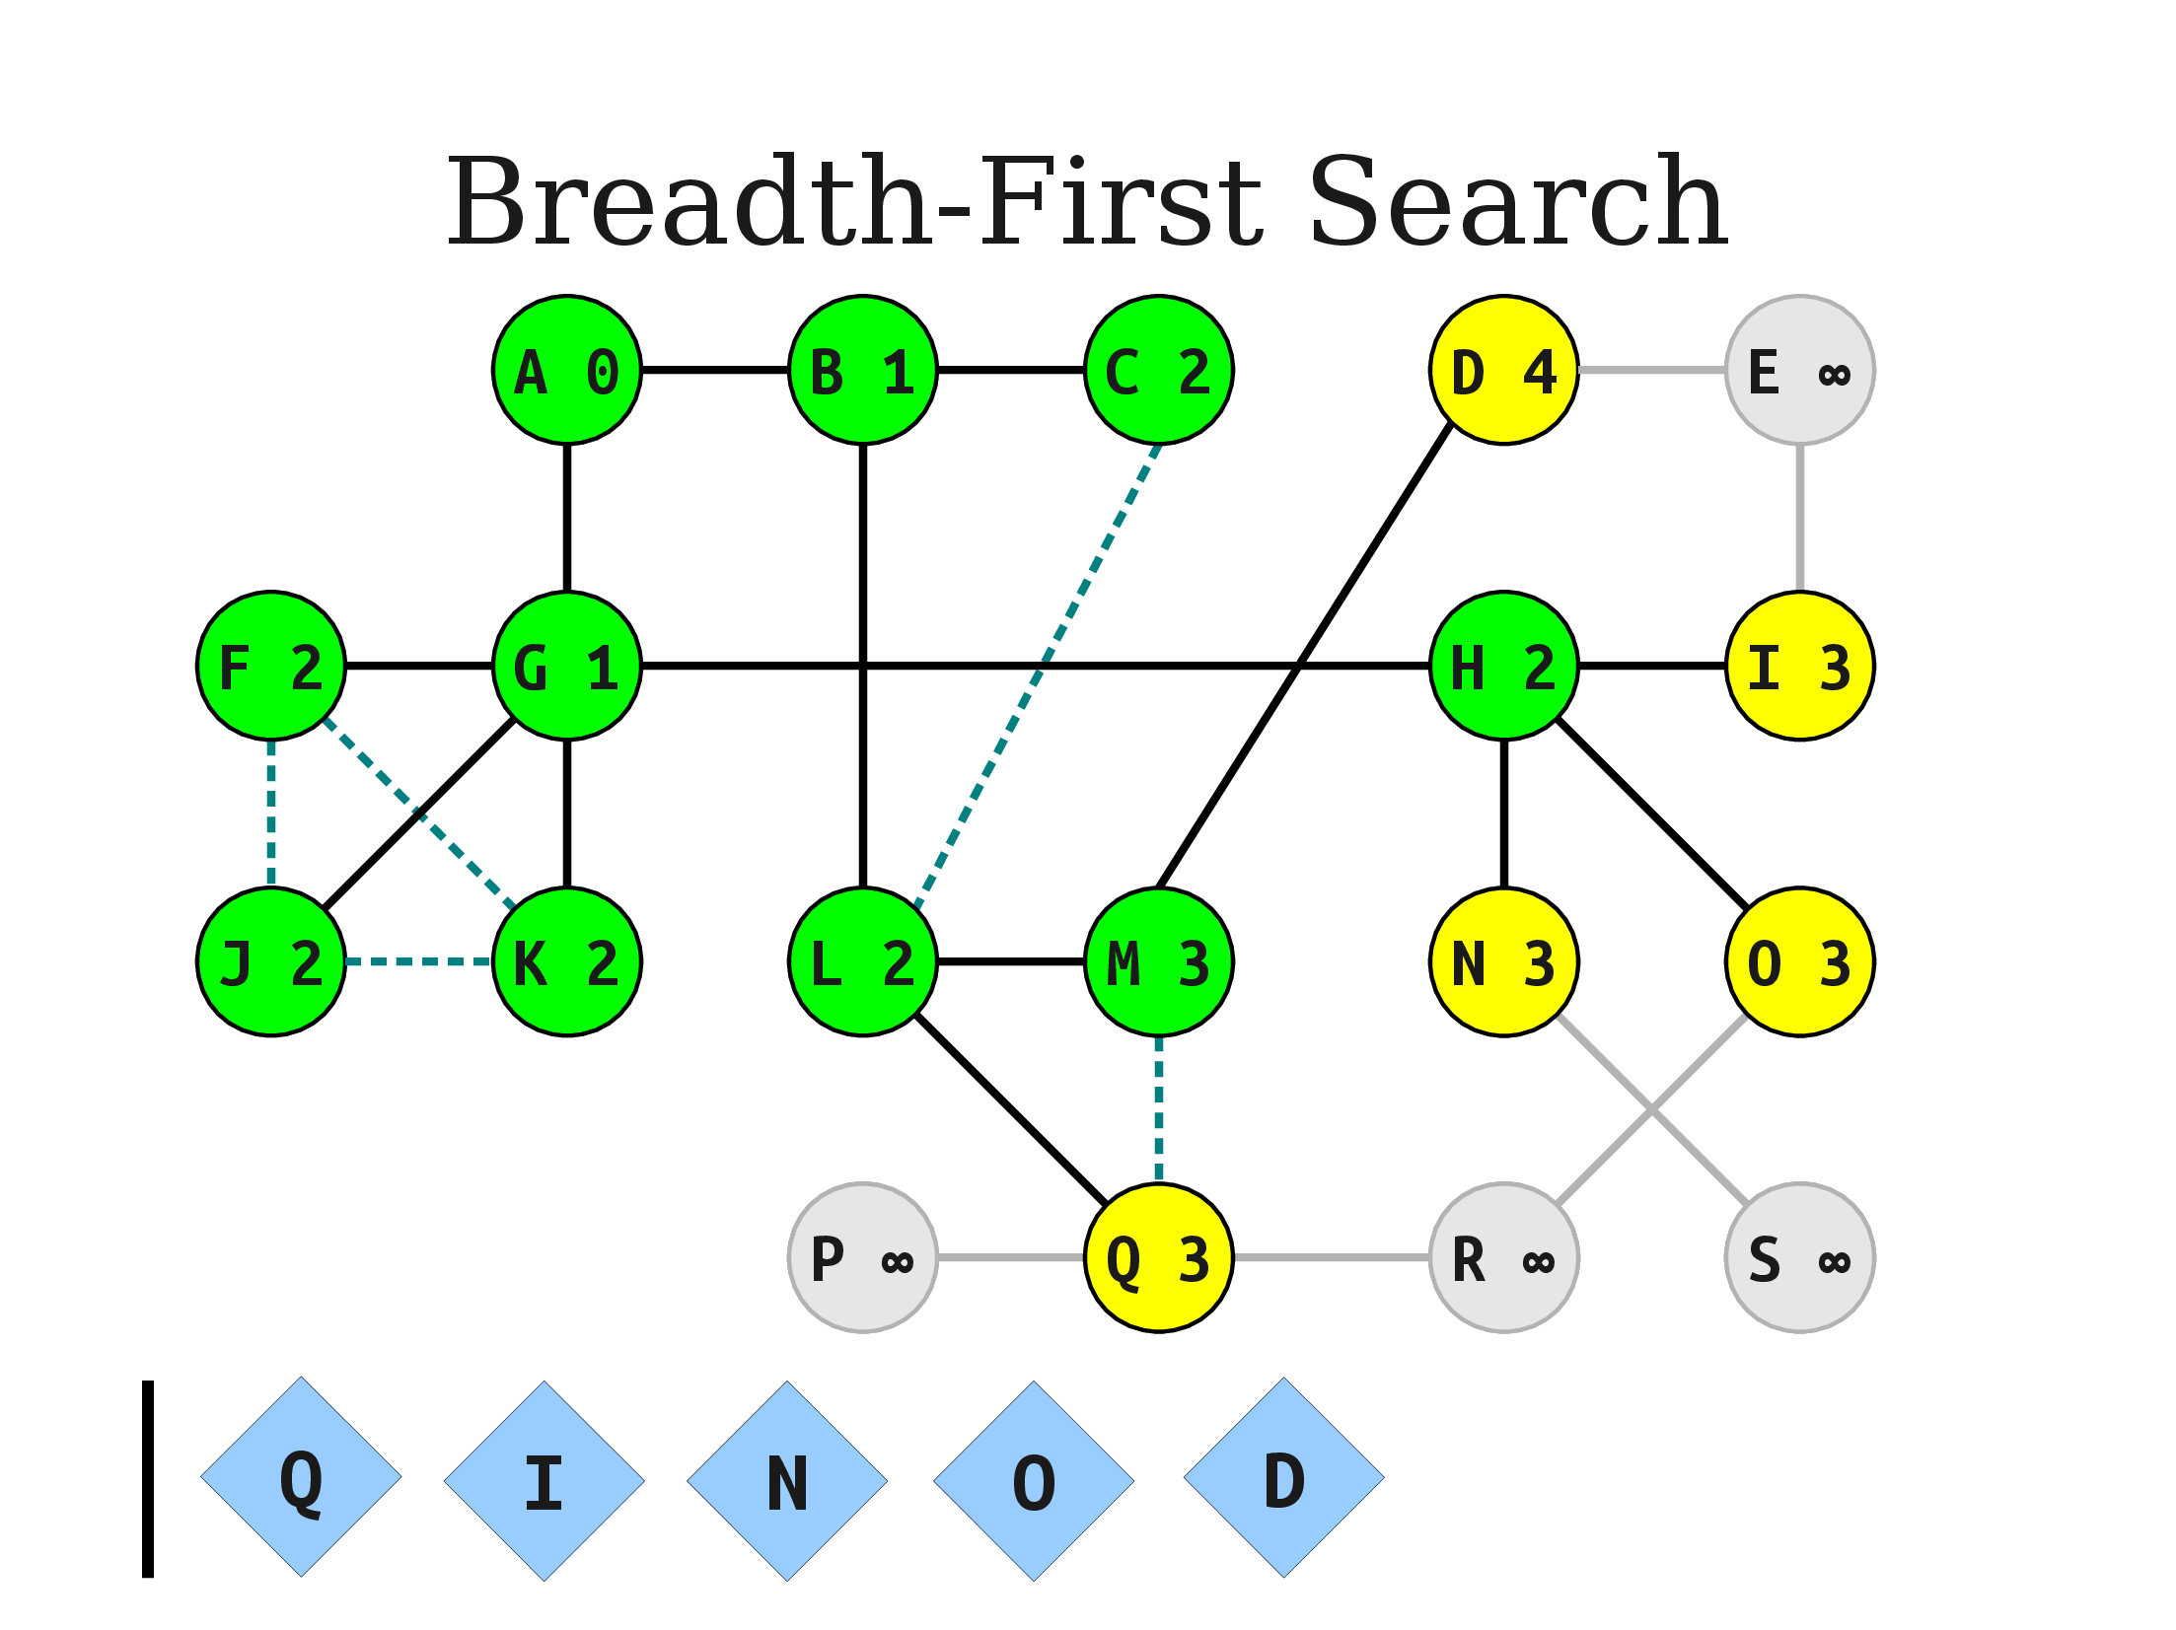

Slide 42
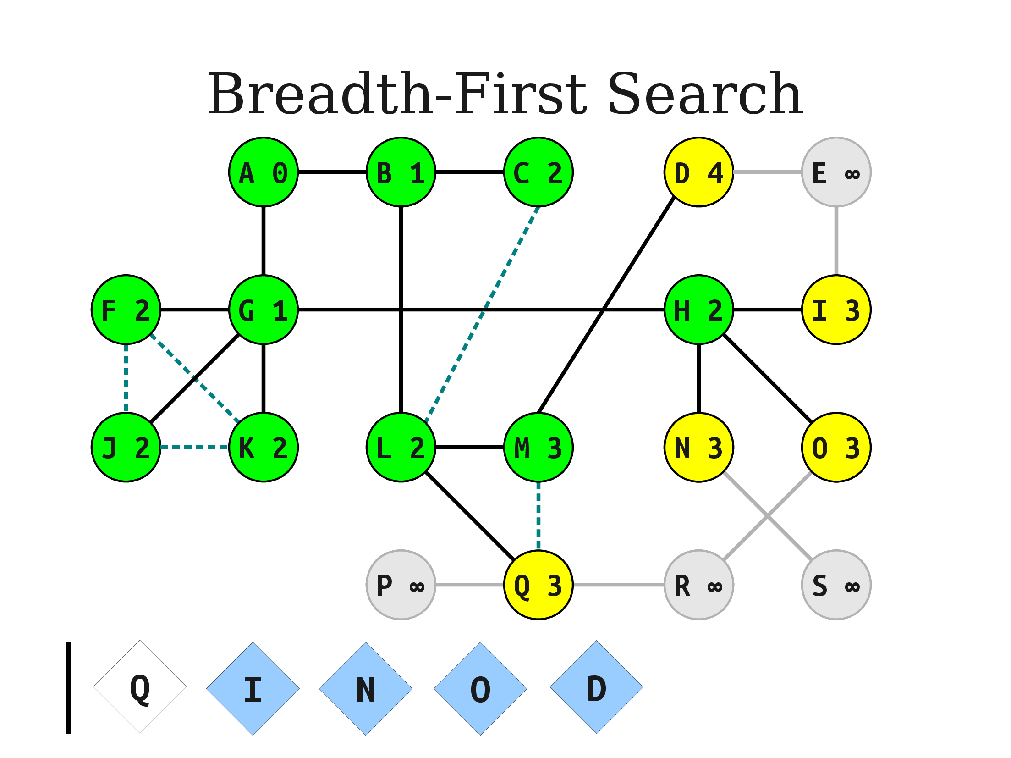
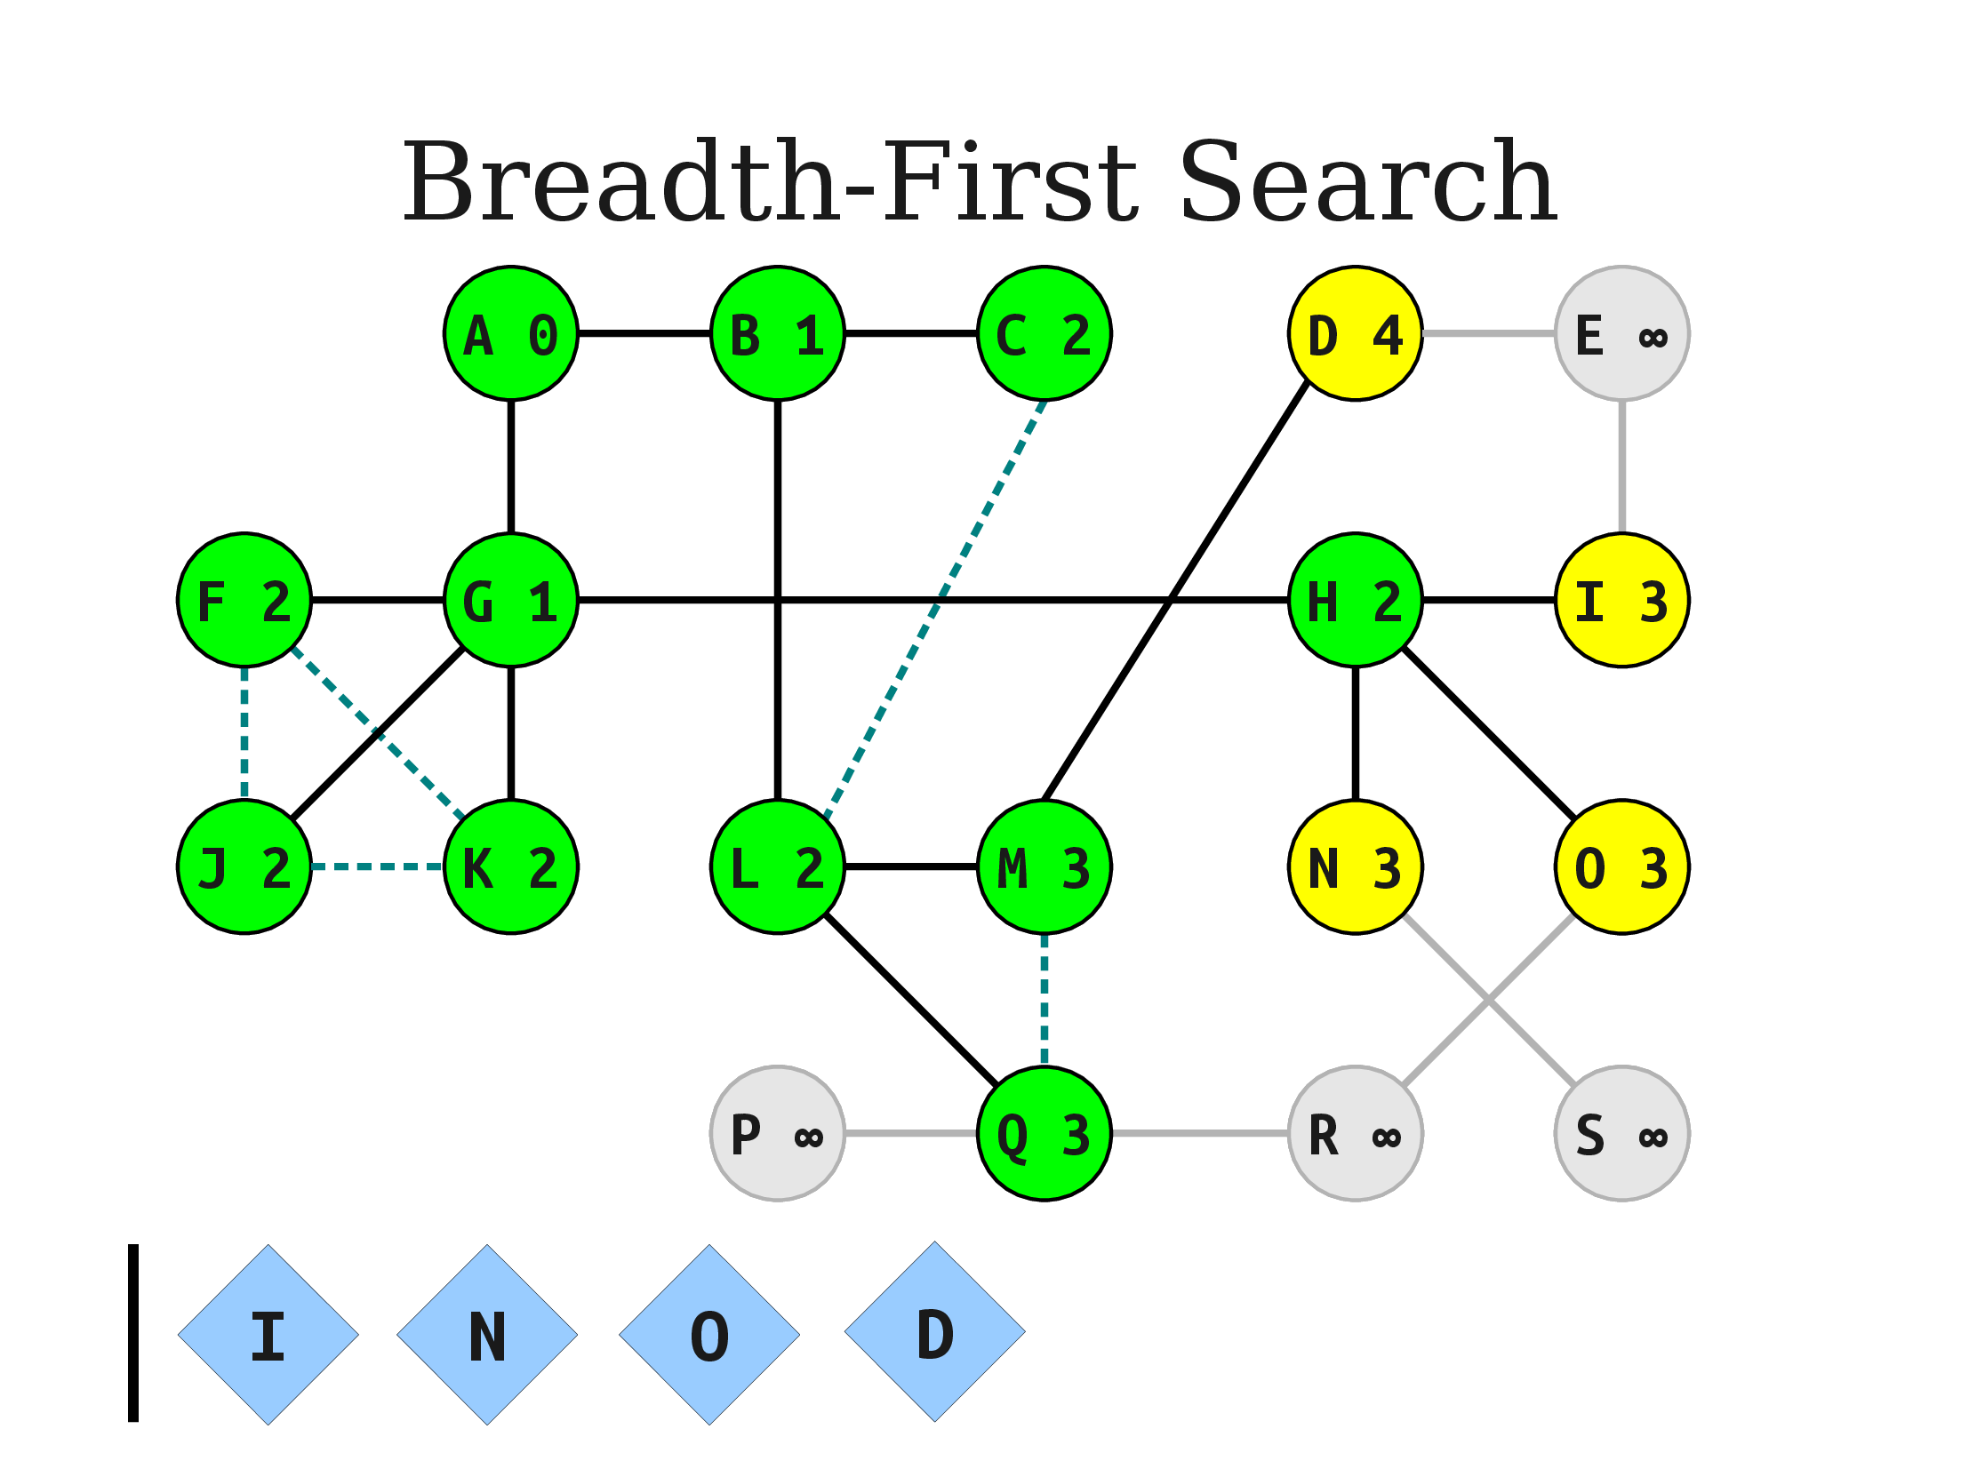
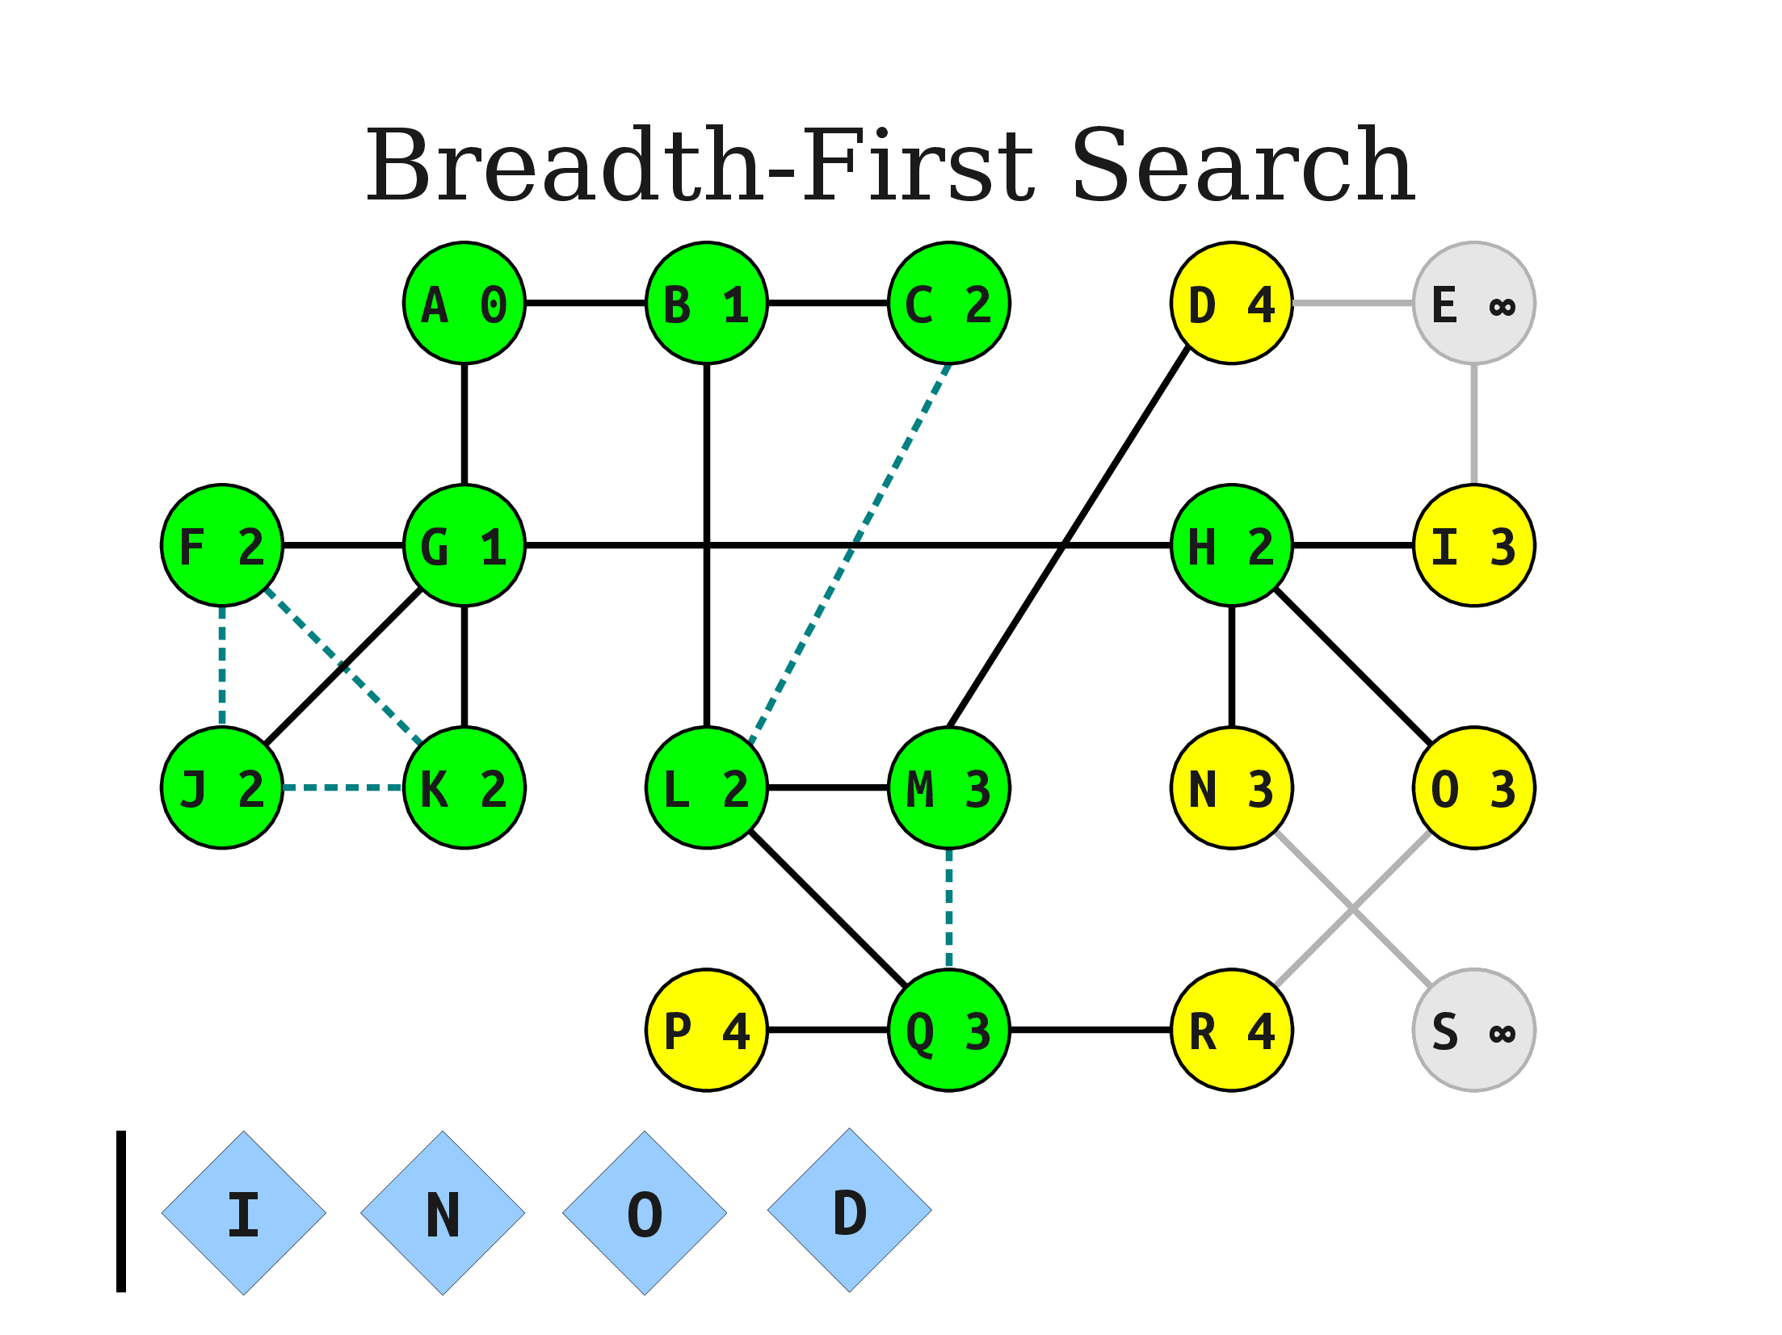

Slide 43
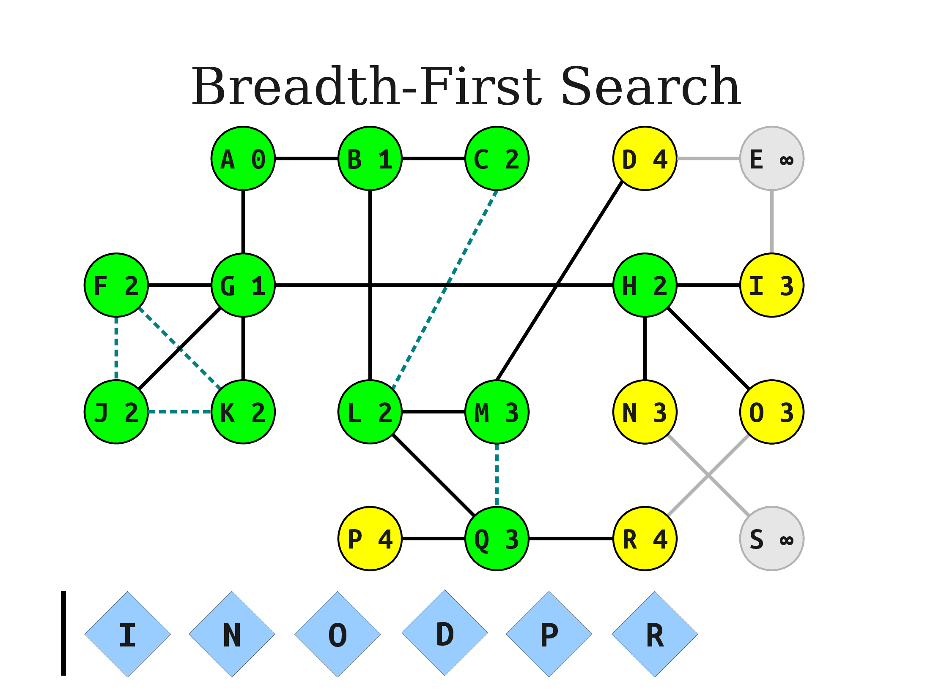



Slide 44




Slide 45



Slide 46



Slide 47




Slide 48



Slide 49



Slide 50


Slide 51


Slide 52


Slide 53




Slide 54


Outgoing edges finding by Adjacency Matrix

Slide 55


Slide 56

If we represent the graph in adjacency List then time complexity will be O(n)

Slide 57

Applications
Using GPS navigation system BFS is used to find neighboring places.
E.G Find the neighboring points of Marvie’s House

Slide 58

Thanks

